Slide 1
ECE 757 Review: Parallel Processors
© Prof. Mikko Lipasti
Lecture notes based in part on slides created by John Shen, Mark Hill, David Wood, Guri Sohi, Jim Smith, Erika Gunadi, Mitch Hayenga, Vignyan Reddy, Dibakar Gope

Slide 2
Parallel Processors
Thread-level parallelism
Synchronization
Coherence
Consistency
Multithreading
Multicore interconnects

Slide 3
Thread-level Parallelism
Instruction-level parallelism
  Reaps performance by finding independent work in a single thread
Thread-level parallelism
  Reaps performance by finding independent work across multiple threads
Historically, requires explicitly parallel workloads
  Originate from mainframe time-sharing workloads
  Even then, CPU speed >> I/O speed
  Had to overlap I/O latency with “something else” for the CPU to do
  Hence, operating system would schedule other tasks/processes/threads that were “time-sharing” the CPU

Slide 4
Thread-level Parallelism
Reduces effectiveness of temporal and spatial locality

Slide 5
Thread-level Parallelism
Initially motivated by time-sharing of single CPU
  OS, applications written to be multithreaded
Quickly led to adoption of multiple CPUs in a single system
  Enabled scalable product line from entry-level single-CPU systems to high-end multiple-CPU systems
  Same applications, OS, run seamlessly
  Adding CPUs increases throughput (performance)
More recently:
  Multiple threads per processor core
    Coarse-grained multithreading (aka “switch-on-event”)
    Fine-grained multithreading
    Simultaneous multithreading
  Multiple processor cores per die
    Chip multiprocessors (CMP)
    Chip multithreading (CMT)

Slide 6
Amdahl’s Law
n
f
# CPUs
1
f
1-f
Time
f – fraction that can run in parallel
1-f – fraction that must run serially

Slide 7
Thread-level Parallelism
Parallelism limited by sharing
  Amdahl’s law:
    Access to shared state must be serialized
    Serial portion limits parallel speedup
  Many important applications share (lots of) state
    Relational databases (transaction processing): GBs of shared state
  Even completely independent processes “share” virtualized hardware through O/S, hence must synchronize access
Access to shared state/shared variables
  Must occur in a predictable, repeatable manner
  Otherwise, chaos results
Architecture must provide primitives for serializing access to shared state

Slide 8
Synchronization
Notes:
Final values of A, assuming initial value of 0: (a) 3; (b) 4; (c) 4; (d) 1

Slide 9
Some Synchronization Primitives
Primitive | Semantic | Comments
Fetch-and-add | Atomic load/add/store operation | Permits atomic increment, can be used to synthesize locks for mutual exclusion
Compare-and-swap | Atomic load/compare/conditional store | Stores only if load returns an expected value
Load-linked/store-conditional | Atomic load/conditional store | Stores only if load/store pair is atomic; that is, there is no intervening store
Only one is necessary
  Others can be synthesized

Slide 10
Synchronization Examples
All three guarantee same semantic:
  Initial value of A: 0
  Final value of A: 4
b uses additional lock variable AL to protect critical section with a spin lock
  This is the most common synchronization method in modern multithreaded applications

Slide 11
Multicore Designs
Belong to: shared-memory symmetric multiprocessors
  Many other types of parallel processor systems have been proposed and built
  Key attributes are:
    Shared memory: all physical memory is accessible to all CPUs
    Symmetric processors: all CPUs are alike
  Other parallel processors may:
    Share some memory, share disks, share nothing
    May have asymmetric processing units or noncoherent caches
Shared memory in the presence of caches
  Need caches to reduce latency per reference
  Need caches to increase available bandwidth per core
  But, using caches induces the cache coherence problem
  Furthermore, how do we interleave references from cores?

Slide 12
Cache Coherence Problem
Load A
P0
P1
Load A
Store A<= 1
Load A
A
0
1
A
0
Memory

Slide 13
Cache Coherence Problem
Load A
P0
P1
Load A
Store A<= 1
Load A
A
0
A
0
1
A
1
Memory

Slide 14
Invalidate Protocol
Basic idea: maintain single writer property
  Only one processor has write permission at any point in time
Write handling
  On write, invalidate all other copies of data
  Make data private to the writer
  Allow writes to occur until data is requested
  Supply modified data to requestor directly or through memory
Minimal set of states per cache line:
  Invalid (not present)
  Modified (private to this cache)
State transitions:
  Local read or write: I->M, fetch modified
  Remote read or write: M->I, transmit data (directly or through memory)
  Writeback: M->I, write data to memory

Slide 15
Invalidate Protocol Optimizations
Observation: data can be read-shared
  Add S (shared) state to protocol: MSI
State transitions:
  Local read: I->S, fetch shared
  Local write: I->M, fetch modified; S->M, invalidate other copies
  Remote read: M->S, supply data
  Remote write: M->I, supply data; S->I, invalidate local copy
Observation: data can be write-private (e.g. stack frame)
  Avoid invalidate messages in that case
  Add E (exclusive) state to protocol: MESI
State transitions:
  Local read: I->E if only copy, I->S if other copies exist
  Local write: E->M silently, S->M, invalidate other copies

Slide 16
Sample Invalidate Protocol (MESI)
BR

Slide 17
Sample Invalidate Protocol (MESI)
Current State s | Event and Local Coherence Controller Responses and Actions (s' refers to next state)
 | Local Read (LR) | Local Write (LW) | Local Eviction (EV) | Bus Read (BR) | Bus Write (BW) | Bus Upgrade (BU)
Invalid (I) | Issue bus read if no sharers then s' = E else s' = S | Issue bus write s' = M | s' = I | Do nothing | Do nothing | Do nothing
Shared (S) | Do nothing | Issue bus upgrade s' = M | s' = I | Respond shared | s' = I | s' = I
Exclusive (E) | Do nothing | s' = M | s' = I | Respond shared s' = S | s' = I | Error
Modified (M) | Do nothing | Do nothing | Write data back; s' = I | Respond dirty; Write data back; s' = S | Respond dirty; Write data back; s' = I | Error

Slide 18
Snoopy Cache Coherence
Origins in shared-memory-bus systems
All CPUs could observe all other CPUs requests on the bus; hence “snooping”
  Bus Read, Bus Write, Bus Upgrade
React appropriately to snooped commands
  Invalidate shared copies
  Provide up-to-date copies of dirty lines
    Flush (writeback) to memory, or
    Direct intervention (modified intervention or dirty miss)
P0
P1
A
0
A
0
1
A
1
Memory

Slide 19
Directory Cache Coherence
Directory implementation
  Extra bits stored in memory (directory) record MSI state of line
  Memory controller maintains coherence based on the current state
  Other CPUs’ commands are not snooped, instead:
    Directory forwards relevant commands
  Ideal filtering: only observe commands that you need to observe
  Meanwhile, bandwidth at directory scales by adding memory controllers as you increase size of the system
    Leads to very scalable designs (100s to 1000s of CPUs)

Slide 20
Another Problem: Memory Ordering
Producer-consumer pattern:
  Update control block, then set flag to tell others you are done with your update
  Proc1 reorders load of A ahead of load of flag, reads stale copy of A but still sees that flag is clear
Unexpected outcome
  Does not match programmer’s expectations
  Just one example of many subtle cases
ISA specifies rules for what is allowed:
memory consistency model
Proc 0 Proc 1
st flag=1
st A=1
st flag=0 if (flag==0) {
read A;
} else {
wait;
}
OOO load A
bypasses load
of flag

Slide 21
Sequential Consistency [Lamport 1979]
P1
P2
Processors treated as if they are interleaved processes on a single time-shared CPU
All references must fit into a total global order or interleaving that does not violate any CPUs program order
  Otherwise sequential consistency not maintained

Slide 22
Constraint graph
Reasoning about memory consistency [Landin, ISCA-18]
Directed graph represents a multithreaded execution
  Nodes represent dynamic instruction instances
  Edges represent their transitive orders (program order, RAW, WAW, WAR).
If the constraint graph is acyclic, then the execution is correct
  Cycle implies A must occur before B and B must occur before A => contradiction

Slide 23
Constraint graph example - SC
Proc 1
ST A
Proc 2
WAR
2.
4.
Program
order
LD B
ST B
Program
order
3.
RAW
LD A
1.
Cycle indicates that execution is incorrect
Notes:
E.G. OoO processor

Slide 24
Anatomy of a cycle
Proc 1
ST A
Proc 2
Incoming invalidate
WAR
Program
order
LD B
Cache miss
ST B
Program
order
RAW
LD A
2. Check for remote writes
1. Track all OOO loads
Notes:
E.G. OoO processor

Slide 25
High-Performance Sequential Consistency
1. Track all OOO loads
2. Check for remote writes
Load queue records all speculative loads
Bus writes/upgrades are checked against LQ
Any matching load gets marked for replay
At commit, loads are checked and replayed if necessary
  Results in machine flush, since load-dependent ops must also replay
Practically, conflicts are rare, so expensive flush is OK

Slide 26
Recapping
Multicore processors need shared memory
Must use caches to provide latency/bandwidth
Cache memories must:
  Provide coherent view of memory
  →must solve cache coherence problem
Cores and caches must:
  Properly order interleaved memory references
  → must implement memory consistency correctly

Slide 27
Coherent Memory Interface

Slide 28
Split Transaction Bus
“Packet switched” vs. “circuit switched”
Release bus after request issued
Allow multiple concurrent requests to overlap memory latency
Complicates control, arbitration, and coherence protocol
  Transient states for pending blocks (e.g. “req. issued but not completed”)

Slide 29
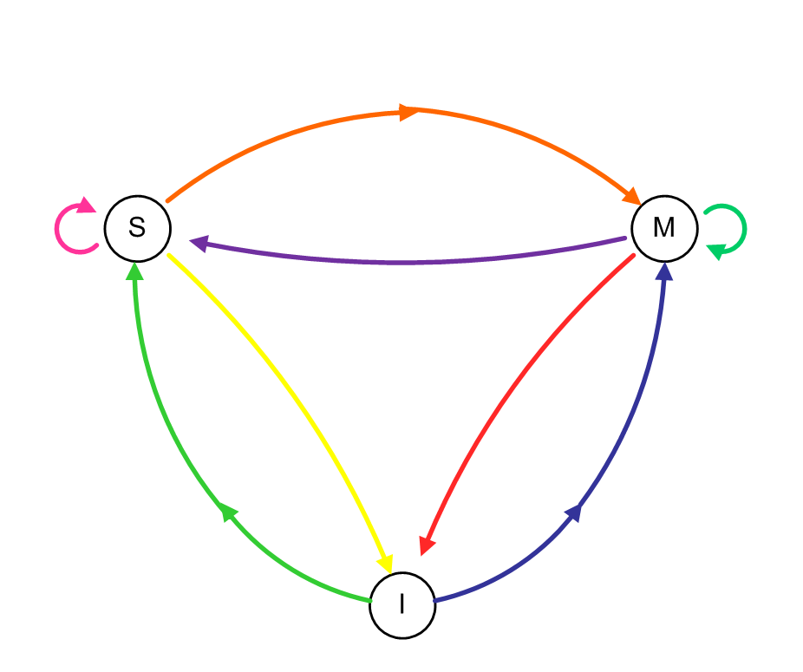
Example: MSI (SGI-Origin-like, directory, invalidate)
High Level

Slide 30
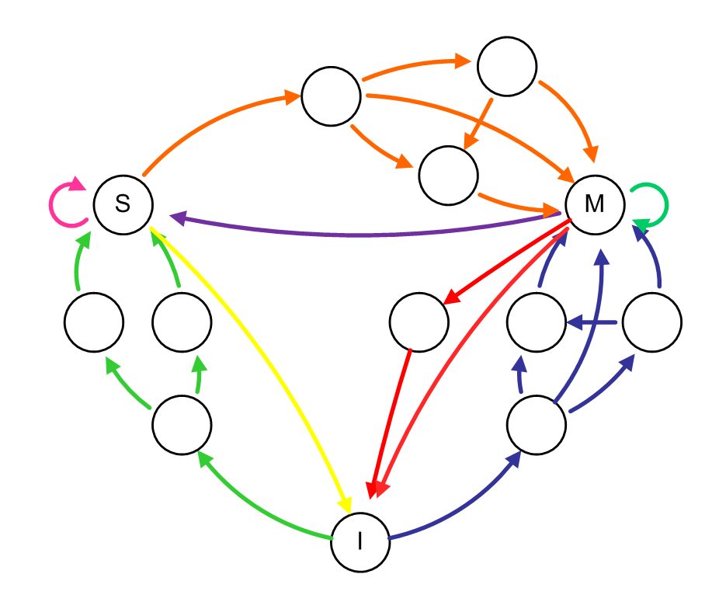
Example: MSI (SGI-Origin-like, directory, invalidate)
High Level
Busy States

Slide 31
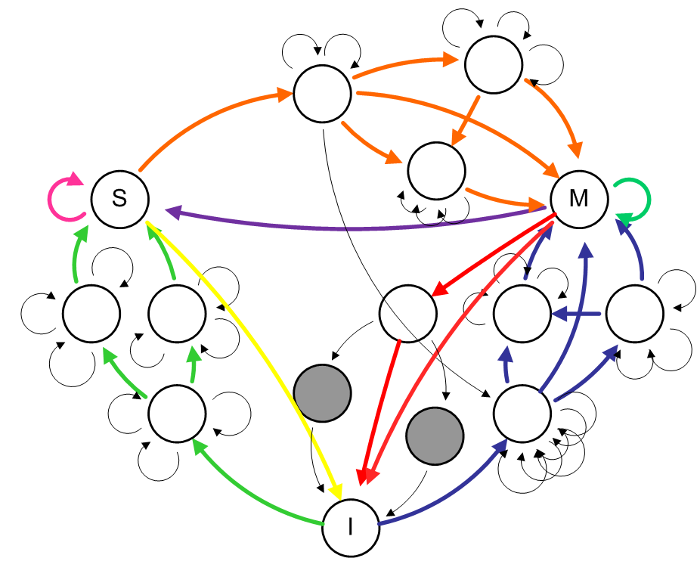
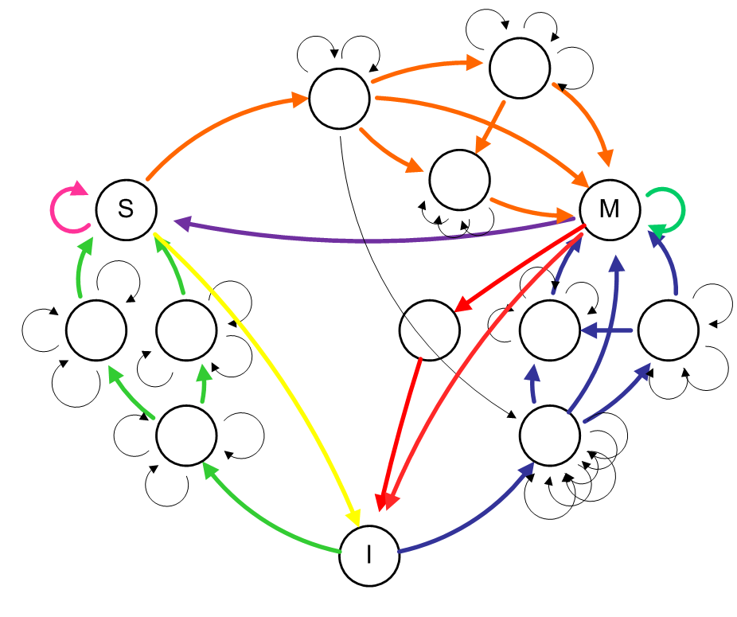
Example: MSI (SGI-Origin-like, directory, invalidate)
High Level
Busy States
Races

Slide 32
Multithreaded Cores
Basic idea:
  CPU resources are expensive and should not be idle
1960’s: Virtual memory and multiprogramming
  Virtual memory/multiprogramming invented to tolerate latency to secondary storage (disk/tape/etc.)
  Processor-disk speed mismatch:
    microseconds to tens of milliseconds (1:10000 or more)
  OS context switch used to bring in other useful work while waiting for page fault or explicit read/write
  Cost of context switch must be much less than I/O latency (easy)

Slide 33
Multithreaded Cores
1990’s: Memory wall and multithreading
  Processor-DRAM speed mismatch:
    nanosecond to fractions of a microsecond (1:500)
  H/W task switch used to bring in other useful work while waiting for cache miss
  Cost of context switch must be much less than cache miss latency
Very attractive for applications with abundant thread-level parallelism
  Commercial multi-user workloads

Slide 34
Approaches to Multithreading
Fine-grain multithreading
  Switch contexts at fixed fine-grain interval (e.g. every cycle)
  Need enough thread contexts to cover stalls
  Example: Tera MTA, 128 contexts, no data caches
Benefits:
  Conceptually simple, high throughput, deterministic behavior
Drawback:
  Very poor single-thread performance

Slide 35
Approaches to Multithreading
Coarse-grain multithreading
  Switch contexts on long-latency events (e.g. cache misses)
  Need a handful of contexts (2-4) for most benefit
Example: IBM RS64-IV (Northstar), 2 contexts
Benefits:
  Simple, improved throughput (~30%), low cost
  Thread priorities mostly avoid single-thread slowdown
Drawback:
  Nondeterministic, conflicts in shared caches

Slide 36
Approaches to Multithreading
Simultaneous multithreading
  Multiple concurrent active threads (no notion of thread switching)
  Need a handful of contexts for most benefit (2-8)
Example: Intel Pentium 4/Nehalem/Sandybridge, IBM Power 5/6/7, Alpha EV8/21464
Benefits:
  Natural fit for OOO superscalar
  Improved throughput
  Low incremental cost
Drawbacks:
  Additional complexity over OOO superscalar
  Cache conflicts

Slide 37
Approaches to Multithreading
Chip Multiprocessors (CMP)
Very popular these days
Processor | Cores/ chip | Multi-threaded? | Resources shared
IBM Power 4 | 2 | No | L2/L3, system interface
IBM Power 7 | 8 | Yes (4T) | Core, L2/L3, DRAM, system interface
Sun Ultrasparc | 2 | No | System interface
Sun Niagara | 8 | Yes (4T) | Everything
Intel Pentium D | 2 | Yes (2T) | Core, nothing else
Intel Core i7 | 4 | Yes | L3, DRAM, system interface
AMD Opteron | 2, 4, 6, 12 | No | System interface (socket), L3

Slide 38
Approaches to Multithreading
Chip Multithreading (CMT)
  Similar to CMP
Share something in the core:
  Expensive resource, e.g. floating-point unit (FPU)
  Also share L2, system interconnect (memory and I/O bus)
Examples:
  Sun Niagara, 8 cores per die, one FPU
  AMD Bulldozer: one FP cluster for every two INT clusters
Benefits:
  Same as CMP
  Further: amortize cost of expensive resource over multiple cores
Drawbacks:
  Shared resource may become bottleneck
  2nd generation (Niagara 2) does not share FPU

Slide 39
Multithreaded/Multicore Processors
MT Approach | Resources shared between threads | Context Switch Mechanism
None | Everything | Explicit operating system context switch
Fine-grained | Everything but register file and control logic/state | Switch every cycle
Coarse-grained | Everything but I-fetch buffers, register file and con trol logic/state | Switch on pipeline stall
SMT | Everything but instruction fetch buffers, return address stack, architected register file, control logic/state, reorder buffer, store queue, etc. | All contexts concurrently active; no switching
CMT | Various core components (e.g. FPU), secondary cache, system interconnect | All contexts concurrently active; no switching
CMP | Secondary cache, system interconnect | All contexts concurrently active; no switching
Many approaches for executing multiple threads on a single die
  Mix-and-match: IBM Power7 CMP+SMT

Slide 40
IBM Power4: Example CMP

Slide 41
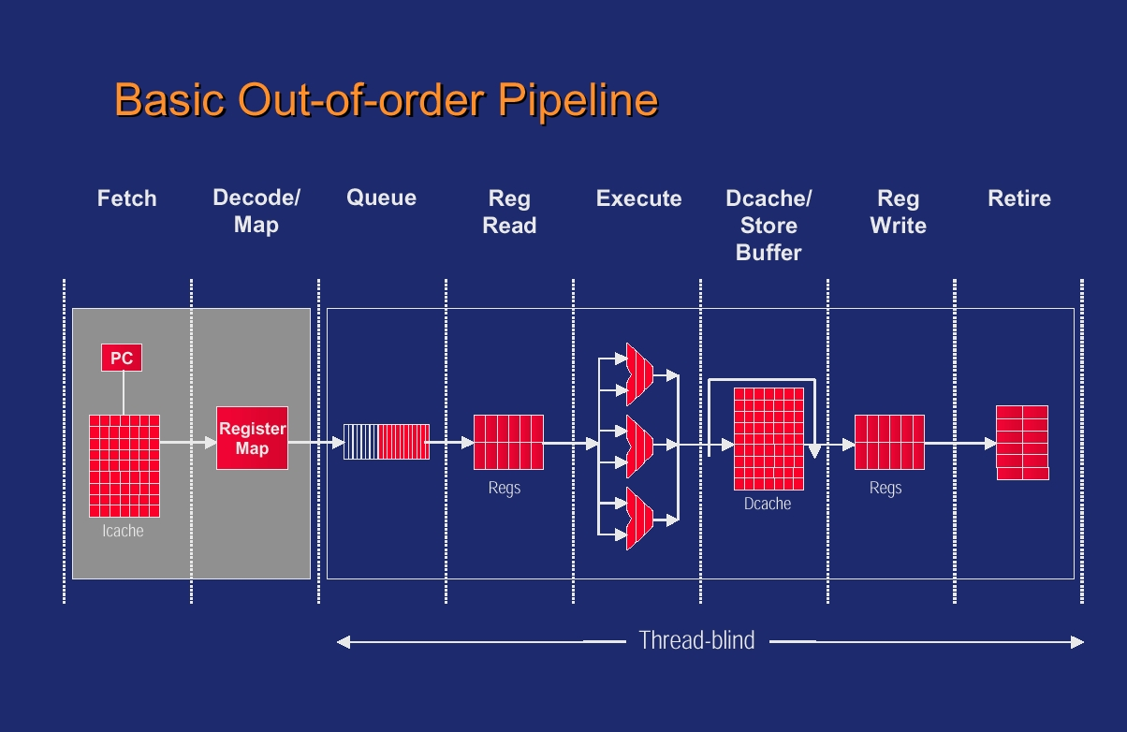
SMT Microarchitecture (from Emer, PACT ‘01)

Slide 42
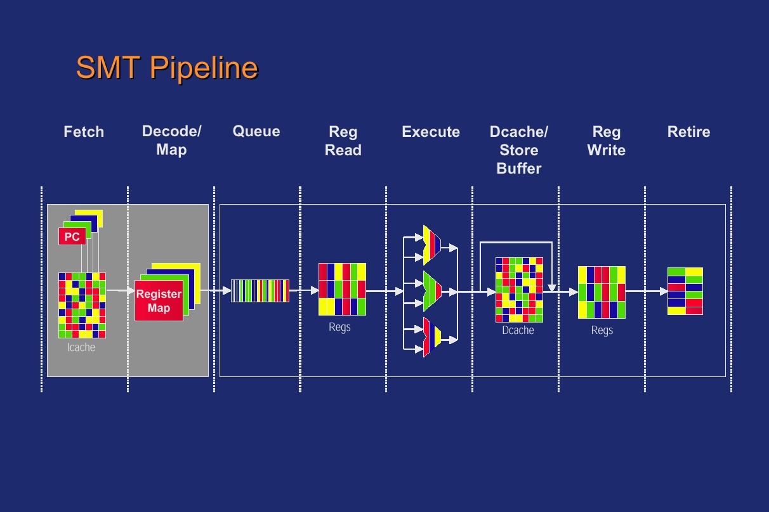
SMT Microarchitecture (from Emer, PACT ‘01)

Slide 43
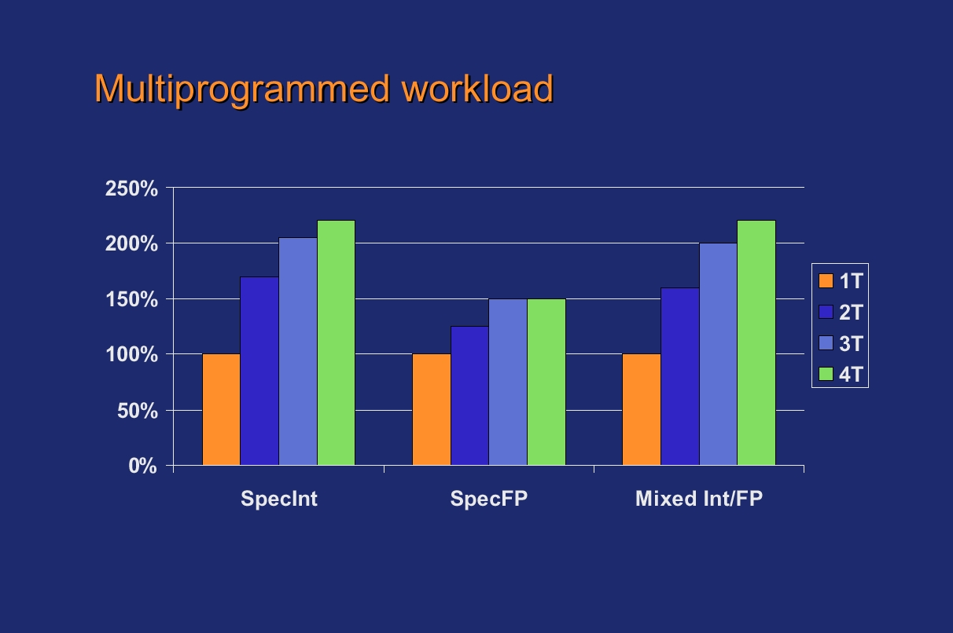
SMT Performance (from Emer, PACT ‘01)

Slide 44
SMT Summary
Goal: increase throughput
  Not latency
Utilize execution resources by sharing among multiple threads
Usually some hybrid of fine-grained and SMT
  Front-end is FG, core is SMT, back-end is FG
Resource sharing
  I$, D$, ALU, decode, rename, commit – shared
  IQ, ROB, LQ, SQ – partitioned vs. shared

Slide 45
Multicore Interconnects
Bus/crossbar - dismiss as short-term solutions?
Point-to-point links, many possible topographies
  2D (suitable for planar realization)
    Ring
    Mesh
    2D torus
  3D - may become more interesting with 3D packaging (chip stacks)
    Hypercube
    3D Mesh
    3D torus

Slide 46
Cross-bar (e.g. IBM Power4/5/6/7)
Core0
Core1
Core2
Core3
Core4
Core5
Core6
Core7
L1 $
L1 $
L1 $
L1 $
L1 $
L1 $
L1 $
L1 $
8X9 Cross-Bar Interconnect
L2 $ Bank0
L2 $ Bank1
L2 $ Bank2
L2 $ Bank3
L2 $ Bank4
L2 $ Bank5
L2 $ Bank6
L2 $ Bank7
I/O
Memory Controller
Memory Controller
Memory Controller
Memory Controller

Slide 47
On-Chip Bus/Crossbar
Used widely (Power4/5/6/7 Piranha, Niagara, etc.)
  Assumed not scalable
  Is this really true, given on-chip characteristics?
  May scale "far enough" : watch out for arguments at the limit
    e.g. swizzle-switch makes x-bar scalable enough [UMich]
Simple, straightforward, nice ordering properties
  Wiring can be a nightmare (for crossbar)
  Bus bandwidth is weak (even multiple busses)
  Compare DEC Piranha 8-lane bus (32GB/s) to Power4 crossbar (100+GB/s)
  Workload demands: commercial vs. scientific

Slide 48
On-Chip Ring (e.g. Intel)
Core0
L2 $ Bank0
L2 $ Bank3
Core3
L1 $
L1 $
Core1
Core2
L2 $ Bank1
L2 $ Bank2
L1 $
L1 $
Memory Controller
Router
Directory Coherence
QPI/HT Interconnect

Slide 49
On-Chip Ring
Point-to-point ring interconnect
  Simple, easy
  Nice ordering properties (unidirectional)
  Every request a broadcast (all nodes can snoop)
  Scales poorly: O(n) latency, fixed bandwidth
Optical ring (nanophotonic)
  HP Labs Corona project
  Much lower latency (speed of light)
  Still fixed bandwidth (but lots of it)

Slide 50
On-Chip Mesh
Widely assumed in academic literature
Tilera [Wentzlaff], Intel 80-core prototype
Not symmetric, so have to watch out for load imbalance on inner nodes/links
  2D torus: wraparound links to create symmetry
    Not obviously planar
    Can be laid out in 2D but longer wires, more intersecting links
Latency, bandwidth scale well
Lots of recent research in the literature

Slide 51
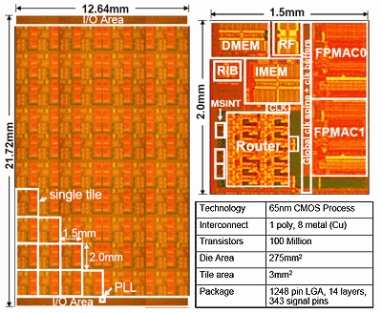
2D Mesh Example
Intel Polaris
  80 core prototype
Academic Research ex:
  MIT Raw, TRIPs
    2-D Mesh Topology
    Scalar Operand Networks
2D MESH
Notes:
The last current example I have is the Intel Polaris prototype. This is an 80-core prototype that connects cores via a 2-D grid or mesh network. I’ve highlighted the mesh in white on the die photo. At each intersection in the mesh, there is a router. The router makes decisions about how messages travel through the network. If you look at the blown up photo of one of the 80 tiles, you can see that the router occupies roughly 25% of the area of a tile. Significant area and power will be devoted to the on-chip network in future designs so it is crucial that we utilize this area efficiently for high performing solutions.
Add RAW, TRIPs

Slide 52
Virtual Channel Router
Routing Computation
Virtual Channel Allocator
Switch Allocator
VC 0
VC 0
VC 0
VC x
MVC 0
Input Ports
VC 0
VC 0
MVC 0
VC x

Slide 53
Baseline Router Pipeline
BW
RC
VA
SA
ST
LT
Canonical 5-stage (+link) pipeline
  BW: Buffer Write
  RC: Routing computation
  VA: Virtual Channel Allocation
  SA: Switch Allocation
  ST: Switch Traversal
  LT: Link Traversal

Slide 54
On-chip Routers
Virtual Channel Router Pipeline Evolution
BW
RC
VA
SA
ST
LT
BW
NRC
VA
SA
ST
LT
BW
NRC
VA
SA
ST
LT
VA
NRC
SA
ST
LT
5-stages excessive for 1-cycle LT
Collapsed into fewer and fewer pipestages
  Speculation rampant

Slide 55
On-Chip Interconnects
More coverage in ECE/CS 757 (usually)
Synthesis lecture:
  Natalie Enright Jerger & Li-Shiuan Peh, “On-Chip Networks”, Synthesis Lectures on Computer Architecture
  http://www.morganclaypool.com/doi/abs/10.2200/S00209ED1V01Y200907CAC008

Slide 56
Lecture Summary
ECE 757 Topics reviewed (briefly):
  Thread-level parallelism
  Synchronization
  Coherence
  Consistency
  Multithreading
  Multicore interconnects
Many others not covered

