Slide 1
Caches for Accelerators
ECE 751
Brian Coutinho, David Schlais, Gokul Ravi & Keshav Mathur

Slide 2
Summary
Fact: Accelerators gaining popularity - to improve performance and energy efficiency
Problem: Accelerators with scratchpads require DMA calls to satisfy memory requests (among other overheads)
Proposal: Integrate caches into accelerators to exploit temporal locality
Result:
  Lightweight Gem5 – Aladdin integration capable of memory-side analyses
  Benchmarks can perform better with caches over scratchpads under high DMA overheads/ bandwidth limitations

Slide 3
Outline
Introduction
Motivation : Caches for Fixed Function Accelerators
Framework and Benchmarks Overview
Results
Gem5 – Aladdin tutorial (Hacking Gem5 for by Dummies)
Conclusion

Slide 4
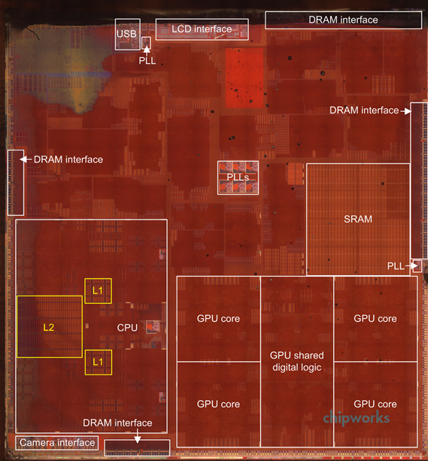
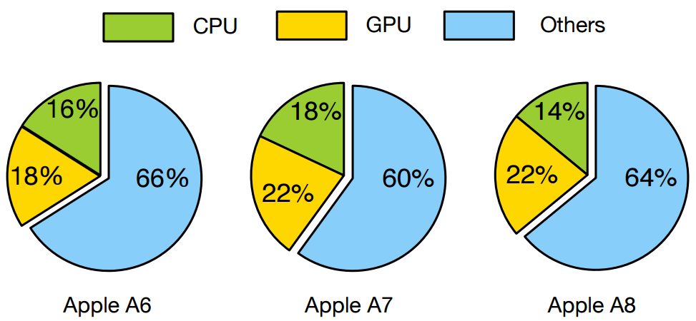
Accelerators are Trending
Multiple accelerators on current day SOCs.
Often loosely coupled to the core.
Inefficient data movement affects performance and power.

Slide 5
Location Based Classification
Acc Datapath
CPU
In – Core
                Cache based
        Fixed Function
Fine Grained
Tightly coupled
Cache
Cache
LLC
DRAM
Un-core
    Scratchpad based
Domain specific
IP like granularity , easy integration
Loosely coupled
DMA Engine
ACC

Slide 6
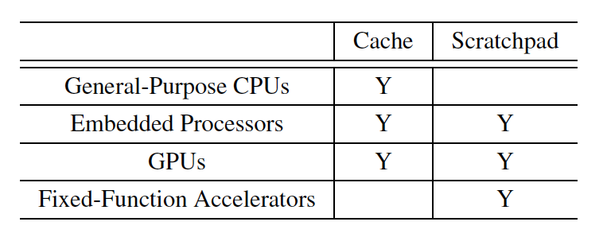
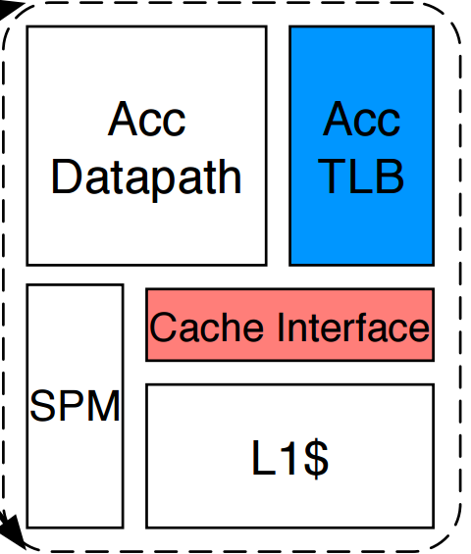
Future of Accelerator Memory Systems
Y
On-chip memory in different compute fabrics
Cache friendly Accelerator
Towards Cache Friendly Hardware Accelerators , Yakun Sophia Shao, Sam Xi, Viji Srinivasan† , Gu-Yeon Wei, David Brooks

Slide 7
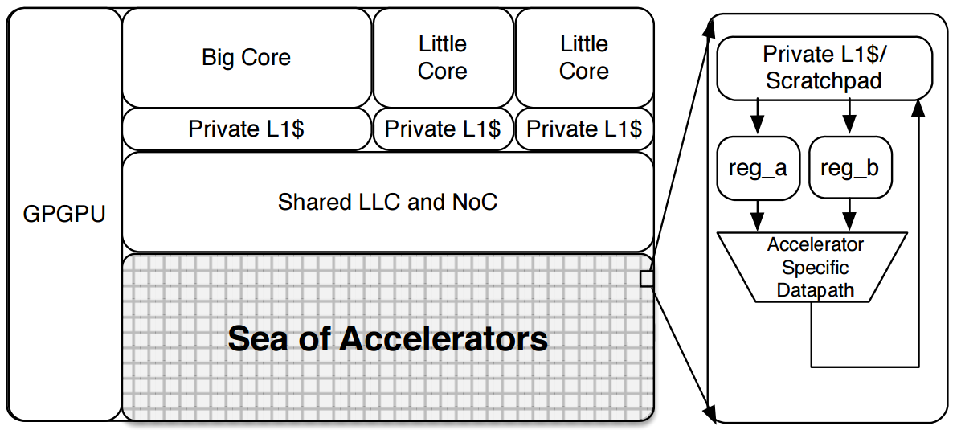

Fixed Function Accelerators
Fine grain off-loading of functions to multiple accelerators
Enables data path reuse + Saves control path power
DMA
LLC
func1();
func2();
func3();
func4();
Y. S. S. B. R. Gu and Y. W. D. Brooks. Aladdin: A pre-rtl, powerperformance
accelerator simulator enabling large design space exploration
of customized architectures
Creates producer - consumer scenario
Forwarding Buffers ? Co-located, shared memory?
Incurs frequent data movement ( DMA Calls )
Scratchpad ? Cache ? Stash ? Both ? Always ???

Slide 8
Scratchpad vs Caches
Deterministic Access
Low Load Use Latency
Efficient Memory Utilization
Incoherent ,Private Address Space
Software Managed
Programmer/Compiler Burdened
Coherent , Non polluting memory
Capture locality, enable reuse
Programmability
H/w address translation energy and latency
Implicit data movement, lazy writebacks
Indeterministic behaviour (Hit/Miss)
Scratchpad Caches

Slide 9
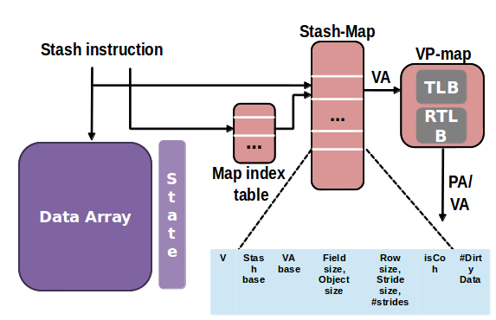
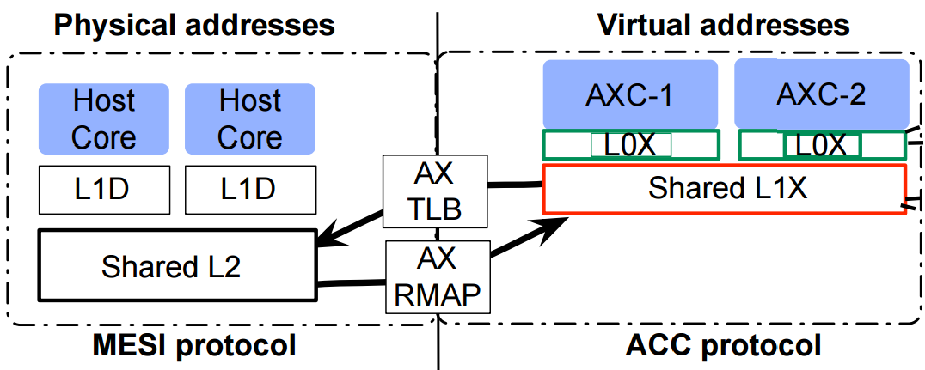
Plugging Caches to the core
Fusion Architecture
Private L0 cache per accelerator
Shared L1 per tile
Virtual Address space in tile
Timestamp based coherence between L0 and L1
TLB and RMAP table for crossing requests
Explicitly declared scratchpad and cached data
Coherency with CPU memory
Lazy Writebacks
Smaller/segments of cache block

Slide 10
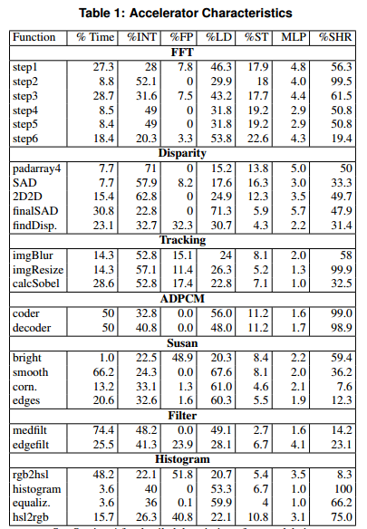
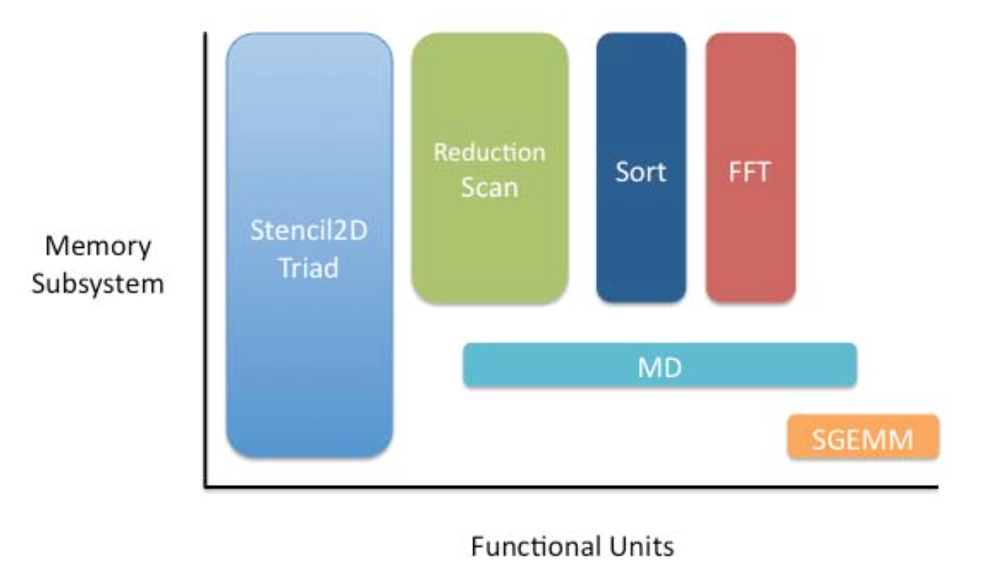
Benchmarks and Characterization
SHOC [1]: Common tasks found in several real-application kernels
Machsuite [2]: TBD
Benchmark | Description
FFT | 2D Fast Fourier Transform (size=512)
BB_GEMM | Block Based Matrix Multiplication
TRIAD | Streaming Vector dot product (A+ s.B)
PP_SCAN | Parallel Prefix Scan [Blelloch 1989]
MD | Molecular Dyn: Pairwise Lennard Jones Potential
STENCIL | Simple 2D 9-point Stencil
REDUCTION | Sum Reduction of a Vector
Dumped image from fusion paper, machsuite characterization
Notes:
SHOC: These algorithms represent common tasks in parallel processing and are commonly found in a significant portion of the kernels of real applications.
Note: Stress on the fact that we treat accelerators for this benchmarks as monolithic even if they have multiple parallel functions. (contrast against FUSION)

Slide 11
Tool Flow
Aladdin
Param Sweep
Pareto-Optimal Design points
Protobuf Stage
Parse R/W request
Gem5
Cache config sweep
Pareto-optimal analysis
Generate Mem Trace
Generate Gem5 compatible packets
Sweep Cache size, assoc

Slide 12
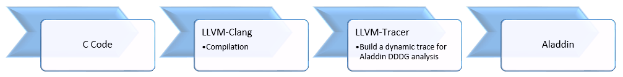
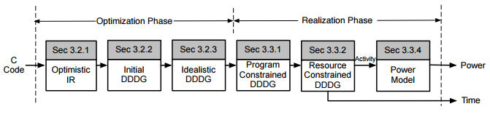
Aladdin : Pre RTL Design Space Exploration Tool
Aladdin flow

Slide 13
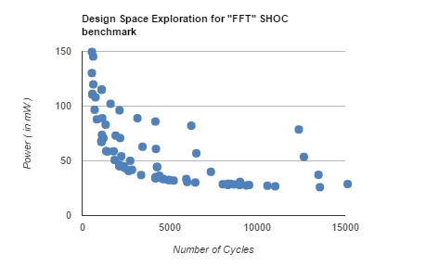
Aladdin analysis example : FFT
FFT Design Space exploration
  Partitions
  Loop unrolling
  Loop pipelining
  Cycle time
Design Points chosen
  Energy Delay
  Energy
  Power
  Delay
Current
GOAL

Slide 14
Is Aladdin Enough?
Pros
  Provides quick accelerator design space exploration
  Application specific accelerators
  Cycle accurate memory accesses
  Power modeling of datapath and memory
Limitations
  Integrating caches
    Proposed gem5-aladdin integration (still in the works)
    Aladdin outputs untraceable VAs
  Limited benchmarks
  Assumes free scratchpad fills (no DMA overhead)
  Incapable of realistically sweeping through scratchpad sizes
  Multiple hardcoded configurations

Slide 15
Accelerator Caches: gem5 Integration
Memory Traces
  VA to PA translation
  Integrating Aladdin to gem5 formats
  Invoking DMA accesses
Cache interaction
  Simulate memory system latency
Accessing the Accelerator
Notes:
Generate memory address traces from Aladdin,
Inject traces into gem5, support for address translation
Leverage gem5’s inbuilt cache model which is coherent with CPU Data cache and LLC.
We model latencies for data transfer from the cache hierarchy.

Slide 16
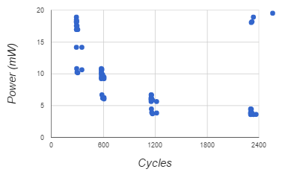
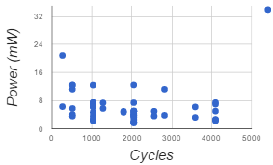
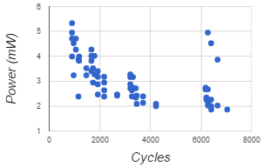
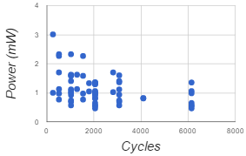
Aladdin: Pareto-Optimal Analysis
BB_Gemm
Triad
PP_SCAN
Reduction
Benchmark | Min Power | Min Delay |  | Min Pow.Delay | Min Pow.Delay2
BB_Gemm | p1_u2_P1_6n | p8_u4_P1_6n |  | p8_u4_P0_6n | p8_u4_P0_6n
Triad | p8_u1_P0_6n | p8_u8_P1_6n |  | p8_u8_P1_6n | p8_u8_P1_6n
PP_SCAN | p1_u1_P0_6n | p8_u4_P1_6n |  | p8_u1_P1_6n | p8_u2_P1_6n
Reduction | p8_u1_P0_6n | p8_u8_P1_6n |  | p8_u8_P1_6n | p8_u8_P1_6n

Slide 17
Integrating Caches - Results
  Pareto – Optimal Analysis
  Sweeping cache size and associativity.
  Size: 16/32/64 KB.
  Associativity: 2/4/8
  No Prefetching! ☹

Slide 18
Uninteresting Benchmarks?

Slide 19
Caches vs. Scratchpads
Scratchpad?

Slide 20
Gem5-Aladdin Tutorial
Adding Accelerator Sim Object
Inserting Memory Requests from Aladdin trace file
Connecting Accelerator Cache
Invoking Accelerator

Slide 21
Typical SoC like system
CPU
CPU
Acc Datapath
Cache
Cache
Scratchpad
TLB
Cache
DMA Engine
LLC
DRAM

Slide 22
Simulated System with Accelerator
Simobj: CPU
Simobj: CPU
DMA Module->Acc
L1 I$
L1 D$
L1 I$
L1 D$
L1 D$ ->axcache
Crossbar
L2
DRAM

Slide 23
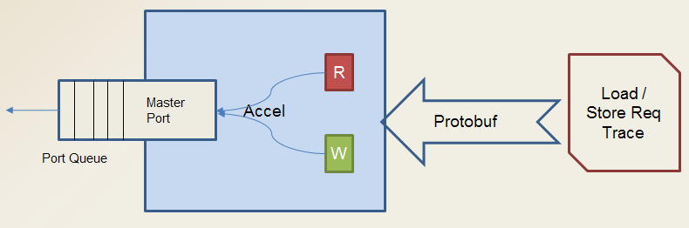
Adding SimObject
Object to ping a cache at its CPU side port with memory requests
Derive Object from DMA module implementation
Creates Read/ Write Packet requests and Inserts on Master Port (cache) queue
Injects memory trace when invoked by invoke() call

Slide 24
Protobuf :
What ? Protocol Buffer Module to convert encoded strings in known protocol packets
Why?
  Package data into a struct used by gem5 objects
    Used to inject data into gem5 to ping the caches
How to do it?
  Create protobuf type
    Fill with gem5 needed data
      Cycle Number
      Memory Address
      Read/Write

Slide 25
Interacting With the Cache
Standard Gem5 Cache Object
Allows Parameterized sweep
of size and associativity
Coherent to L2
Accelerator
CPU Side Port
AxCache ( L1)
Mem Side Port
Coherent L2 Cache

Slide 26
Invoking Acc from CPU
Simobj: CPU
DMA Module->Acc
L1 I$
L1 D$
L1 D$ ->axcache
Crossbar
L2
DRAM

Slide 27
Pseudo Instruction Addition
Why?
  Need to invoke accelerator from CPU
  Stall CPU until accelerator trace completes
How to do it:
  Gem5 provides reserved opcodes
  Write functional simulation prototype
  Create m5op
  Insert into application source code and appropriately compile
  http://gedare-csphd.blogspot.com/2013/02/add-pseudo-instruction-to-gem5.html

Slide 28
CPU Page Table Hack
Why?
  Memory trace from accelerators need address translation
  Use the CPU Page Table?
    Different virtual addresses - Shifted by a base offset value
How to do it?
  Hack gem5 to track addresses of CPU and Memory Trace
    Subtract hard-coded base-shift value from the virtual addresses

Slide 29
Conclusion
Caches can simplify programming accelerators
  No explicit memory copies
  At the cost of:
    Indeterministic Hit/Miss
    Required address translations
  Need for cache prefetching
    Accelerator accesses exhibit spatial locality
    Address stream fairly predictable
Cache Hierarchy allows Scalability
  Scaling coherence protocol
  Cache-based forwarding
Need for gem5-aladdin integration
  Tutorial on integration
  Limited benchmarks

Slide 30

Questions??

Slide 31
Backup

Slide 32
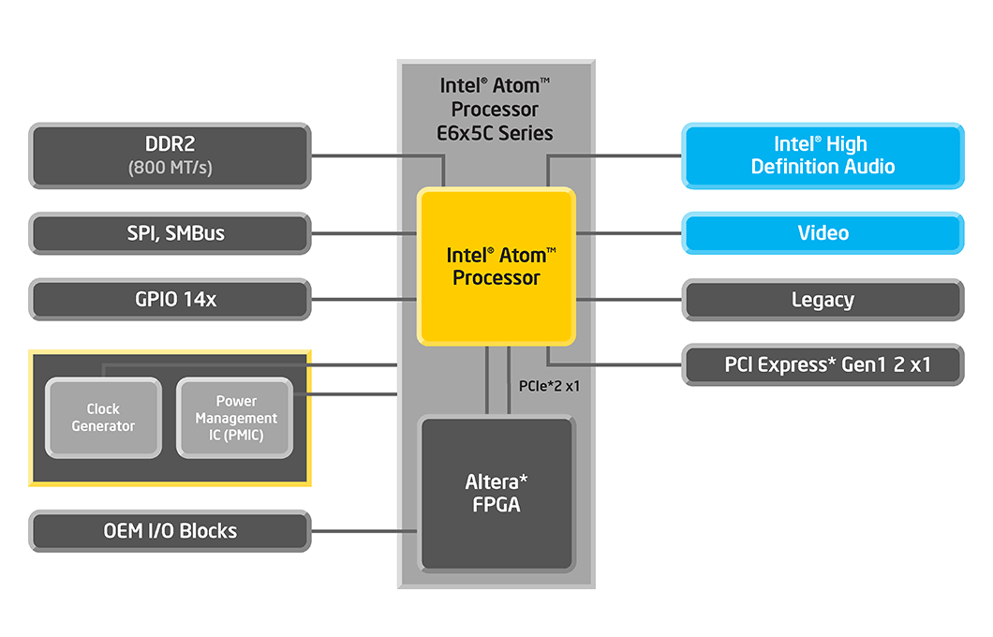
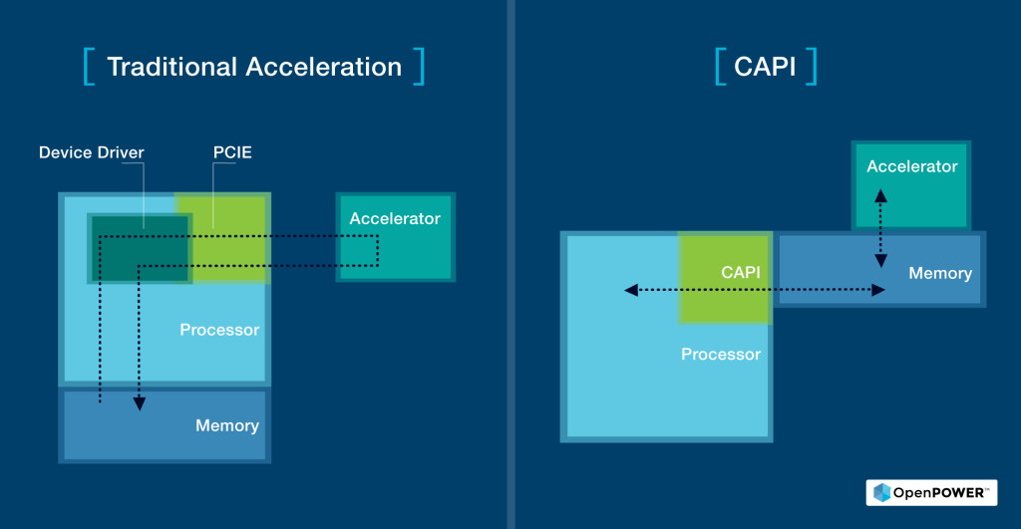
Possible Architectures : Loosely Coupled
Programmable FPGA bonded next to Intel Atom processor
Connected via PCIe bus
FPGA and Power8 processor on same die
Connected via on chip PCIe interface
Coherent view of memory to accelerator and CPU

Slide 33
Master Port Queue
Queue for requests called TransmitList
AccRead(), AccWrite() : Packaging for request and changes status to “ready for queuing”
queueDMA() : Actually queues the request
Transmit Count : Number of entries in list
Transmit List Maintains :
  Packet to be sent
  Relative delay in cycles from previous request

Slide 34
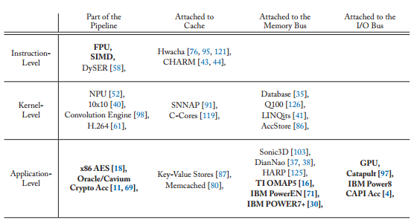
Accelerator Taxonomy
Coupling ( Location with respect to core )
Granularity ( Fine to Coarse )
Research Infrastructures for Hardware Accelerators
Synthesis Lectures on Computer Architecture
November 2015, 99 pages, (doi:10.2200/S00677ED1V01Y201511CAC034)

Slide 35
Future Work
Complete design space sweep for all (extended) benchmarks
Enable prefetching for caches
Modeling scratchpads and their DMA overheads on Gem5
Power calculation of Scratchpad Model
Explore cache and/or scratchpad optimizations

