Slide 1
Hardware Accelerator for Hot-word Recognition
Gautam Das Govardan Jonathan Mathews Wasim Shaikh Mojes Koli

Slide 2
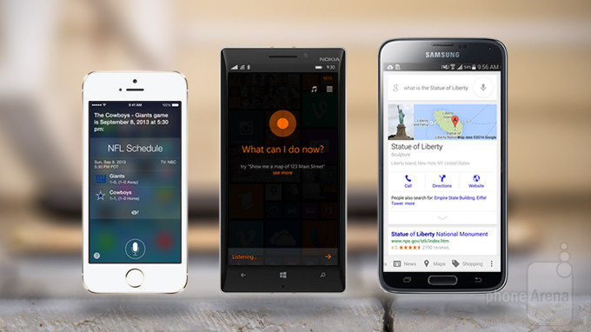
Hot word recognition
Widely used in intelligent personal assistants.
Siri
Apple :
Google :
Google Now
Microsoft :
Cortana
Samsung :
S Voice
LG :
Voice Mate
IBM :
Watson
Such speech recognition technology is now built into every major operating system.
http://www.phonearena.com/news/Google-Now-vs-Siri-vs-Cortana-showdown_id59877
Speech recognition technology uses methods and algorithms which can be
power consuming, considering ALWAYS ON feature in the above implementations
Motivation :
Build hardware accelerators for optimized implementation of this algorithms for speed, power and efficiency.

Slide 3
Speech Recognition - Overview
Feature Extraction
Mel Frequency Cepstral Coefficents (MFCCs)
Linear Prediction Coefficients (LPCs)
Linear Prediction Cepstral Coefficients (LPCCs)
Comparison with trained system
Hidden Markov Model (HMM)
“OK GOOGLE”

Slide 4
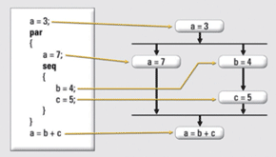
Hardware Implementation – Why?
An FPGA algorithm accelerator is by definition meant to take advantage of the parallelism inherent in hardware.
Advantages of implementing the C code in the hardware? All operations
finish in lesser clock cycles
An in-order processor will take multiple clock cycles to execute this code
Can a designer write a C code at a high level of abstraction and truly expect it to generate quality hardware in the FPGA?

Slide 5
Mel Frequency Cepstral Coefficient (MFCC)
1. Widely used in automatic speech recognition systems
2. Mel-Frequency analysis of speech is based on human perception experiments
3. Keeps only linguistic features, discards other stuff that carries Information
like background noise etc.
Steps involved :
> Frame signal into short frames.
- Usually 20-40 frames
> For each frame, find its spectral density by characterizing it in frequency
domain.
- FFT representation
> Apply the Mel filterbank to above power spectra, sum the energy in each filter.
- What are Mel filterbanks?
> Take logarithm of all the filterbank energies
- Why?
> Take DCT of the log filterbank energies
> Keep DCT coefficients 2-13, discard the rest

Slide 6
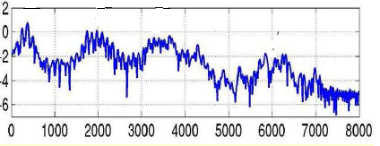
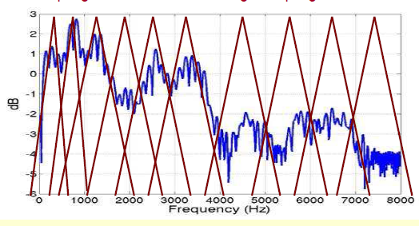
Mel Frequency Cepstral Coefficient (MFCC)
Input audio signal
Keep 2 to 13 values only
Pre-emphasis
&
Windowing
DCT
FFT
Log of filter bank energies
Mel filter banks

Slide 7
Implementation
Hardware Accelerator: MFCC feature extraction
Zedboard: Zynq 7000 AP
Processing System: 33.33MHz
Programmable Logic: 100MHz
512MB DDR3
Onboard USB-JTAG

Slide 8
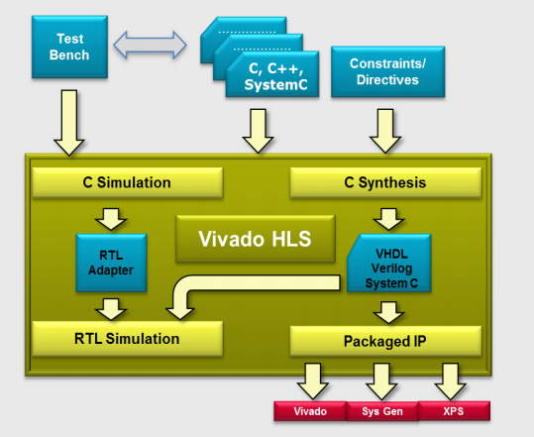
Development Tools
Vivado HLS
High Level Synthesis software
1. Execute C algorithm to validate it against written testbench
2. Run synthesis to obtain desired RTL implementation
3. Apply constraints/Directives to obtain desired optimizations
4. Reuse same testbench for C/RTL cosimulations
5. Package and export final IP
Vivado Interconnect Tool
6. Provides a GUI to make interconnections between the imported IP, application processor system, BRAM controller etc. through high speed AXI interconnect buses. A bitstream file is generated and exported to Xilinx SDK
Xilinx SDK
7. Uses the generated bitstream file to program the Zync 7000 device on Zedboard

Slide 9
Vivado HLS (High Level Synthesis)
HLS transforms a C specification into an RTL implementation
Benefits of HLS:
1. Algorithms developed at C level: abstracts the user from implementation
details
2. Functional correctness is validated using verification at C level: Faster than
traditional HDL verification techniques
3. Optimization directives allow C synthesis to produce hardware with the
required area – performance requirement
3. Quick design space exploration: Creating many different implementations
increases the likelihood of finding the most optimal solution
Vivado HLS provides Synthesis and Analysis views:
Synthesis: Gives estimates of the Performance, Utilization and Interface
Analysis: Gives a count of number of clocks taken by each instruction

Slide 10
Optimizations
Vivado HLS provides directives for optimization. Important ones are:
1. Pipeline: Loops, functions and tasks can be pipelined to reduce the time
interval (or increase the throughput)
2. Loop Unroll: For-loops can be unrolled to create multiple independent
operations
3. Inline: Inlining a subfunction removes all the function hierarchy. Enables
logic optimization across function boundaries and improves latency by reducing function call overhead
4. Array Partition: Partitions large array into multiple smaller arrays to improve access to data and remove block-RAM bottlenecks
5. Allocation: Specifies limit on the number of operations, cores or functions
to be used. Forces sharing of hardware and hence increases the latency,
but reduces the area

Slide 11
MFCC Accelerator
1. A C code for MFCC algorithm is simulated using test bench and verified for correctness using Vivado HLS
2. The C function is synthesized into HDL
3. The baseline HDL is generated without forcing any optimization.
The resource utilization is shown in the figure
4. The percentage resource utilization is not fairly distributed

Slide 12
Baseline MFCC Accelerator
Summary shows that it takes approximately 1.414 million clocks to complete one execution
The outer for loop (FILTER_FOR) and the inner for loop (BINSIZE_FOR) latencies is shown below

Slide 13
Optimized MFCC Accelerator
A sub-function called by the inner function is pipelined to optimize for performance
A 35% reduction in the interval was observed in the optimized implementation, with approximately 8% increase in FF and 1% increase in LUT utilization

Slide 14
Next Steps
1. Hidden Markov Model: Programmable Logic resource constraints forces software implementation on the application processor
2. Power measurements for all the accelerators with different optimizations needs to be measured
3. Real time audio processing for input from microphone

