Slide 1
Studying MIMD Processors for Vision
Ajay Sekar
Bharadwaj Krishnamurthy
Deepinder Singh
Vijay Thiruvengadam

Slide 2
Problem Being Addressed
Efficiency is often achieved at the cost of programmability
Example – DSP, Fixed Function Accelerators, Programmable Accelerators
Interesting Question – How close can we get to the efficiency of specialized processors using the simple MIMD programming paradigm enabled by tiny, low-power energy efficient cores, in the mobile domain?

Slide 3
Objectives
Two “abstract” MIMD architectures studied
Not An Objective: Propose a concrete MIMD architecture
Objective: Study the performance and power efficiency of MIMD style processing at a high level, ignoring low level details like coherence, interconnection networks, etc.
Workload Domain Choice: A domain with abundant thread-level parallelism – Vision Processing

Slide 4
Architecture(s) Under Study
Architecture 1: Conventional Krait-like mobile core coupled with 16 Tensilica LX3 cores with single-precision FP support, and HMC 3D memory for high bandwidth availability. Each LX3 core is coupled with 16KB, 4Way L1 cache
Architecture 2: Similar to Architecture 1, but with LX3 cores placed on HMC’s logic die
We also present sensitivity study of varying L1 cache sizes coupled with LX3 cores

Slide 5
Target Workloads
SD-VBS benchmark suite from San Diego
7 Workloads Studied
Support Vector Machine (SVM)
Scalar Invariant Feature Transform (SIFT)
Feature Tracking
Robot Localization
Disparity Map
Face Detection
Texture Synthesis

Slide 6
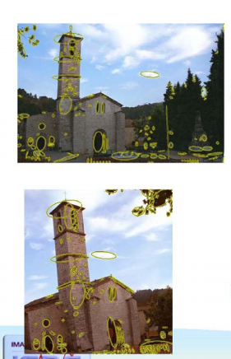
MSER/FaceDetection
About MSER | Algorithm | Advantages
Blob detector – Differentiates regions based on intensity and background | 1. A threshold is considered and swept across (black -> white) gray scale | Faster than other region detectors
Recognizes regions on skewed images | 2. Connect regions (r) with common properties : “Extremal Regions” | Stable – range of threshold checks
 | 3. Select a region which has less variation over a large set of thresholds - MSER | Affine invariant
 | 4. Mark region as completed | - Prone to lighting and shadows

Slide 7
MSER Workload Characteristics
Kernels | Temporal Locality ? | Spatial Locality ? | Parallelizable ?
Phase 1 : Computing Strides | No | Unwanted data cached in L1 | No
Phase 2 : Bucket Sort | No | Yes | Yes
Phase 3 : Bucket Sort | No | Yes | No
Phase 4 : Bucket Sort | No | Yes | Yes
Phase 5 : Initializing the nodes | No | Unwanted data cached in L1 | Yes
Phase 6 : MSER algo | No |  | Yes

Slide 8
Texture Synthesis
Texture synthesis constructs a large digital image from a smaller portion by utilizing some features of its structural content.
Methods were difficult to break in parallel regions.
Create_texture () is compute intensive and relies on temporal locality.
Create_all_candidates() was the only serial component.
Memory intensive – most operations are on pixel granularity.
Compute intensive
Needs TLP to hide the memory latency

Slide 9
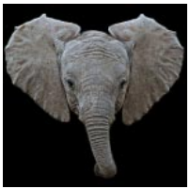
Support Vector Machine (SVM)
SVMs are a class of machine learning algorithms for learning structure from data. Used for data classification/pattern recognition.
The SVM is trained to recognize the input vectors (features of images) and then classify test features into categories.
Want to learn a classifier: y = f (x, α ) from input data. Objective is to minimize (Training Error + Complexity Term). Translates into a non-linear convex optimization problem.
Similar to neural networks except for the fact that the algorithm finds global minima.

Slide 10
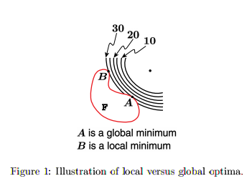
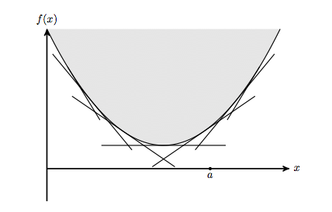
Support Vector Machine (SVM)
The SVM Benchmark in SD-VBS uses the iterative interior point method to find the solution of the Karush Kuhn Tucker conditions of the problem.
Interior point method – Split a non-linear graph into its epigraph
KKT conditions – First-order necessary conditions for a solution in nonlinear programming to be optimal.
Algorithm works in two phases – Training and Testing. This training kernel classifies the data points into two groups. Works sequentially across iterations. The testing Phase involves functions such as finding the polynomial fit and many matrix operations. High scope of parallelism.
Boils down to compute intensive, heavy polynomial functions, matrix Operations

Slide 11
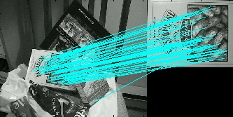
Scale Invariant Feature Transform (SIFT)
The SIFT algorithm is used to detect and describe robust and highly distinctive features in images.
Image features that are invariant to scaling, rotation and noise have wide applicability in domains such as object recognition, image stitching, 3D modeling and video tracking.
Kernel Phases –
Preprocessing, filtering and linear interpolation.
Detection of keypoints
Feature descriptor computation.

Slide 12
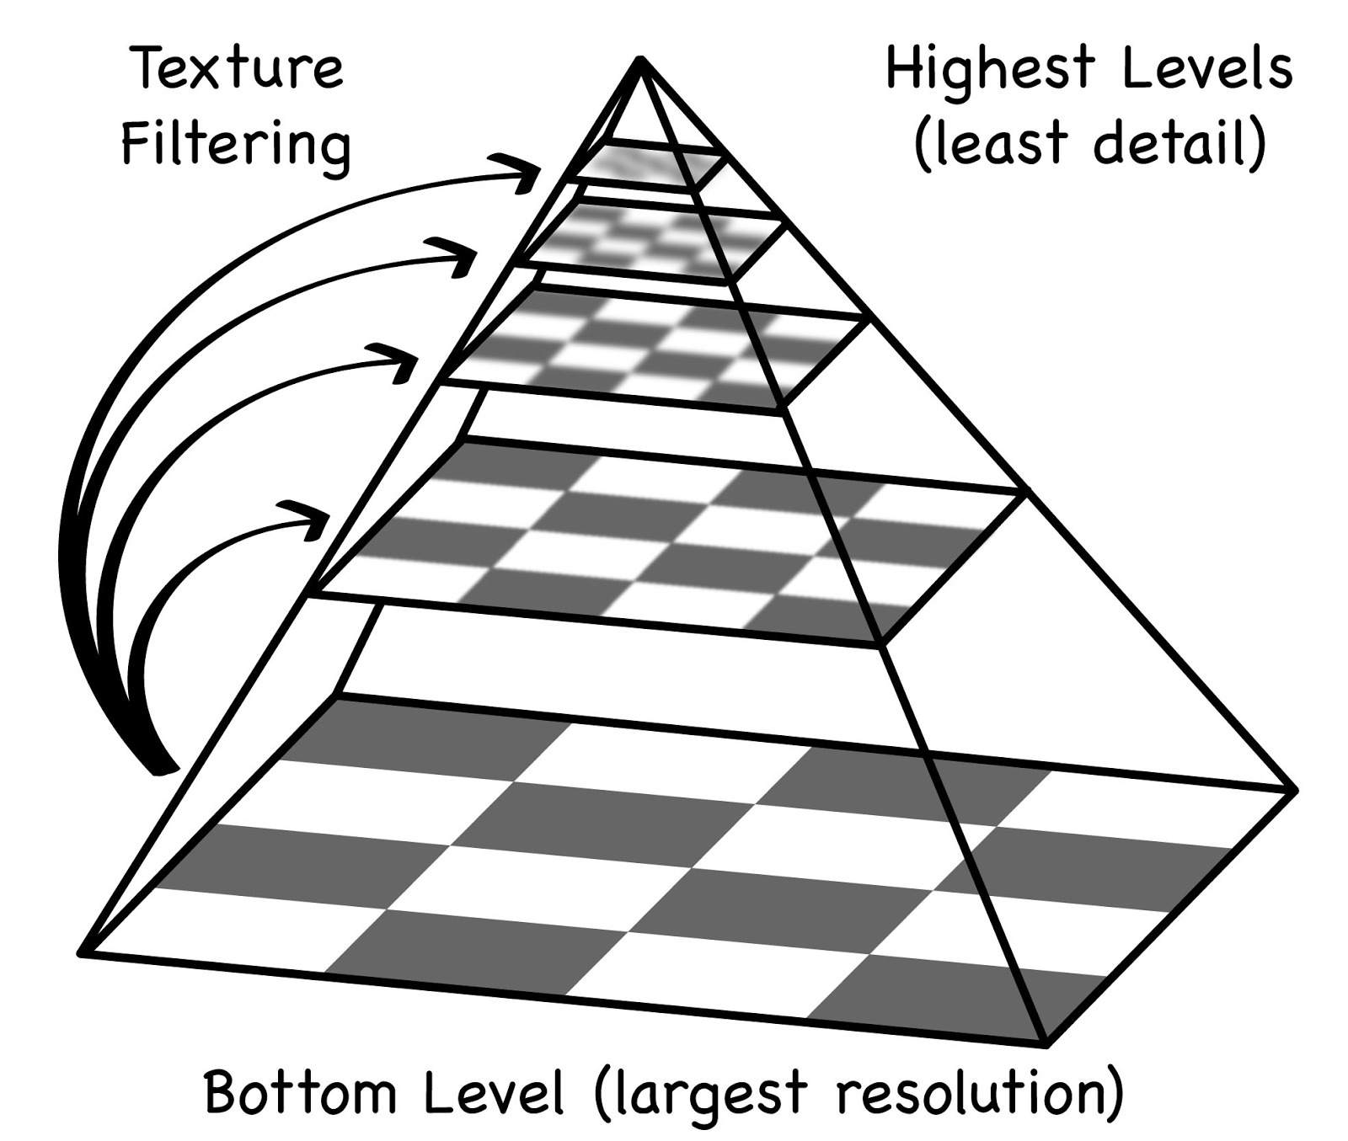
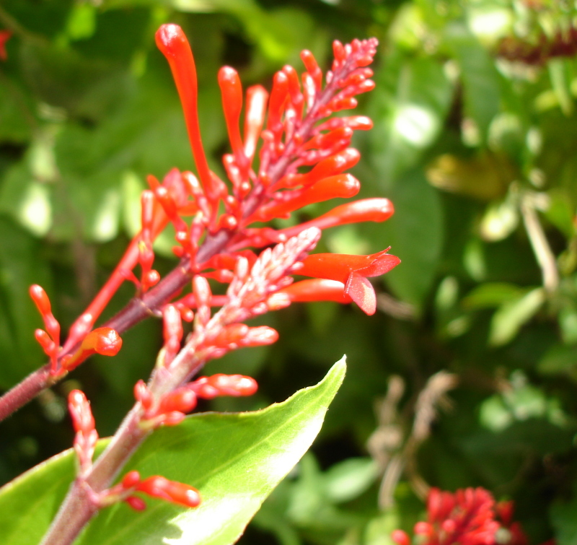
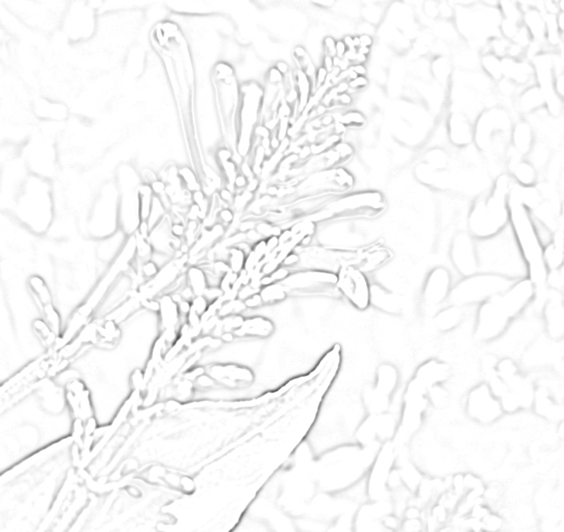
Scale Invariant Feature Transform (SIFT)
Phase I –
The image is normalized. A Gaussian pyramid is constructed. Each level of the pyramid is smoothened.
Compute intensive.
Phase II -
Creation and pruning of difference of gaussians.
Data intensive. Scope of parallelism.
Phase III –
Histogram binning, strength testing etc to assign orientations to feature points.
Compute intensive. High parallelism.

Slide 13
Analytical Model for this Study
A python script of about 1000 lines of code containing some Constants and Formulae. We have an analytical model, not cycle level simulator
A bunch of constants are hardcoded into this script (obtained from literature)
Latency numbers for arithmetic instructions, cache access
Frequency, core count ➔ 500MHz, 16
Static and dynamic compute power for LX3 cores ➔ 4.9mW, 10.6mW
HMC static power ➔ 1.5W
HMC external and internal access energy per 64-byte access ➔ 3.06nJ, 1.95nJ
SRAM static power and dynamic access energy per 32-bit word ➔ 0.14nJ, 0.32W
Available bandwidth for HMC ➔ 20 GB/sec
The script contains formulae that compute the performance, power and energy of the system.
The script reads instruction count, instruction mix, cache hit rates for each workload generated using Intel PIN instrumentation tool

Slide 14
Summary of Results
Observation 1: Across all workloads, both architectures studied sustain average 9 IPC, and 13-14 IPC for 3 workloads. Hexagon DSP sustain ~4 IPC
Observation 2: LX3 cores + SRAM + HMC DRAM consume ~3W power, with static DRAM power being the largest contributor with 1.5W.
Observation 3: All workloads have good memory access locality leading to at least 80% L1 hit rate, even with a 1KB cache.
Implications of Observation 3:
Required read bandwidth is less than 10 GB/sec
Stacking cores near memory is not worth it. Return of engineering investment of stacking cores on memory die is too low

Slide 15
Observation 1: Sustained IPC 9 ➔ Better than Hexagon IPC of 4

Slide 16
Observation 2: Static DRAM power is the largest contributor to total power, followed by Dynamic SRAM power

Slide 17
Observation 3: > 80% Cache Hit Rate even with 1KB cache

Slide 18
Required Bandwidth is less than 10 GB/sec, for Vision Workloads

Slide 19
Stacking Cores Near Memory is not worth it

Slide 20
Next Steps
Evaluate the performance and power implications of more recent, low power memory solution – LPDDR4
Evaluate the performance and power implications of LX3 cores with double precision floating point support
Evaluated workloads contain double-precision floating point operations, but we model these workloads assuming that the double precision FP operations were single precision

Slide 21
Conclusions
IPC sustained by both studied MIMD style processors exceed that of Hexagon by 1x to 4x
Power consumed by 16 LX3 cores + L1 cache SRAM = ~1W. This power can be reduced by using a lower-power, lower bandwidth memory solution. Hexagon reportedly consumes ~250mW
Overall, these processors seem comparable to a Hexagon-like DSP in energy efficiency, as long as the FP operations are limited to single precision.
We believe these processors are easier to program than DSPs, that often require specialized intrinsic programming and/or extensive compiler support

Slide 22
Thank You. Questions?

Slide 23
Backup Slides

Slide 24
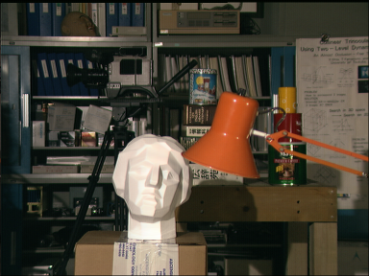
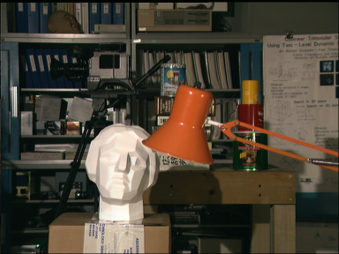
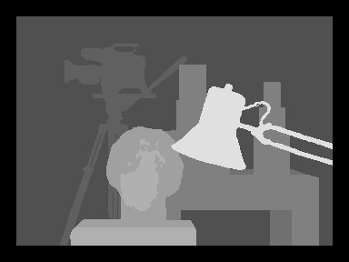
Disparity
Computes the depth information of objects in the image using a pair of stereo images for the scene.
The benchmark takes in two input images and assumes they have the same vertical position.
Algorithm computes dense disparity, which operates on each pixel in the image.
High parallelism since the operations are done at pixel granularity.
The algorithm involves series of SSD computations followed by correlation(data intensive).
Run time is dependent on the image size.

Slide 25
Disparity
Run time analysis shows that the execution time is dominated by SSD computation (finalSAD,computeSAD) and Correlating phase(CorrelateSAD_2D). Both operate at pixel granularity and high scope for parallelism.
It has predictable working set and regular memory access. Workload data is suitable for prefetching to improve hit rates.
Correlation and SSD computation kernel scales with input image size.
Fewer computations per load. Hence execution time is dominated by moving the data in and out of memory. Fitting workload for acceleration using Near-Memory Processing.

Slide 26
Robot Localization
Computes the position of the robot in a given map without apriori knowledge.
The benchmark uses Monte Carlo localization algorithm to compute the global position of the robot in a map and keep track of the local changes thereafter.
Execution starts with a probability distribution map assuming that the probability of robot being in any of those coordinates are equal.
Subsequent iterations zeros in the location.

Slide 27
Robot Localization
It is a compute intensive workload. Involves trigonometric operations and heavy use of floating point operations.
Run time is dominated by weighted sample function which computed weighted sum for all the locations in the map(data intensive).
Depending on the nature of the data point, different set of functions are executed. Hence run time is independent of the size of the input.
Irregular data access pattern makes it difficult to parallelize.
High spatial locality for fMtimes and fSetArray and data is suitable for prefetching.

