Slide 1
The TM3270 Media-Processor

Slide 2
Introduction
Design objective – exploit the high level of parallelism available.
GPPs with Multi-media extensions (Ex: Intel’s MMX and AltiVec in PowerPC)
Highly programmable
Most effective when operating on data stored consecutively
Higher power consumption, may not be suitable for energy sensitive applications
Smaller register size and distinct register files for SIMD operations
Dedicated hardware
Limited format support
Notes:
These simd style instructions work well when there is a pattern in memory accesses. There Increase in control overhead when working on sub-block of a matrix.
For instance, H.264 processes sub-blocks 4*4 of a matrix
Media processors have a larger register sizes, 128 in this particular one. Also bigger reg file size means it can support a large working dataset, fewer load store operations
Dedicated hardware can have low power low cost implementation, but limited scope.

Slide 3
Design Features – TM3270 media processor
Multi-purpose programmable solution
Backward source code compatible
Unified 128*32 bit register file
32 bit address range and datapath
VLIW architecture with 5 issue slots
64 Kbyte Instruction cache – 8 way set associative
128 Kbyte Data cache – 4 way set associative
Variable length instruction encoding
Operations are guarded
Non-aligned memory access
Notes:
Flexible, Time to market is small, since no lengthy hardware design cycle for algorithmic changes.
Only recompilation needed. With intel’s mmx extensions, if the architecture is upgraded to 128 from 64, the programmer has to rewrite the application to get the benefit.
Operations are conditionally executed based on the value of the guard bit this allows the compiler to aggressively predicate.
Does not incur any miss stalls during memory access

Slide 4
ISA Enhancements
2 slot operations
Collapsed load
CABAC

Slide 5
Two-slot operations Executed in Functional units in neighbouring issue slots
SUPER_DUALIMIX
Pairwise 2-taps filter on 16 bits, and the results are stored in 2 destination registers.
SUPER_LD32R
Retrieves 2 consecutive 32-bit values from memory and stores them in 2 destination register
Notes:
Doubles the load bandwidth

Slide 6
Collapsed load operations
Used for motion estimation
LD_FRAC8
Notes:
5 byte of consecutive data, and weighted average in pairs. 4 weighted averages stored in 2 destination registers

Slide 7
Context Based Binary Arithmetic coding(CABAC)
H.264 compression feature
Lossless compression of syntax elements in the video stream, based on the probabilities of syntax elements of the given context.
High compression ration
Computationally intensive
Notes:
Single bit is decoded from a stream

Slide 8
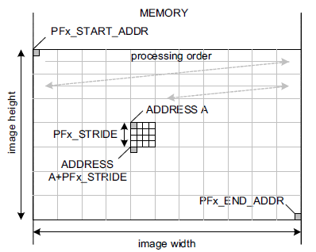
Prefetching
Prefetching to hide memory latency
Prefetching based on memory regions
Memory regions defined by start address, end address and stride
Memory regions are under software control
4 memory regions supported

Slide 9
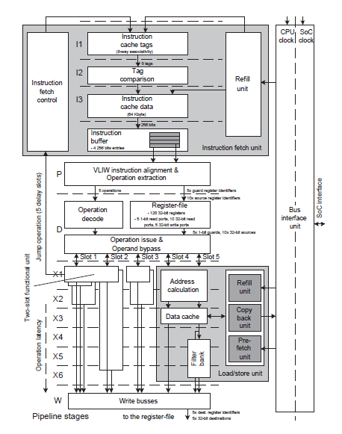
Pipeline
Sequential Icache design
Unified register file
5 delay slots for jump
Load –Store unit connects to 2 issue slots
Two slot execution unit
Notes:
Icache lookup, comparison and cache data. Sequential icache – significantly low power consumption

Slide 10
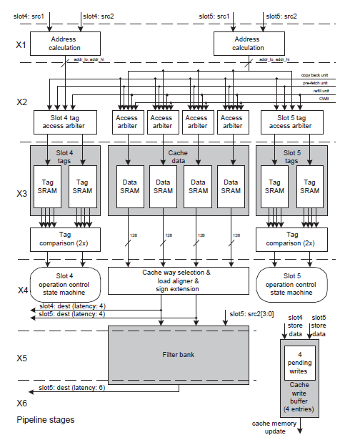
Load store unit
Loads issued only from slot 5
Two copies of tags
Two extra cycles for fractional load
Notes:
X1 – address calculation for addr hi and addr low for non aligned access
X2 : arbitration to tag memory and data memory structures
X3: access and comparison
X4: way selection, if hit else replaced
If the load address is not aligned, there might be two cache misses and 2 lines are read to cache from memory
X5 and x6 filter bank to process collapsed load
Store – request access only to tag
Load – both memory and tag
2 copies of tag to perform 2 stores, only slot 5 has access to data memory structures.

Slide 11
Realization
Fully synthesizable, low power process design in 90nm
High threshold voltage
Frequency
450 MHz – 1.2V
350 MHz – 1.08V
Area : 8mm sq.
Almost 50% for SRAMS
Power
0.7 – 1mW / MHz (1.2V)
Clock gating – 70 clock domains
Notes:
Easy to port to different process, p n r driven by tools.
the supply voltage can be scaled based on computational requirements.
It is connected to the rest of the SoC through asynchronous bus interfaces, and hence the frequency can be varied independently.

Slide 12
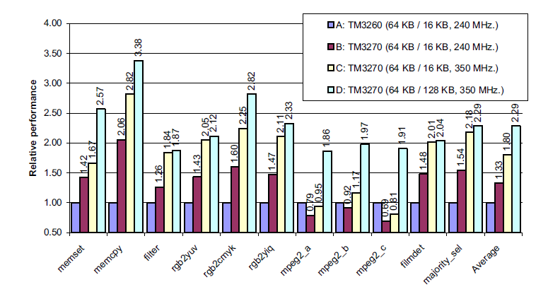
Relative Performance
Notes:
Mpeg2 – cache misses – word size of 128 than 16
Highest - Memcpy – 60 used fetch on write miss

Slide 13
Sources
The TM3270 Media processor
(Thesis carried out at Philips Semiconductor)

