Slide 1
Lx: A Technology Platform for Customizable VLIW Embedded Processing

Slide 2
Introduction
Problem
Complexity of embedded applications is escalating
Time to market is a primary concern
Thus, a software based approach is desired
a DSP platform coupled to microprocessor functionality
Solution
A VLIW architecture specialized to an application domain
Aggressive ILP complier
Notes:
2) Time to market is a concern because lifetime of products is becoming lesser
3) Software based approach is faster
4) As opposed to separate DSP and Micro-controller

Slide 3
Comparison to competing Technologies
Notes:
ASIP = application specific instruction set processors, components of SOC’s

Slide 4
Goals
Scalability
Increase issue width
Increase set of legal operations which can be issued together
Customization
Try to do computation at hand efficiently

Slide 5
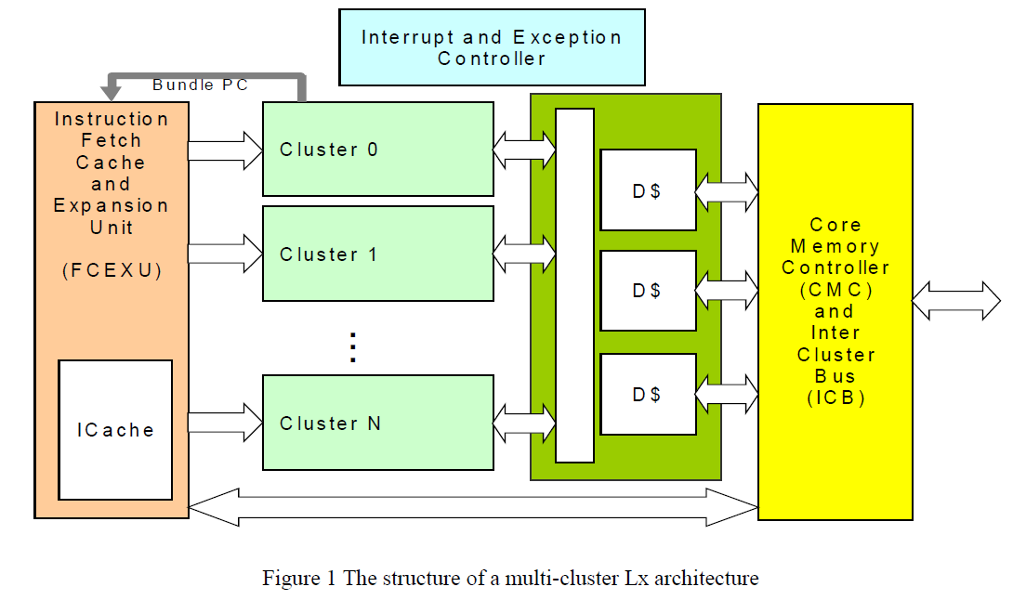
The Lx Core Architecture
Notes:
Unified Instruction Cache amongst clusters so they run in lock step and single execution pipeline

Slide 6
Multi-Cluster Organization
Unified Instruction Cache amongst clusters so they run in lock step and single execution pipeline
Inter-cluster communication
To transfer data between clusters
Done using compiler controlled send and receive instructions
Data-Cache organization
Problem: Multiple memory accesses
Possible solutions suggested
MESI-like synchronization of independent caches
Pseudo multi-ported cache implementation
Not discussed in paper

Slide 7
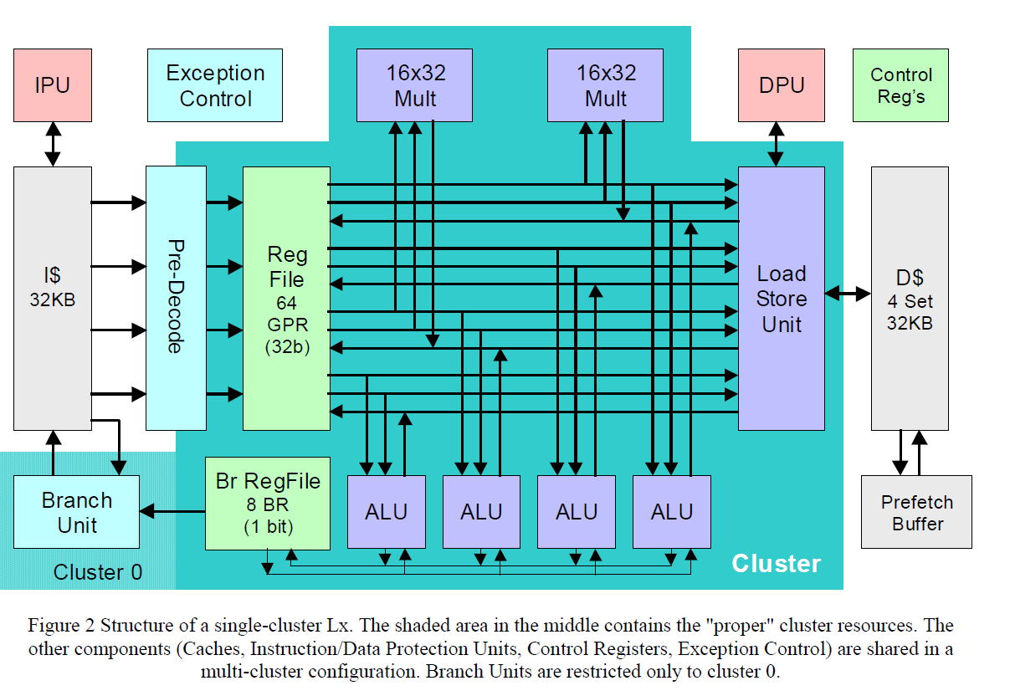
Organization of single cluster
Four 32-bit integer ALU’s
Two 16X32 multipliers
One load/store unit
64 32 bit General-purpose registers
Branch unit (only cluster 0)

Slide 8
More on single cluster
RISC ISA with minimal predication support
Supports dismissible loads
Has a “two-step” branch architecture such that compare and branch operations are decoupled
8 1-bit branch registers
32KB, 4-way associative data cache
Fully associative 8 entry Prefetch Buffer which is software controlled
Notes:
Some select instructions to support predication
Dissmissible loads – compiler can move load ahead, which allows to consume its value provided there is no exception
Compiler can move the compare operation ahead so that branch can be resolved before hand

Slide 9
Code Density
Sparse ILP encoding
No-ops for unused units
Use end-of-bundle bit
RISC has intrinsically sparser encoding then CISC and latencies are exposed at ISA level in VLIW
Use simplified form of Instruction set
Compression. Compressed by software and decompressed on demand
Compiler-driven code expansion
Hard factor to quantify
User guidance to the complier to do this only in the computationally intensive kernal
Notes:
Huffman like algo for compression

Slide 10
Code density
Average of 48% increase except bmark for optimized code
After compression average goes to 14.9%
For compilation with minimal code size we have 26% and -14%

Slide 11
Performance
Baseline – Intel Pentium-II @ 333 MHz
Programs in application domain as well as reference benchmarks are considered
Compared against StrongArm SA-110 @ 275MHz, high performance 32 bit embedded processor
Scaling clock Frequency
May not always be preferred for embedded domains because of limited energy budget
Realistic range of 200-400 MHz is considered

Slide 13
Results of scaling clock Frequency
In the target domain, performance scaled linearly, and this remained true for 2-cluster and 4-cluster configurations as well
For general purpose applications, scaling did not make much of a difference

Slide 14
Scaling Issue width
Functional units and registers represent only fraction of power consumption
Thus, increasing issue width changes power consumption only marginally
However, cost is higher as data-path grows and bandwidth of data-cache also has to be higher

Slide 16
Results of Scaling Issue width
In the application domain, some advantage bit non-uniform across applications
In general-domain it was ineffective and sometimes detrimental

Slide 17
Customization levels
Domain Specific
What Lx did
We make choices like core ISA, pipeline organization, memory hirerarchy
Application Specific
Sizing and scaling the basic resources according to application
Algorithm Specific
Special computation instructions, storage organization and other structures
Implementation specific
Customize for specific way of implementing the algorithm
Notes:
Digital Camera – application domain

Slide 18
MD5 Encryption Case Study
Commonly done operation in MD5, are fairly generic
Instructions to support operations

Slide 19
MD5 Encryption Case Study
Operations very specific to MD5

Slide 20
Comaparision with SHA

Slide 21
Conclusion
Domain-Specific Customization is effective
Scalability by increasing ILP resources is not uniform across applications. Increasing clock-speed gives scales linearly but is limited by the power budget
Aggressive customization works in certain cases but can be dangerous

Slide 22
Questions?

