Slide 1
An Architecture FRAMEWORK FOR Transparent ISA customization in Embedded Processors
Vinay Gangadhar
gangadhar@wisc.edu
ECE 751 Talk, Fall 2015
Department of Electrical and Computer Engineering
UW- Madison

Slide 2
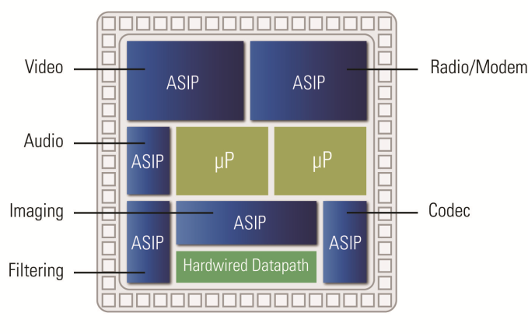
Background
Embedded workloads – Computationally demanding
Mobile processors → High performance in tight area and power constraints
SOCs employing Customization/Specialization to meet the demands
Speech recognition
Face/Image recognition
Signal Processing
General Purpose
ASIC Solutions
Hardwired and Fixed Functions
Not programmable
ASIP Solutions
- Application specific customization
- Programmable to some extent
Notes:
As embedded workloads like image/face recognition, speech processing are computationally demanding
Mobile SOCs need to deliver high performance

Slide 3
Background – ISA Customization
CPU
ASIPs → Low cost, energy and some degree of programmability
Instruction Customization → Performance and Efficiency improvement
Ex: Xtensa Customizable processors, Hexagon DSP etc.,
Targeted for computationally demanding regions of an application
Custom instructions execute on a special custom hardware or accelerator
ASIP
MPY
LD
LD
XOR
SHR
MPY
SHR
Custom
Inst.
AND
XOR
MOV
XOR
ISA Customization

Slide 4
Problem
High Non-Recurring Engineering costs – Mask and refabricating costs
Needs intense design verification of the new ASIP
High system integration costs → ASIP with new interface to GPP
Retargeting software toolchain and library porting is time consuming
High ASIP Hardware design and Software migration time/cost
CPU
ASIP
….
…..
…..
CPU
ASIP
Application and Libraries
CPU
ASIP
Notes:
Every time you design an application specific hardware and customization
High ASIP Hardware design and Software migration time/cost
Time and the cost for each new application processor is immense
Reverification of core
Functional and timing verifictaion
Porting new software program is time consuing
Refabricate lithography masks
Retarget software tool chain
Automated tools like one we studied in Xtensa paper, but still it’s a manual process to identify the potential instructions
And it impose some restrictions on the type of customization you can do

Slide 5
Solution
Fixed GPP design and base instruction set
Well defined interface to augment new accelerators or custom hardware blocks
Architectural framework to transparently customize the instructions with support of base processor
Offline static subgraph discovery
Dynamic realization of custom instructions in special purpose hardware
Takeaway
An architectural framework for transparent ISA customization
Enables Plug-and-Play style accelerators (CCA style)
One time verification of the system
No ISA change needed
Improve execution efficiency without overheads
Hybrid Arch Framework
….
…..
…..
CPU
Application Binary
Subgraph identification and Compilation
Transparently Customize instructions
1
Compute Accelerator
(CCA)
2

Slide 6
Configurable Compute Accelerator (CCA) [1]
Goal: Support important computation subgraphs
Array of function units
Mix of Arithmetic and Logical units
Configured with control signals at runtime
Uses 2 approaches for execution:
Dynamic: Trace cache fill unit
Static: Offline subgraph discovery and runtime replacement of CCA instructions
Above approaches don’t fit for embedded domain → Use Hybrid Approach
General Purpose CCA
I1
I2
I3
I4
O1
O2
Arith/Logic
Logic
[1] N. Clark et al. "Application-specific processing on a general-purpose core via transparent instruction set customization." IEEE/ACM international symposium on microarchitecture. 2004.
6
Notes:
Dynamic approach (Trace cache fill unit): Energy and cost not viable for embedded domain
Static: (Control bits loaded to a table) – Fixed to a particular CCA style and also need to depend on ISA regsiter encoding

Slide 7
INSight – Transparent customization
Hybrid Approach
Offline subgraph identification → Enables complex patterns to be analyzed
Subgraph selection not limited by encoding of registers (ARM ISA)
Generate control on-the-fly inside H/W instead of placing control in binary
Make it forward compatible and executable on multiple CCA types
Best of both worlds:
Sophisticated offline subgraph discovery algorithms + Flexibility of online realization to various CCAs
7
Notes:
Can target subgraph size more than of a linear chain
Limited endcoding of registers don’t become hinderance for this type of customization

Slide 8
Outline
Configuration
Stream
Subgraph
Execution
Unit (CCA)
Subgraph
Execution
Unit (CCA)
1
Control
Generation
4
Application
Inputs
Outputs
Compiler
&
Framework
Core Standard
Pipeline
Compiler
&
Framework
…
Subgr.
…
…
Subgr.
…
Instructions
2
3

Slide 9
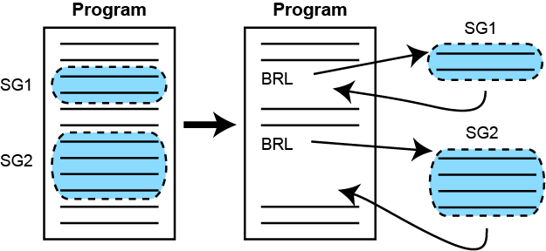
Compilation & Architecture Framework
Static identification of subgraphs
Critical portions of program pulled out to separate locations →Procedure Abstraction
Make use of Branch and Link (BRL)
Dynamic Realization in Hardware
Execute the subgraph on regular core → Generate config. stream for CCA
Execute the newly synthesized opcode on custom hardware (CCA) directly
Execution 1
Execution 2 → N
Configuring CCA
CCA Subsystem
CCA Subsystem
Subgraph
Results
Core
Core
Subgraph
Results

Slide 10
Outline
Configuration
Stream
Subgraph
Execution
Unit (CCA)
Subgraph
Execution
Unit (CCA)
1
Control
Generation
4
Application
Inputs
Outputs
Core Standard
Pipeline
Compiler
&
Framework
Core Standard
Pipeline
Compiler
…
Subgr.
…
…
Subgr.
…
Instructions
2
3

Slide 11
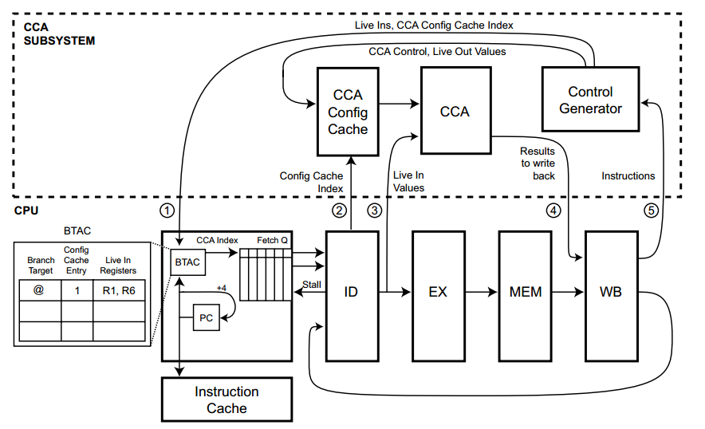
Pipeline Interface
Notes:
Baseline system is augmented with CCA with 3 major parts.
CG: Responsible for examining retiring instructions and generating required control signals in config cache
Each entry in config. Cache → Control signals, opcode, interconnect b/w FUs and literal values
At fetch stage of pipeline – instruction stream substitution occurs and is decide by BTAC

Slide 12
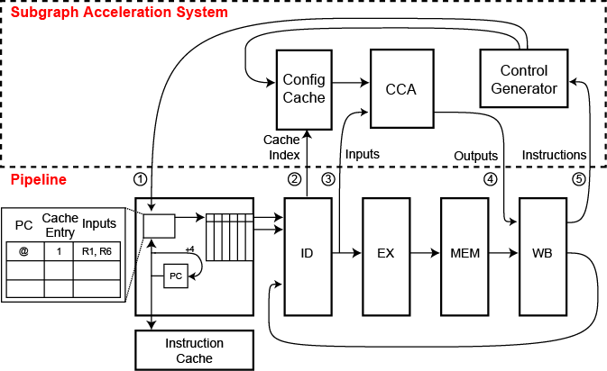
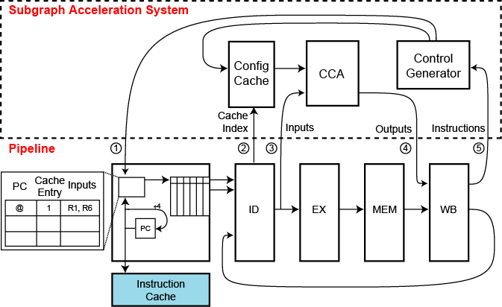
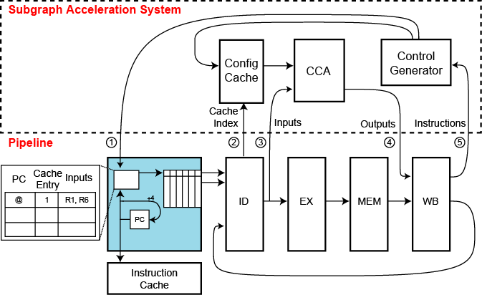
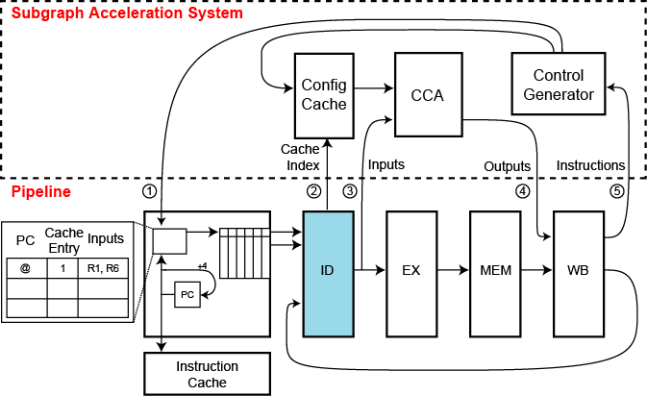
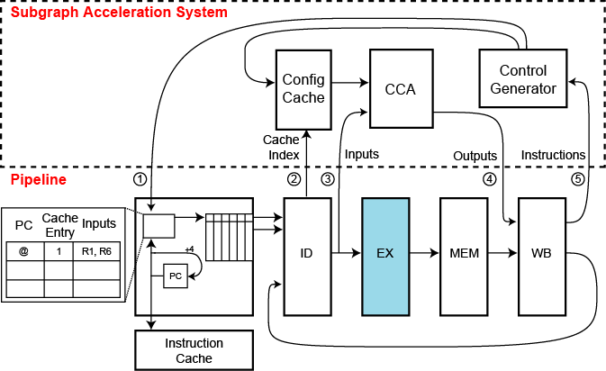
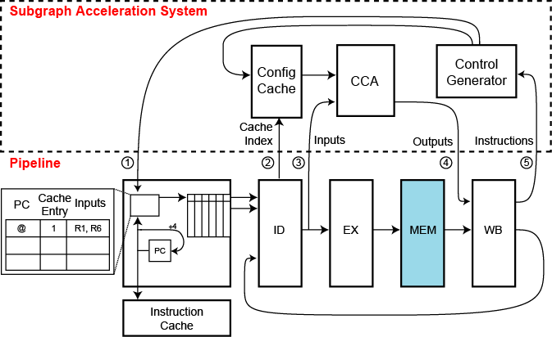
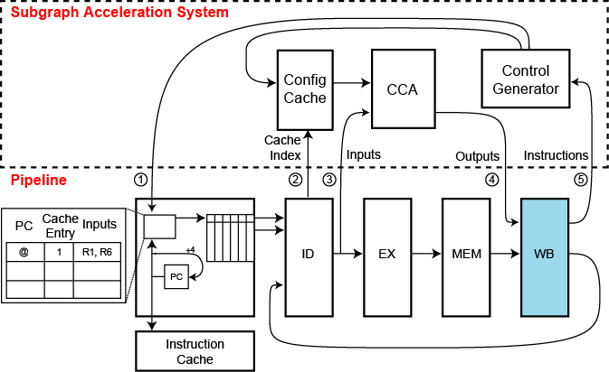
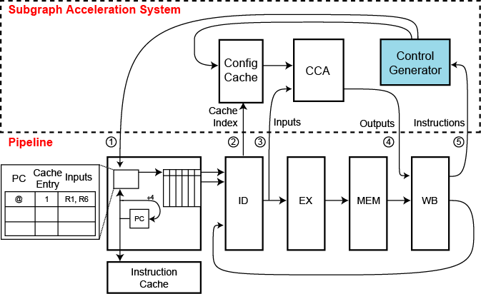
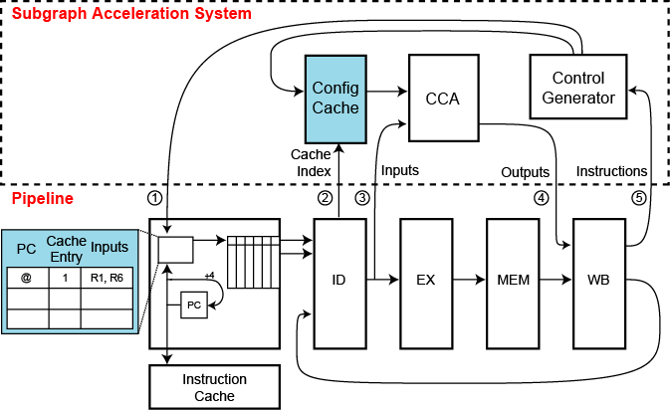
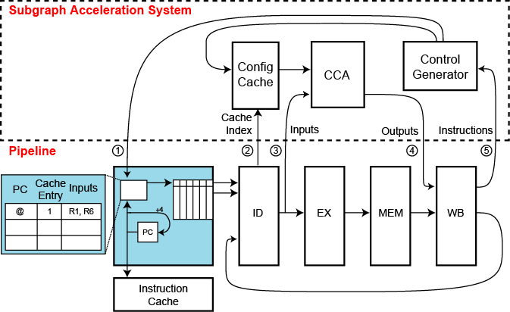
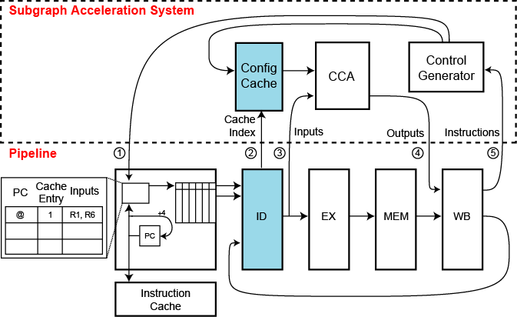
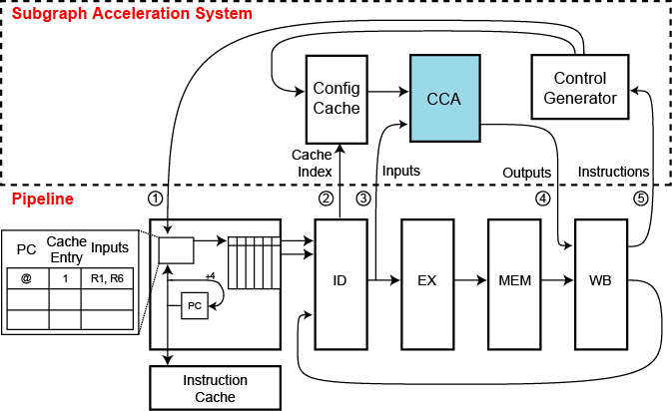
Dataflow subgraph Execution
BRL’: Branch and Link Instruction
Notes:
BRL’ is hit in BTAC, then corresponding control bits and cache index is forwarded from decode stage to CCA
PC increments to next inst. (Branch is not taken as it recognizes BRL’ as regular CCA instruction)
Multiple cycles may be needed to read operands for 4 inputs of CCA
Talk about why config cache and control bits are put in CCA subystem and not base proc

Slide 13
Outline
Configuration
Stream
Subgraph
Execution
Unit (CCA)
Subgraph
Execution
Unit (CCA)
Control
Generation
Control
Generation
1
4
Application
Inputs
Outputs
Core Standard
Pipeline
Compiler
&
Framework
Core Standard
Pipeline
…
Subgr.
…
Instructions
2
3

Slide 14
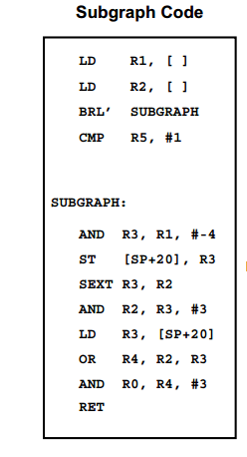
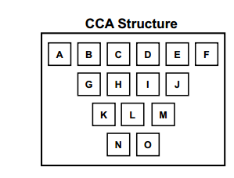
1. Dataflow subgraph Control
generation
CAM for spilled values
A
B
Producer table updated for each Reg write
Live-out table for output values
G
Live in table → Sent to BTAC
Running count of nodes
Notes:
PC of BRL is recorded to update the BTAC entry
CAM to store the the stack offset of the node which produces the spill value [Size of CAM === No. of nodes]
Helps eliminate the spill code in the subpgraph (If transient values consumed inside the graph)
Producer table holds the value of most recently produced value with reg number abd live out cond,
In every cycle, the reg written is marked as potential live out unless proven otherwise

Slide 15
2. Dataflow subgraph Control
generation
A
B
G
Decide potential live-out values
K
N
Notes:
PC of BRL is recorded to update the BTAC entry
CAM to store the the stack offset of the node which produces the spill value [Size of CAM === No. of nodes]
Helps eliminate the spill code in the subpgraph (If transient values consumed inside the graph)
Producer table holds the value of most recently produced value with reg number abd live out cond,
In every cycle, the reg written is marked as potential live out unless proven otherwise

Slide 16
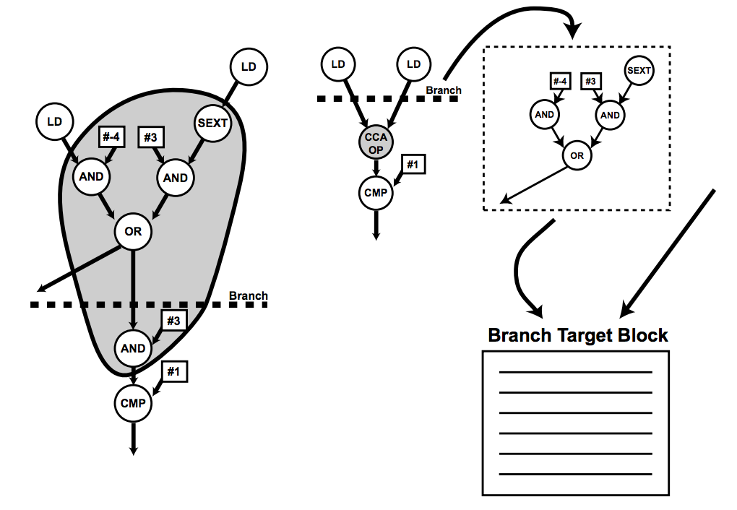
Compiler Code generation
Subgraph identification → Partition heuristic (branch and bound technique)
Code motion → Downward code motion across the branch boundary
Prepass/Postpass scheduling: Subgraphs turned into BRL’ instructions
Expansion: Expand to facilitate register allocation
Compaction and Outlining: Spill code generation and procedural absrtaction
16
Notes:
Determine which subgraphs execute on CCA
For remainining some phases, subgraphs need to be considered as an atomic unit
Identification: NP-Hard problem
Generate subgraphs capable of executing on target CCA
Subgraphs are identified before reg allocation for larger sized graphs
Reg alloc: Caller save code for saving link register

Slide 17
Evaluation
Ported Trimaran compiler infrastructure to ARM ISA
Subgraph identification engine
Simplescalar ARM branch [ARM 9 series processor]
Configured as ARM926EJ-S
- 5 stage pipe, 250 MHz, 1 cycle 16k I/D caches, Single issue
- 1 cycle subgraph execution latency
Mediabench, SpecInt2K and Encryption suite benchmarks
BTAC Study: Chose a 512 entry BTAC with Average 98.5% hit rate
CCA Synthesized results: 130nm cell library
Control generator: 0.169mm²
CCA: 0.61mm²
17

Slide 18
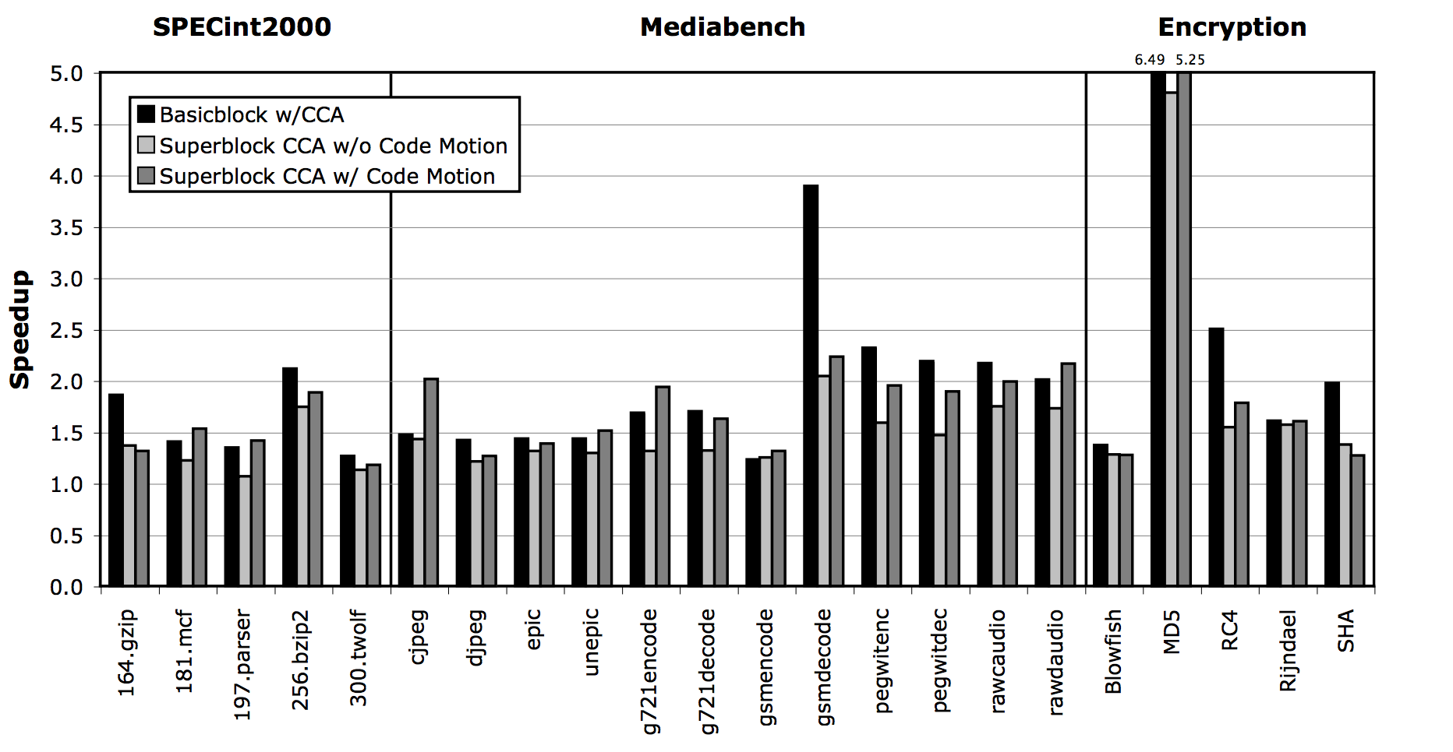
Performance – General Purpose CCA
Takeaway
CCA achieves good speedup for regular compute intensive workloads
Speedup with simple inexpensive tightly coupled accelerator
Superblocks have register pressure
1.6x
1.91x
2.79x
Notes:
Specint are irregular control intensive → So suffer due to that
Encryption → regular and larger basic blocks can be mapped to a subgraph
Superblocks – increased size of live ranges (need to handle spill code)

Slide 19
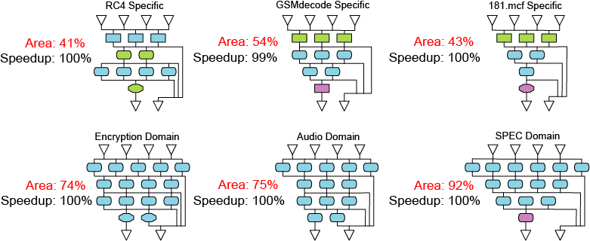
Plug-and-Play Benefits
Control: 73b
Control: 84b
Control: 55b
Control: 181b
Control: 140b
Control: 171b
Baseline General purpose CCA
Area: 0.61mm² Speedup: 1.6x Control: 172b
Notes:
Compiler used a reservation table based heuristic (subgraphs with profile weights )
Application specific – union of all subgraph operations
General purpose CCA was hand tuned (172b and 3.19ns of delay)

Slide 20
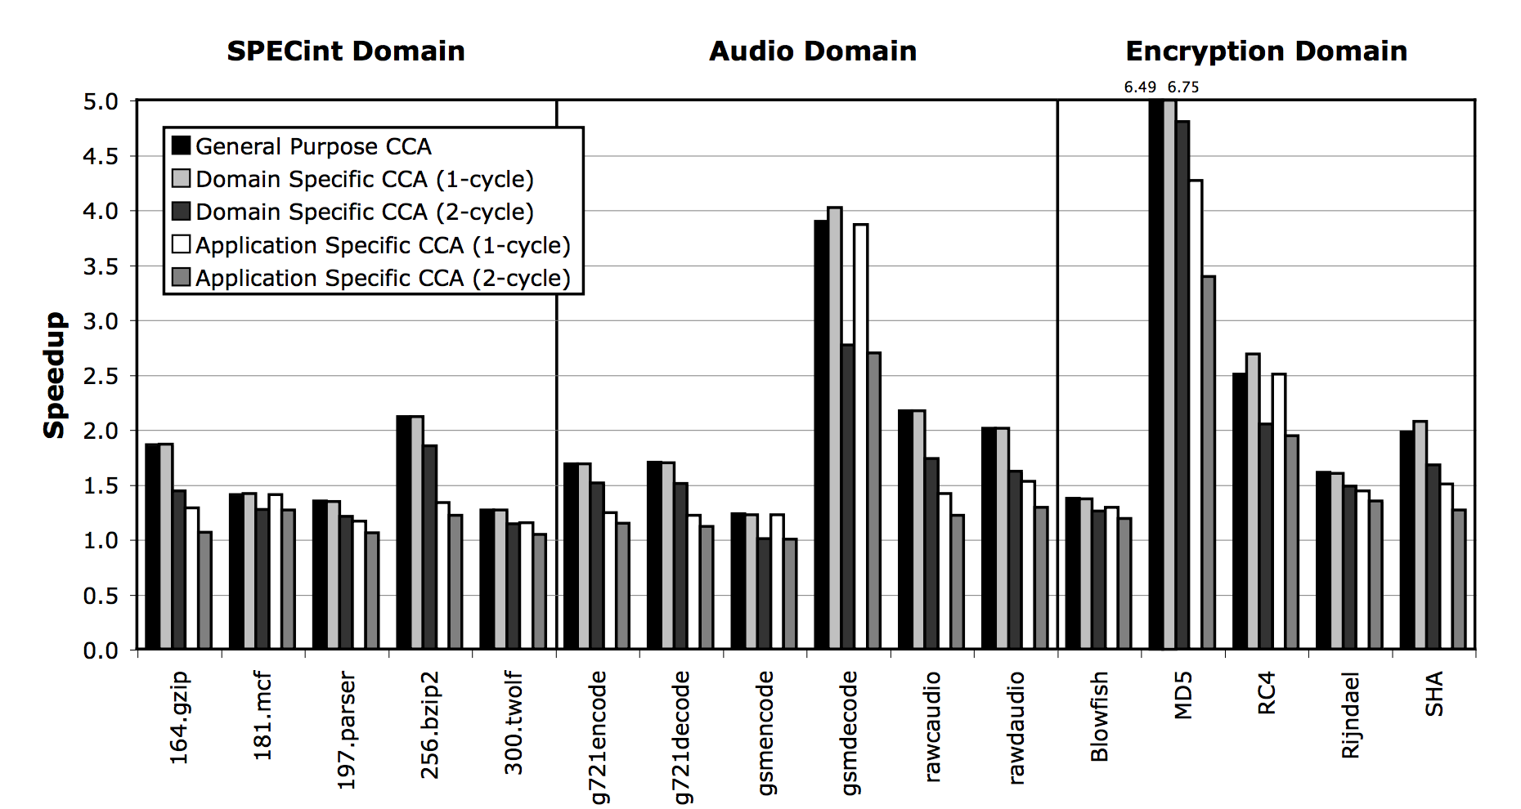
Flexibility of framework
Takeaway
Domain specific CCAs have avg. speedup close to GP CCA with less area
Application specific CCAs slightly underperform

Slide 21
Related work
Utilization of Trace cache for Subgraph mapping: D. Friendly et. al, "Putting the fill unit to work: Dynamic optimizations for trace cache microprocessors."Proceedings of the 31st annual ACM/IEEE international symposium on Microarchitecture. IEEE Computer Society Press, 1998.
DISE: M. Corliss et. al. "DISE: A programmable macro engine for customizing applications." Computer Architecture, 2003. Proceedings. 30th Annual International Symposium on. IEEE, 2003.

Slide 22
Questions to think of ??
Power/Energy estimates for General purpose CCA ?
CAMs are used for Config. caches. How much better or extra overhead is added compared to trace cache based design ? (Dataflow processors demised due to heavily used tag matching CAMs)
Why not use a traditional wide issue VLIW and SIMD style machine instead of general purpose CCA ?? Plug-and-play are the only extra benefits out of this framework ?
Compiler still needs to be aware of target CCA to generate subgraphs to be consumed by it ?

Slide 23
COnclusion
Flexible framework for transparent ISA customization
Hybrid approach for efficiency improvement without overheads
Plug-and-play benefits to fit multiple CCAs
Reduces design and verification cost of ASIP
Domain specific and Application specific CCAs can be easily integrated into baseline processor with speedup upto 2.21x in average.

Slide 24
BACK-UP
24

Slide 25
Control Generation
I1
I1
I1
I2
I2
I3
I4
Subgraph:
AND r3, r1, #-4
SEXT r2, r4
AND r2, r2, #3
OR r3, r3, r2
RET
O1
O2
25

Slide 26
CCA Utilization
Realization
Static Dynamic
ASIPs
– ISA change
– High NRE
ASIPs
– ISA change
– High NRE
ASIPs
– ISA change
– High NRE
ASIPs
– ISA change
– High NRE
+ Powerful selection
+ Simple hardware
– Some ISA change
– Recompile necessary
+ Powerful selection
+ Simple hardware
– Some ISA change
– Recompile necessary
+ Powerful selection
+ Simple hardware
– Some ISA change
– Recompile necessary
+ Powerful selection
+ Simple hardware
– Some ISA change
– Recompile necessary
Static
Selection
+ No ISA change
+ No recompile
– Simple selection
– Hardware complexity
+ No ISA change
+ No recompile
– Simple selection
– Hardware complexity
+ No ISA change
+ No recompile
– Simple selection
– Hardware complexity
+ No ISA change
+ No recompile
– Simple selection
– Hardware complexity
Dynamic

Slide 27
Creating Custom Instructions
Candidate discovery
Identify customization opportunities
Examine program DFG
Partition DFG at:
Memory operations
Unprofitable edges
Enumerate candidate subgraphs within each partition
27

