Slide 1
Improving Program Efficiency by Packing Instructions Into Registers
Hines, Green, Tyson AND Whalley, Florida State University
(ISCA’05)

Slide 2
Motivation
Code size is crucial for embedded systems power consumption
I-Fetch logic consumes approximately 36% of total processor power on a StrongARM time
Reduction in code size -> Power savings
But trade off in code size vs power and execution time
Code compression and voltage scaling reduce power requirements, but may increase execution time

Slide 3
Solution proposed
Claim – no increase in power or execution time
Some instructions are referenced much more frequently than others
Store the frequently referenced instructions in a special register file inside the pipeline
The original code now, will be converted into a pointer to this instruction register file, and needs lesser space in memory
Two new SRAM structures - Instruction Register File (IRF) to hold common instructions, and Immediate Table (IMM) to hold most common immediate values

Slide 4
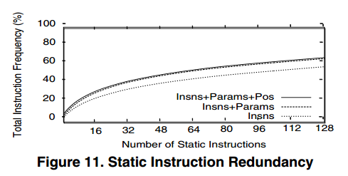
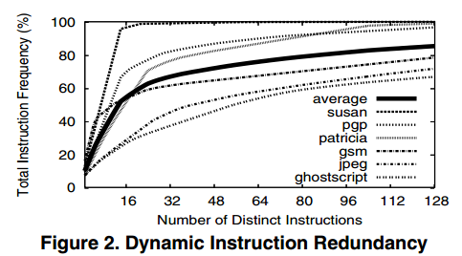
Vision for benefit/performance
Observation - Instruction redundancy (data from MiBench)
Static instruction redundancy – lesser code size
Dynamic instruction redundancy – lesser power
Another observation – redundancy in immediate values
Introduce IMM, which allows a further level of indirection in storing the common immediate values

Slide 5
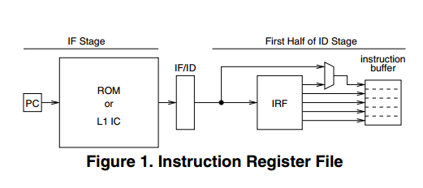
About the IRF and the IMM
The IRF can be integrated into the pipeline either at the end of fetch or at the start of decode
They claim that this doesn’t add any latency
They also claim that the IRF can be modified to hold partially decoded instructions and accessed over multiple cycles.
If the I-cache fetch hits a packed instruction, all the instructions it points to are written in the instruction buffer

Slide 6
Packing of instructions (I)
Modified the MIPS ISA to produce two types of packing - ‘loose’ and ‘tight’
Loose - an IRF instruction pointer is added to a standard instruction eliminating shamt and shifting function
Impact on original instruction – Shamt and lui
For standard MIPS instructions, inst field points to nop in IRF

Slide 7
Packing of instructions (II)
Tight – All fields of the original instruction replaced with pointers
Can support from one to five instructions from the IRF
Nop is used to signal stop of execution to hardware
Loosely packed instructions were designed because often only 1 IRF entry is detected in the code

Slide 8
Parameterization of immediate values
A level of indirection used to decrease code size
Observation - 51.9% of static instructions and 43.4% of the dynamic instructions are I-type instructions
The tightly packed instruction can contain up to two parameterized immediate values
These can point to any entry in the IMM
Any instruction can use any parameter; Opcode + S bit decide this
Every instruction also has a default value

Slide 9
Positional Registers
Based on the observation that a lot of times you’re doing the same thing but using different registers.
E.g imagine a commone code snippet -
load <VarReg>, <imm>
Add <FixReg>, <VarReg>, 5
They use a scheme where registers can be referred as s[<pos>] and u[<pos>]
The code now becomes
load <VarReg>, <imm>
Add <FixReg>, s[0], 5
Increases instruction redundancy and allows denser packing

Slide 10
Special care for branches
Branches can be packed in either the loosely or tightly packed instructions but are packed
Observation - 63.2% of static branches and 39.8% of dynamic branches can be represented with a 5-bit displacement.
So, instead of picking the jump offset from the IMM, it is directly encoded as a parameter.

Slide 11
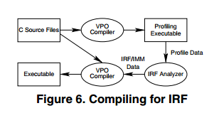
Compiler Modifications
Compiler used is a port of VPO (Very Portable Optimizer) for MIPS
Compilation is done twice on the source program
First compiles and forms a profiling executable
Then analysis tools takes the profile and selects instructions for IRF
After selection, packing is done
Claim - future work could remove the need of profiling by allowing the compiler to approximate dynamic frequencies by looking at loop nesting depths and the entire program CFG

Slide 12
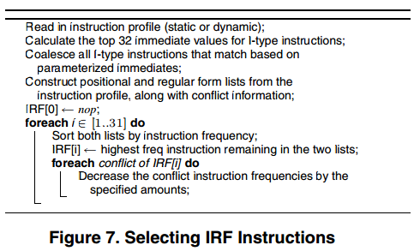
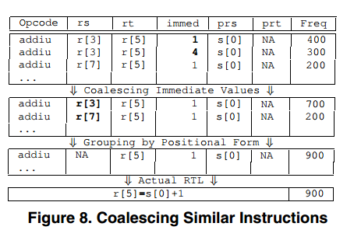
Instruction selection for IRF (I)
Done using a heuristic. A greedy algorithm selects the most frequently occurring instructions as well as default immediate values

Slide 13
Instruction selection for IRF (II)
Some problems–
Commutative operators – Same to SW but different to HW
Compiler always reorders to one format
Equivalent instructions – E.g mov is same as add with 0 or or with 0
Compiler always outputs as addi with zero, for maximum reuse

Slide 14
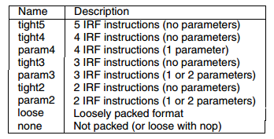
After profiling (the process of packing)
In profiling, all possible instructions are optimized
Now, each instruction is marked as present in IRF, present in IRF with parameterization, or not present in the IRF
In profiling, all possible instructions are optimized
Then packing is done per basic block by a sliding window algorithm
Unused slots are filled with nops
Repeated for each block containing an unpacked branch

Slide 15
An example with everything

Slide 16
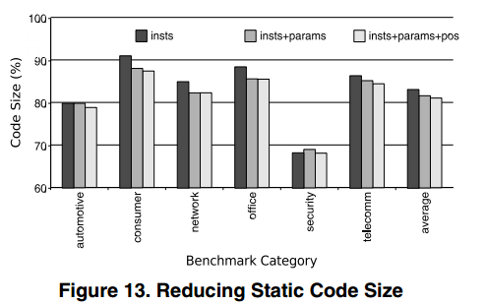
Results (I) –Code Size
Average code size was reduced to –
83.23% with just packing
81.70% with +parameterization
81.09% with +positional registers

Slide 17
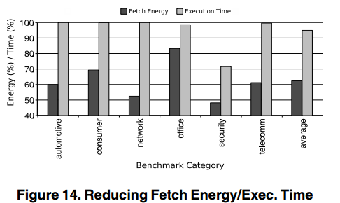
Results (II) - Energy and execution time
An average reduction of 37% in fetch energy
Energy savings come from two sources –
Increased fetch rate ( allowing applications to complete in fewer cycles)
Fewer accesses to the I-cache and memory
Average execution time savings was 5.04%

Slide 18
Results (III)

Slide 19
Issues pointed to by the paper itself
Preservation of state (IRF and IMM) during context switches
Can do this using a routine associated each process
State only needs to be restored, not saved
Addressing of exceptions in the middle of a packed instruction when structural/data hazards prevent all instructions to be simultaneously issued
One or more instructions might have completed
A bitmask of retired instructions can help

Slide 20
Other questions
Not tested on a real pipeline. They’ve just used “Verilog models for simple pipelines”.
Latency issues with the integration of the IRF+IMM in the pipeline.
What are the reasons for difference in redundancy and compression?
What about compilation time? You have to compile twice

Slide 21
Thank You. Questions?

Slide 22
Backup

Slide 23
Comparisons with other similar works
<Table 4.> Methods are -
Microcode -
Procedural abstraction -
L0 -
Echo instruction -
Zero-loop-overhead-buffer -
Codewords/dictionaries -
Dual instruction sets/augmenting instructions -
Heads and tails -
Many of these techniques are complementary to the IRF.

