Slide 1
Dynamic Parallelization of JavaScript Applications Using an Ultra-lightweight Speculation Mechanism
ECE 751, Fall 2015
Peng Liu

Slide 2
Overview
What? JavaScript Engine optimization
How? Light-weight software speculation mechanism
Automatic parallelization of general purpose programs
with Thread-level speculation (TLS)^{[1][2]}
[1] Heine, David, et al. Software and hardware for exploiting speculative parallelism with a multiprocessor. Computer Systems Laboratory, Stanford University, 1997.
[2] Hammond, Lance, Mark Willey, and Kunle Olukotun. Data speculation support for a chip multiprocessor. Vol. 32. No. 5. ACM, 1998.

Slide 3

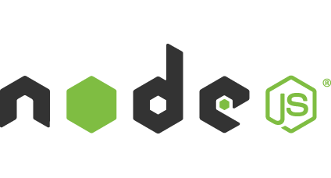
Background
JavaScript is popular on front-end programming (also on server side now)

Slide 4
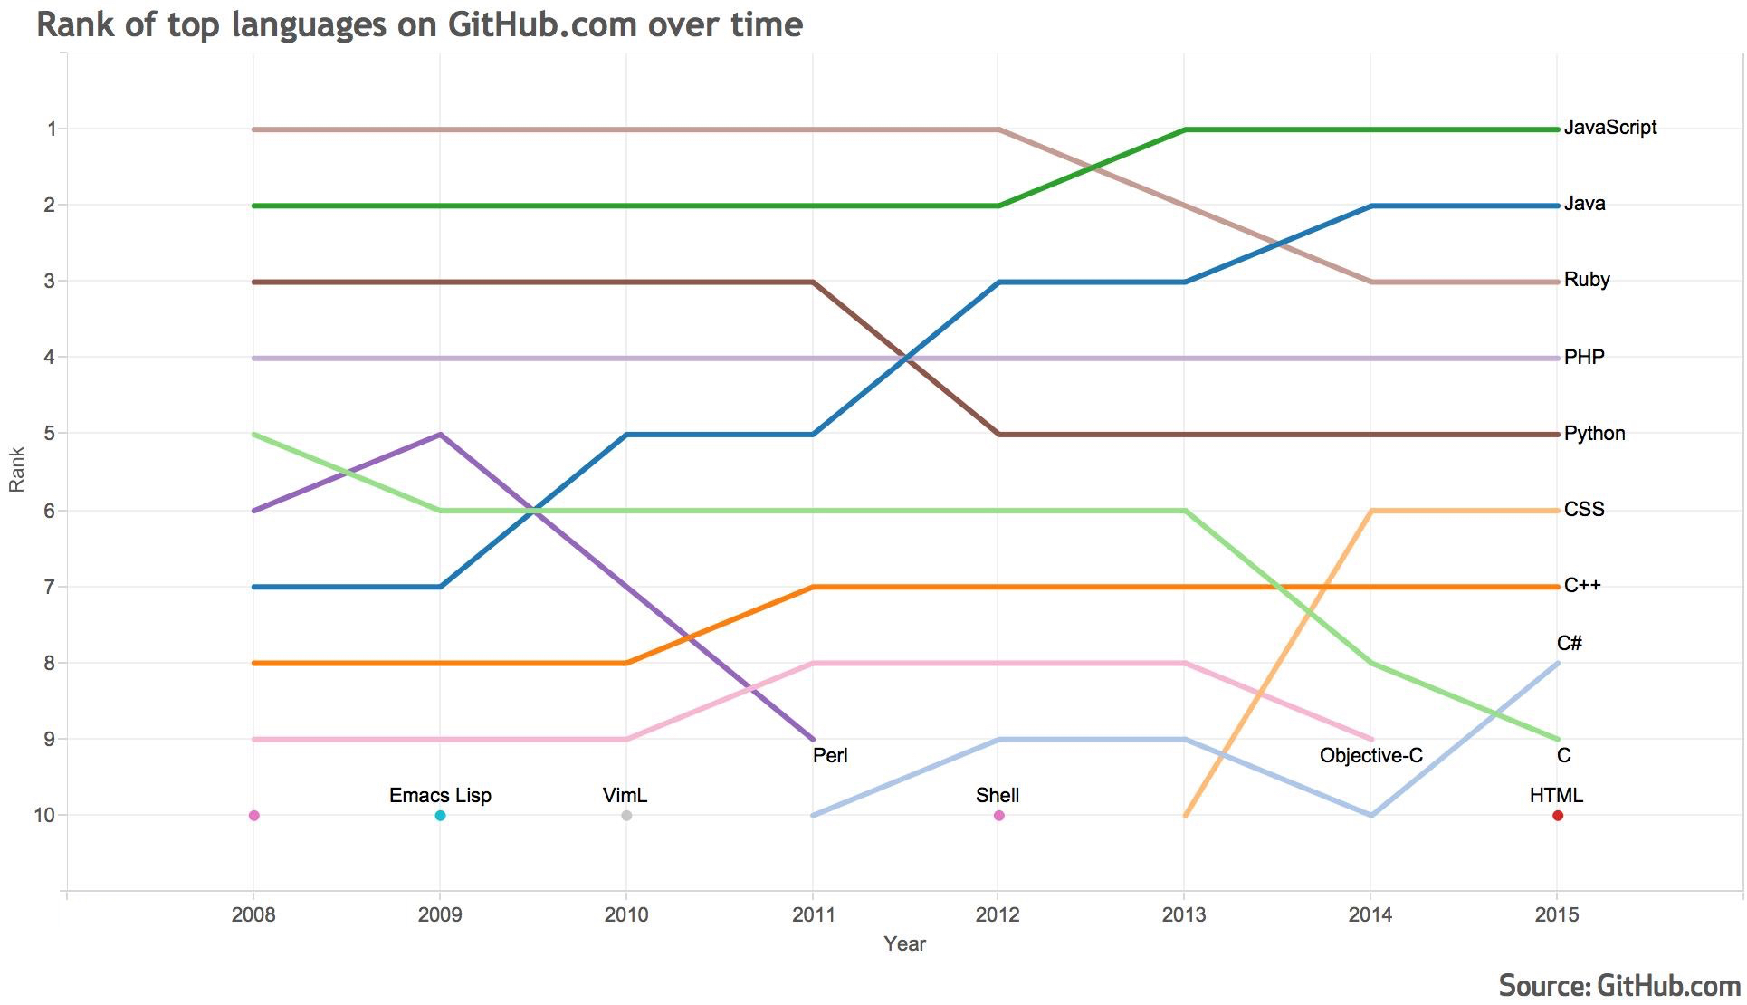
Language Trend on GitHub

Slide 5
Popular JavaScript Engines
Mozilla: SpiderMonkey
Google: V8
WebKit: JavaScript Core (Nitro, SquirrelFish)
Microsoft: Chakra

Slide 6
About TraceMonkey
TraceMonkey was the first JIT compiler written for the JavaScript language
It is a part of SpiderMonkey
It is a tracing JIT, which records control flow and data types during interpreter execution, then optimize the native code.
Now obsolete.

Slide 7
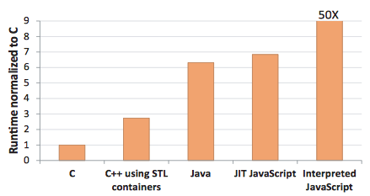
JavaScript Performance
baseline

Slide 8
Two Assumptions
Execution time is dominated by hot loops for compute-intensive applications^{[1]}
Industry benchmarks are representative of JavaScript workloads
[1] Richards, Gregor, et al. "An analysis of the dynamic behavior of JavaScript programs." ACM Sigplan Notices. Vol. 45. No. 6. ACM, 2010.

Slide 9
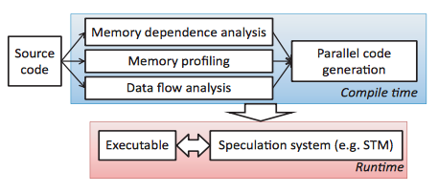
Static Parallelization Overview
Find loops
Speculate execution
Problem: Large overhead for JIT compiler and speculation runtime!

Slide 10
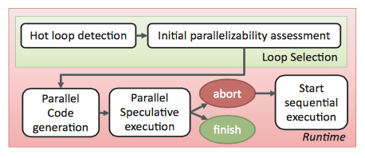
ParaScript Dynamic Parallelization
(1)
(2)
(3)

Slide 11
Loop Selection
Only loops whose iterations is known at runtime are considered
Other restrictions:
  No DOM interactions
  No HTTP request
  No “eval”, “Function”, “setTimeOut”, “setInterval”
Find loops can be easily parallelized

Slide 12
Loop Selection (contd.)
Parallelization Potential Analysis
  Iteration count
  Number of instructions per iteration

Slide 13
Dependence Assessment
Low cost data flow analysis and runtime tests
Detect cross-iteration memory dependences during the first several loop iterations
High accuracy, but not 100% accurate

Slide 14
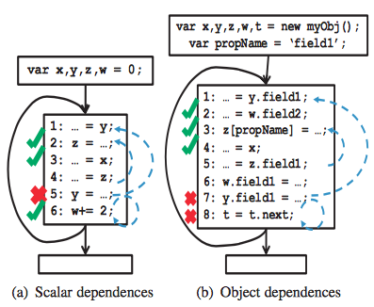
Scalar Dependences
100% accurate

Slide 15
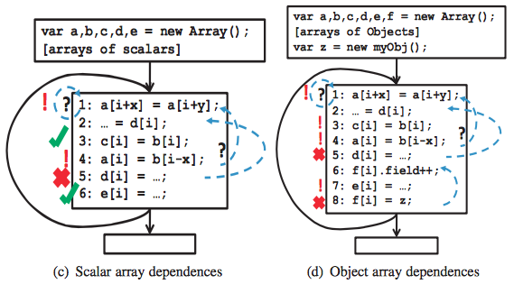
Array Dependences
Not 100% accurate

Slide 16
Parallel Code Generation
original loop Iterations
Chunk 1
Chunk 2
1
2
parallelized iterations in 2 threads
Time saving
Iterations
Loop barrier
Checkpoint
Result cleanup
Conflict check and chunk barrier

Slide 17
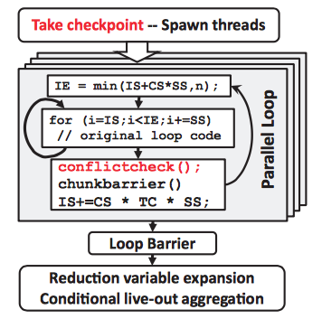
Code Generation Template

Slide 18
Speculation Mechanism
Misspeculation detection
Checkpointing and recovery

Slide 19
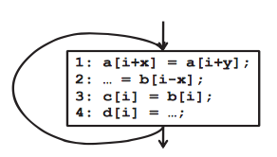
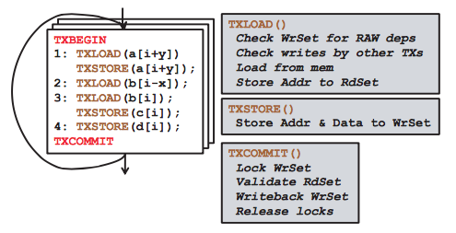
Speculative Parallelization with STM
The overhead posed by STM
may likely overshadow its promise^{[1]}
[1] Cascaval, Calin, et al. "Software transactional memory: Why is it only a research toy?." Queue 6.5 (2008): 40.

Slide 20
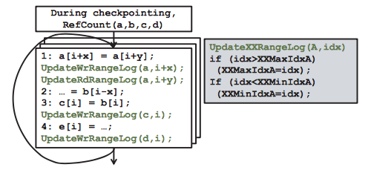
Speculative Parallelization with ParaScript
d

Slide 21
Conflict Detection Using
Reference Counting
For all objects involved with loop arrays
  Add a header (ref_count, array_list)
At checkpointing time, go through all live-in array elements and store them in the state checkpoint. If an array item refers to an object, query the object’s header
  If the object has been referenced by the same array before, conflict detected
  If the object has been referenced by other array before, conflict detected
  If the object has not been reference by other array, record current array and add 1 to the reference count

Slide 22
Conflict Detection Using
Range-based Checks
Each array maintains four local variables
  (rdMinIndex, rdMaxIndex)
  (wrMinIndex, wrMaxIndex)
Every thread records the range of read and write access on the arrays.
In conflictcheck(), checks the read and write access ranges of each array in each thread against write access ranges in all other threads
  Return true if any conflict is found

Slide 23
Instrumenting Array Functions
Array manipulation functions are implemented inside JavaScript engine, and they access a range of items
  pop(), push(), reverse(), etc.

Slide 24
Checkpointing and Recovery
Checkpointing
  Objects are deep-copied (global and local)
Recovery in case of rollback request
  Cross-function speculation is not supported

Slide 25
Checkpointing Optimizations
Selective variable cloning
  Only write accessed variables in the loop need to cloned.
Array clone elimination
  e.g. getImageData(): don’t clone the output of this function, but call this function again with the same parameters.

Slide 26
Evaluation
ParaScript is implemented in SpiderMonkey
SunSpider and a set of filters from Pixastic js image processing library are used for evaluation
Not parallelizable programs were identified early in the dependences assessment stage, so no large performance overhead for them.

Slide 27
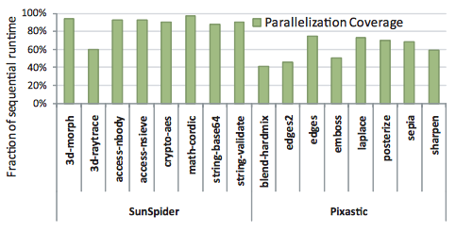
Potential Improvement of Parallelization

Slide 28
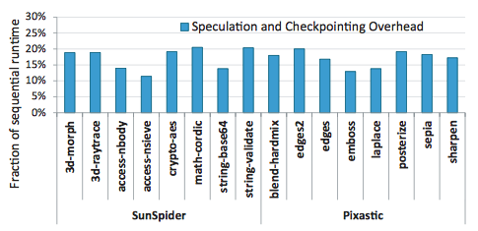
Overhead Analysis

Slide 29
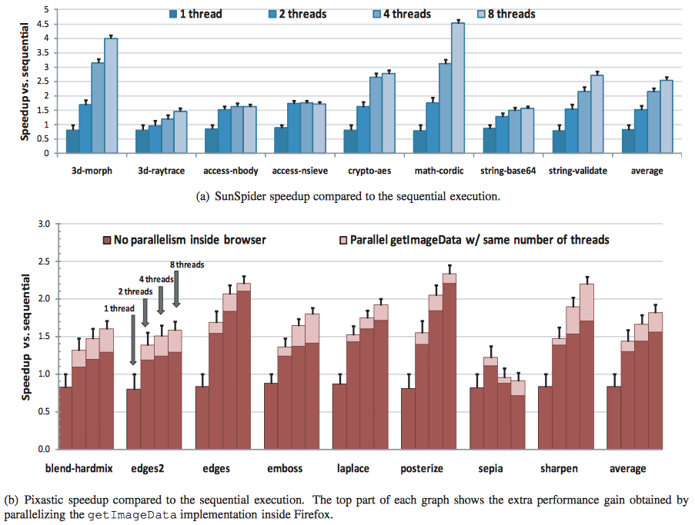
Evaluation Result

Slide 30
Conclusion
For compute-intensive (not interaction-intensive, not memory intensive) JavaScript applications, ParaScript can speedup the execution.

Slide 31
Discussions
Impact on power consumption?
Will ParaScript work on latest JavaScript Engine?
Explicit parallelism
  River Trail (PJS) - a parallel programming model and API for JavaScript^{[1]}
  Web Workders + SharedArrayBuffer^{[2]}
  SIMD.js^{[3]}
[1] Herhut, Stephan, et al. "River trail: a path to parallelism in JavaScript." ACM SIGPLAN Notices. Vol. 48. No. 10. ACM, 2013.
[2] Dave Herman, “The Path to Parallel JavaScript”, https://blog.mozilla.org/javascript/2015/02/26/the-path-to-parallel-javascript/
[3] Benjamin Bouvier, “The state of SIMD.js performance in Firefox”,
https://blog.mozilla.org/javascript/2015/03/10/state-of-simd-js-performance-in-firefox/

Slide 32
Questions?

