Slide 1
WebCore: Architectural Support for Mobile Web Browsing
Zhu, Yuhao, and Vijay Janapa Reddi. "Webcore: architectural support for mobileweb browsing." Proceeding of the 41st annual international symposium on Computer architecuture. IEEE Press, 2014.
Bharadwaj Krishnamurthy
Dept. of Electrical and Computer Engineering
bkrishnamurt@wisc.edu

Slide 2
Motivation
An average user spends about 72 minutes each day using mobile web browser (2010).
The browser performance is critical in a user-driven, highly interactive and latency-sensitive environment.
Battery constraint nature of mobile devices limits the performance of such mobile browsers.
This work aspires to bridge the widening gap between high performance and energy constrained mobile processor designs for Web browsing.

Slide 3
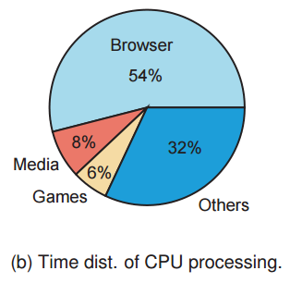
Statistics
Mobile browsers take 63% of the window focus time.
54% of the CPU time is spent mobile web browsing processing.
With the advent of LTE, network latency is not the only bottleneck for mobile web browsing. Processing power of the device is also a critical factor.
Based on a 2010 survey, mobile users prefer Web browsers over native applications for important application domains such as e-commerce and electronic news feeds.
71% of the mobile Web users expect website performance to be not worse than desktop experience(up from 58% in 2009).
Notes:
- Based on study conducted by the industry research partner of the authors.

Slide 4
Browser Engine Kernels
Notes:
Three major data structures are involved in this. DOM tree consists of all the node information and how various methods interact with them.
CSS style rules is like an excel sheet describing each rule and associating them with the corresponding descriptor.
While the DOM tree is being constructed, the browser constructs another tree, the render tree. This tree is of visual elements in the order in which they will be displayed. It is the visual representation of the document. The purpose of this tree is to enable painting the contents in their correct order.
Refer: http://www.html5rocks.com/en/tutorials/internals/howbrowserswork/
To get some detailed idea on DOM tree:
http://www.w3.org/TR/DOM-Level-2-Core/introduction.html

Slide 5
Data Structures
Notes:
Reference: https://developers.google.com/web/fundamentals/performance/critical-rendering-path/render-tree-construction?hl=en

Slide 6
Browser Engine Kernels
Browser engine is composed of 4 kernels:
Dom Kernel
Constructs dom tree from the HTML files.
Extracts CSS style rules from CSS files.
Style Kernel
Computes webpage’s style information from DOM tree and CSS style rules and stores the result in render tree.
Layout Kernel
Traverses render tree and computes <x,y> coordinate of each element and stores it back in render tree.
Render Kernel
Examines the render tree to decide z-ordering of each visible element.
Notes:
Three major data structures are involved in this. DOM tree consists of all the node information and how various methods interact with them.
CSS style rules is like an excel sheet describing each rule and associating them with the corresponding descriptor.
While the DOM tree is being constructed, the browser constructs another tree, the render tree. This tree is of visual elements in the order in which they will be displayed. It is the visual representation of the document. The purpose of this tree is to enable painting the contents in their correct order.
Refer: http://www.html5rocks.com/en/tutorials/internals/howbrowserswork/
To get some detailed idea on DOM tree:
http://www.w3.org/TR/DOM-Level-2-Core/introduction.html

Slide 7
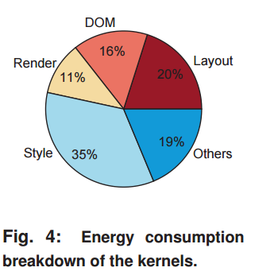
Browser Engine Kernels
Data measured on Cortex- A15 processor in Exynos 5410 SoC.
All 4 kernel consumes over 75% of the execution time. Style kernel takes the maximum time out of the four.
Browser engine consumes most of the energy. Style kernel consumes 35% of the total energy.
The work focusses only on optimizing Browser Engine and javascript engine optimizations are out of scope of this work.

Slide 8
Proposal
WebCore – a general purpose core customized and specialized for mobile web browsing workload.
Tries to strike balance between fully software on a general purpose hardware acceleration and fully hardware specialized approach.
Two optimization units proposed are:
Style Resolution Unit(SRU)
Software-Managed Browser Engine Cache.
Notes:
SRU- Software assisted hardware accelerator for the style resolution kernel.
Browser Engine Cache – software managed L0 cache that exploits unique data locality of the browser engine’s principal data structures.

Slide 9
Experimental setup
Principal Component Analysis(PCA) - a statistical method that reduces the number of inputs without losing generality.
24 websites are chosen. They cover 70% of the variance across all of the original 10,000 webpages.
Marss86 simulator – cycle accurate simulator generally used to model network and OS activity.
Performance counters from Marss86 are fed into McPAT for power estimation.
Notes:
PCA – Principal Component Analysis. A statistical method that reduces the number of inputs without losing the generality.
PC1 – IPC(Microarchitectural features) PC2- No. of DOM tree nodes.

Slide 10
In-order vs Out-of-order
Out of Order design offers much larger performance range when compared to In- order designs.
Out of Order design is flat around 4 seconds load time. Indicates lower marginal energy cost.
At point P1, In-order design has larger caches than out of order design.
In spite of larger cache, In order performs only as good as Out-of-Order core. Thus, it can be concluded that the execution core inhibits better performance than out-of-order core.
Beyond P1 (load time < 4seconds), In-order design shifts towards 4-wide issue and larger L2 Cache.

Slide 11
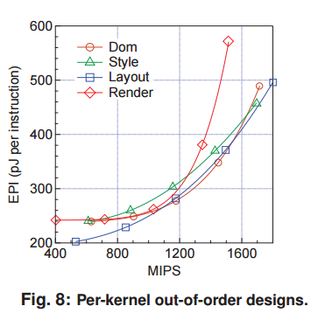
In-Order vs Out-of-order
Kernel trade-offs are sharper in the in-order design.
At 800 MIPS, the EPI difference between style and layout kernel is nearly 300pJ per instruction. It is only 50pJ in out of order kernel.
Since the kernels like Dom and Style do not scale gracefully, they will become bottleneck when designing for higher performance.
For out-of-order design, at 1200 MIPS, all the kernels have similar EPI and similar microarchitecture features.

Slide 12
Out-of-order Design
Point P1 is optimized for minimal energy consumption
Point P2 is optimized for minimal energy consumption at 1600 MIPS.
Large L1 instruction cache size and Physical registers to alleviate the pressure on instruction fetching and dispatching.
Data feeding is critical when optimizing for performance. Hence 64KB data cache at P2.
Larger L1 cache is favorable for energy optimization than having larger L2 cache.
Notes:
- Larger L1 cache size and physical register compared to current design ( ~2012??) snapdragon 810 offers 128 physical registers(32 bit). 80KiB L1 cache. P1 is well within today’s architecture. P2 is a bit of overstretch on register instruction cache. Reference : http://www.anandtech.com/show/8718/the-samsung-galaxy-note-4-exynos-review/5

Slide 13
CUSTOMIZED CORES

Slide 14
Style Resolution Unit
Accelerates the style kernel, which takes about one-third of the execution time and energy consumption of webpage loading.
Style kernel has two phases:
Matching Phase
Applying Phase
Applying Phase has two inherent parallelism:
Rule-Level parallelism
Property-Level parallelism.
Notes:
Matching phase – Each node in the DOM tree should be matched to corresponding style in the CSS style sheet.
Applying Phase – The applying phase takes in a set of CSS rules as inputs and computes property’s final values(RGB values) and stores them back in the render tree.
RLP – Each rule must be applied in correct cascading order. Higher-priority rule overrides Low priority rules. Can be parallelized by speculative execution.
PLP – Each rule has set of properties that can be applied in parallel. Conflicts are resolved during the conflict resolution phase.

Slide 15
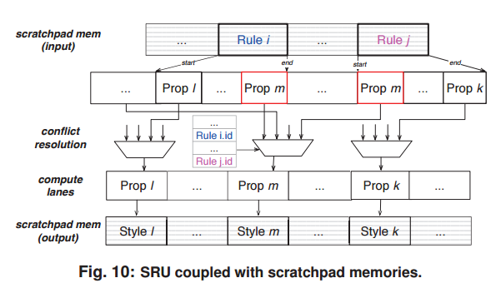
Style Resolution Unit
SRU is tightly coupled to scratchpad, which reduces data communication pressure by bringing operands closer to the SRU.
90% of the time, RLP is below or equal to 4. Thus scratchpad memories store up to 4 styles.
32 CSS properties cover about 70% of the commonly used properties.
Considering these design points, size of input and output scratchpad memories is 1KB
SRU avoids recursions and loops with unknown iterations.
In this study, 72.4% of style rules in all the benchmarked sites can utilize SRU.
Notes:
Each lane in SRU is computes 1 rule. Two rules i and j are being evaluated. “i” has property l amd m, j has property m and k. l and k can be executed in parallel without issues. Prop m requires conflict resolution, which is resolved based on Priorities of Rule I and J.
Is it 4 Rules or 4 styles that can be stored? 4 Rules makes more sense.
Invoked from software style_Apply(Id).

Slide 16
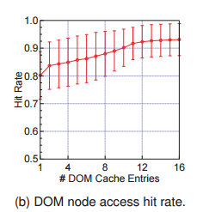
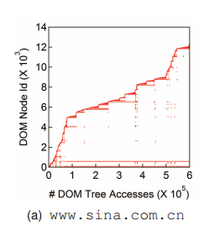
Browser Engine Cache
90% of the DOM tree nodes are reused at least thrice. This is nearly same as the hit rate with a large data cache.
Small and energy efficient L0 cache whose design is motivated by the unique access patterns to the DOM tree and Render tree
The data is physically stored in the hardware and managed by software.
Simple FIFO scheme will work, because browser operates on one DOM node heavily and then moves ahead.
DOM Cache - 4-Entry fully associative cache achieves about 85% hit rate.
Render Cache- 2 Entries cache with average hit rate of 90%
Notes:
Problem with the traditional cache is that they are power hungry and huge. P2 design requires 64KB data cache and has hit rate of 93%. But it consumes one-forth of the total energy consumption.
Invoked using software. DOM_LD(Id, attr) DOM_ST(ID, Attr).

Slide 17
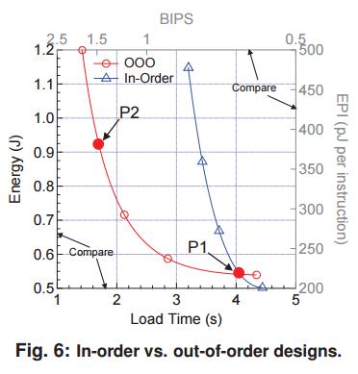
Evaluation
Three Designs are being evaluated:
D1 – Energy Conscious design (Point P1)
1 issue out of order, 72KB L1 Cache.
128 physical registers and 128 ROB entries.
D2 – Performance Oriented Design (Point P2)
3 issue out of order, 192 KB L1 cache.
128 ROB Entries and 140 Physical registers.
D3 – Current out-of-order mobile processor
3 issue out of order core, 32KB L1 Cache.
1MB 16 cycle latency L2 Cache.
140 physical registers and 104 ROB entries.

Slide 18
Evaluation
Area Overhead:
SRU logic and the memory structures is 0.59mm².
Power Overhead
SRU logic introduces 70mW total power.
Browser Engine Cache adds 7.2mW and SRU scratchpad adds 2.4mW.
Timing Overhead
Both SRU scratchpad memory and Browser cache can be accessed in one cycle.
SRU logic latency is 16 cycles under 1.6GHz.
Software Overhead
Mainly involves cache management and SRU compensation code creation.

Slide 19
Evaluation - SRU
Average Performance improvement of 35.6% for D2, 10% for D3 and 8.4% of D1 designs.
Average Energy savings of 13.4% for D2, 10.3% for D3 and 11.6% for D1 designs.
Oracle gain is better for Desktop webpages in comparison to Mobile webpages.
SRU that is customized for mobile webpages could potentially be much smaller.

Slide 20
Evaluation – Browser Engine Cache
On an average, D2 achieves 14.4% energy savings, D1 achieves 5.9% and D3 achieves 9.3%.
Energy savings is directly proportional to Cache Access.
Performance takes a hit due to software management overhead. D2 slows down by 2.5%, D1 by 1.6% and D3 by 2.1%.
Slower performance amortizes the software overhead and hence lower performance penalty due to browser cache.

Slide 21
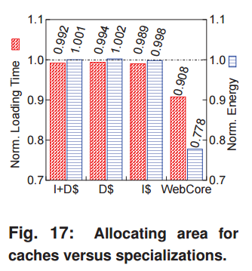
Combined Evaluation
Average performance improvement for D1 is 6.9%, D2 is 9.2% and D3 is 8.1%.
Energy improvements are 16.6% for D1, 22.2% for D2 and 18.4% for D3.
Each design moves slightly right in Fig16, indicating higher load time, when Browser Cache is added to the design. It is due to software overhead in managing the cache.
For similar area overhead by adding more Cache to the existing design, WebCore achieves significant Energy improvements and Load Time reduction.
Notes:
- Each design moves slightly to the right(higher load time) because of the software overheads due to Cache design.

Slide 22
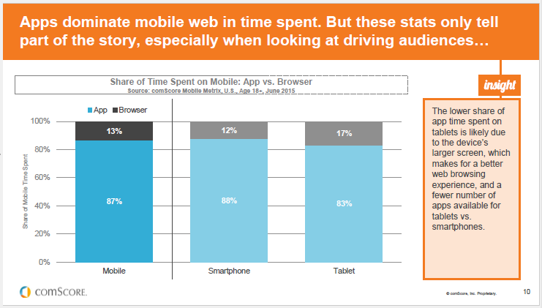
Discussion
Is this design still relevant?
Notes:
- The data above is from ComScore’s 2015 mobile App report.

Slide 23
Discussion
Notes:
Time spent on digital media itself rose from 2 hours 22 minutes in 2013 to 2 hours 42 minutes in 2014.
Reference[1] : http://flurrymobile.tumblr.com/post/115191864580/apps-solidify-leadership-six-years-into-the-mobile
Reference[2] : http://marketingland.com/apps-eat-digital-media-time-with-top-3-capturing-80-percent-143555
According to this report in 2014, An average user spends 2 hours 19 minutes in Apps and just 22 minutes in web browsers.

Slide 24
Backup slides

Slide 25
PC1 vs PC2

Slide 26
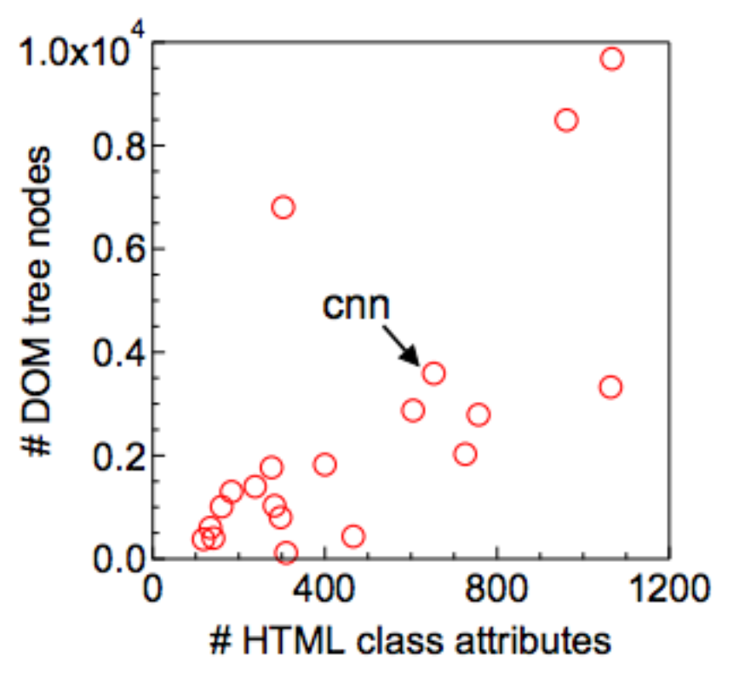
Choosing cnn for benchmarks

