Slide 1
Into the Wild: Studying Real User Activity Patterns to Guide Power Optimizations for Mobile Architectures
Alex Shye, Benjamin Scholbrock, Gokhan Memik
Northwestern University
(Micro’09)

Slide 2
Motivation
Need for Optimization of Power Consumption in a Mobile Architecture.
Limited Battery Life.
Very limited study on patterns, properties and study of user activity – The ultimate Workload

Slide 3
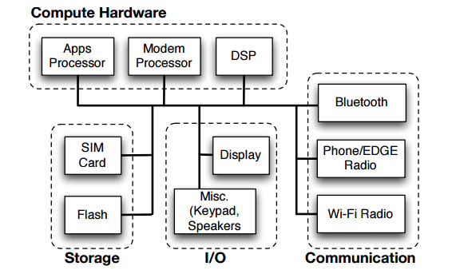
Experimental setup
Mobile Architecture : HTC Dream ADP1 Phone (Android)
Android OS 1.0 system image
Android Platform based on Linux 2.6.25 Kernel
Rooted & Sim-unlocked Version
Dalvik Virtual Machine supported Framework
Qualcomm MSM7201A chipset
Uses 528 MHz ARM 11 apps processor
Supports Dynamic Frequency Scaling (124 MHz, 246 MHz, and 384 MHz)

Slide 4
Collection of User Activity :
Use of a Logger application : Stores System performance Metrics + User Activity
No Special Hardware of Software needed.
Checks Network Connection, Collects User activity Information and Sends back to Server for analysis
Unintrusive app
Consumes minimal Battery/System Resources.
Anonymity Secured
Analysis used data from 20 biggest loggers ~ 250 days of real user activity
Only certain time intervals are significant ~ 145 days of real user activity

Slide 5
Power model
Two power states :
1. Active State :
Application processor in Operation .
All the time when Screen On
System Wake Lock + Screen Off
Typical Power Consumption ~ 300 – 2000 mW
2. Idle State :
Low Power Sleep Mode
Application Proceesor not operational
Modem Processor still operational
Also called standby Mode
Typical Power Consumption ~ 70mW

Slide 6
Parameters chosen :
CPU : Application Processor , Responsible for DFS.
Screen : A. Offset – Whether the screen is On
B. Screen Brightness
3. Call : Measures time spent on ringing and actual phone call
4. EDGE : EDGE Network Power Consumption (When EDGE has Traffic + Traffic Measurement)
5. Wifi : Wifi Network Power Consumption (When Wifi is enabled + Wifi Traffic)
6. SD Card : Number of sectors transferred to/fro Micro SD card.
DSP : To handle multimedia file execution
System : Miscellaneous Power consuming factor

Slide 7
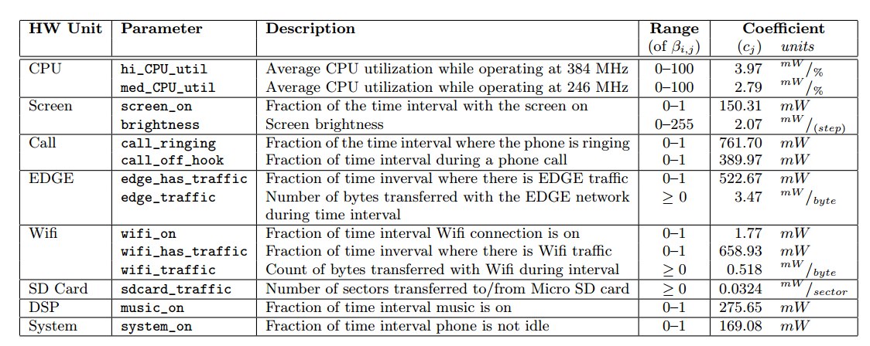
Parameters used for linear regression in our power estimation model

Slide 8
Building Estimation Model
Step 1 : Collect statistics and Power Consumption about the parameters described before.
Step 2 : Training : Use Input from Step 1 to feed to R-tool to build linear regression Model (cj for each parameter)
Step 3 : Can Predict Power now!
Total Power :
For ‘m’ samples :

Slide 9
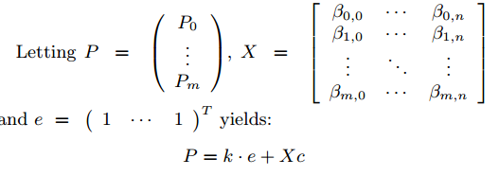
Building Estimation Model
Total Energy with Sampling period ts:
Overall Power Consumption (inclusive of Idle state : )

Slide 10
Power model validation
Collect additional logs (System measurement and Power)on separate device as well
Log notation : 1. Runi_Unit - Specific Hardware
2. Scenarioi – Mix of hardware components involved
Absolute relative Error for sample i :
Relative Error :
Even though two devices are used : Median relative Error is observed : <0.1%

Slide 11
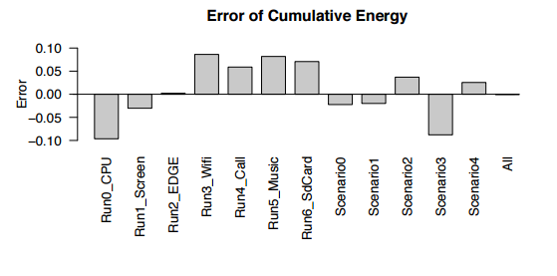

Slide 12
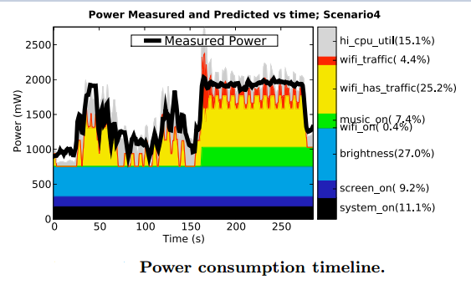
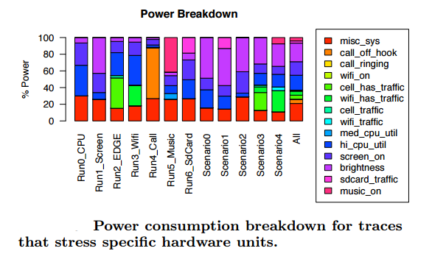
Per component power consumption

Slide 13
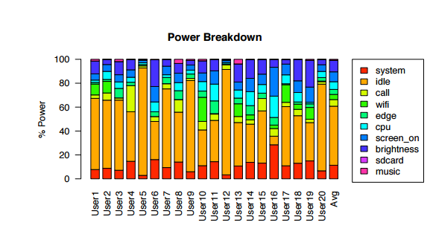
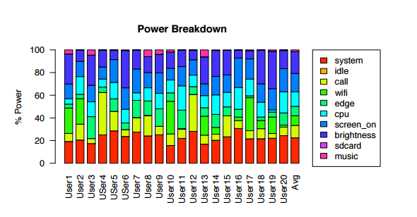
Studying the user activity
Power breakdown including idle time
Power breakdown excluding idle time

Slide 14
Some Useful Data :
Idle state averages to 49.3%, Active State to 50.3%
Biggest three consumers in Active Stage :
Screen Brightness : 19.2%
Screen On : 16.3%
CPU : 12.7%

Slide 15
Screen Usage Data :
Screen Interval : Continuous interval of time when screen is on.
Screen Duration : ∑ Screen Intervals
Inference : Most useful to optimize for Power during long screen Intervals

Slide 16
Optimizations
Change Blindness :
Humans not capable of detecting dynamic changes in surroundings if,
Their attention is elswhere and
The changes are gradual
An interesting video : https://www.youtube.com/watch?v=0grANlx7y2E
How to use Change Blindness :
Reduce Screen Brightness
Reduce CPU frequency
Do it Slowly!

Slide 18
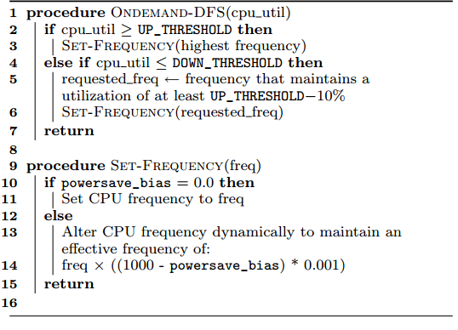
Cpu optimization SCheme
Existing Dynamic Frequency Scaling :
A. If Apps processor Active + Screen On : Use 384MHz
B. If Apps processor Active + Screen Off : Use 246MHz
OnDemand DFS :
A. Powersave_bias : Range 0 to 1000
B. Frequency change interval : 0.1%
C. Increase Powersave_bias by 30 per 4 secs
Till 300 is reached
D. If Screen is turned off : Reset to Zero
E. So reaches 70% of frequency requested
in 40 seconds

Slide 19
Screen Optimization Scheme
When Screen On, start the timer
After every 3 seconds reduce brightness by 7 units
Range of Brightness : 0 – 255
Continue till brightness reaches 60% of user-set
When Screen turned off : Set brightness back to user-set
No reduction of power in small intervals since the brightness decrease is slow.
User will not notice the decrease in brightness.

Slide 20
Results
Screen and CPU Ramp : Reducing Brightness and frequency based on Optimizations
Screen and CPU Drop : Wait 30 seconds, then move to the value eventually Ramp scheme reaches abruptly
Power savings of 10.6% overall
Total system power savings for each of the optimizations as estimated by our power model

Slide 21
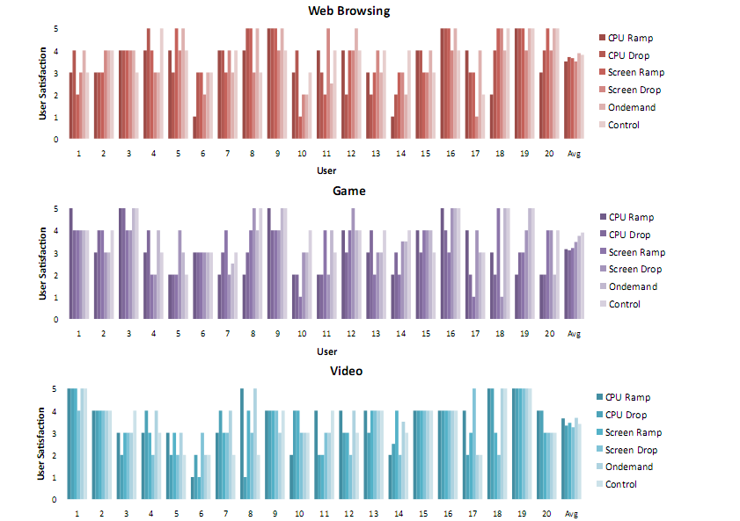
Results oF user Experience

Slide 22
User Feedback
Average user satisfaction of 4 on 5 (scale of 1-5), also depends on the application
Once application becomes jittery, doesn’t matter if freq decrease is via CPU Drop or CPU romp.
If 8 out of 20 could detect brightness drop in Screen Drop, Only 1 in 20 could do for Screen Romp
15 of 20 willing to use architecture with these optimizations
5 of 20 prefer application dependent optimization.

Slide 23
Related/future works
Use performance counter and (or) Communication measurements to estimate power consumption
Power consumption of OS
Software implemented power estimation without any specialized hardware – performance counter or Software – hooks into OS
Screen optimization with OLED technology, to dim certain parts of screen.
Scale to huge number of users now
With more complex apps in 2015, study could give more deeper insights into user activity

Slide 24
Thanks!!

