Slide 1
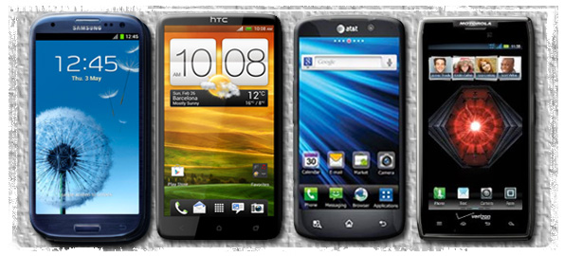
ECE 751- Cells: A Virtual Mobile Smartphone Architecture
Mikkel Nielsen mnielsen3@wisc.edu

Slide 2
What are Virtual Machines?
Multiple OS on the same piece of hardware
Managed by Hypervisor OS
Used in Server and Desktop Space

Slide 3
Applying Virtual Machines to Smartphone's
Challenges:
High overhead to run on a resource constrained phone
Running additional OS to manage VMs is expensive (Hypervisor)
Requires large modifications to kernel-level and user-level software to allow access to phone devices( Screen, Microphone, Camera).

Slide 4
Cells- Idea
http://sigops.org/sosp/sosp11/current/2011-Cascais/13-andrus-slides.pdf

Slide 5
Usage Model- Foreground-Background
One VP has exclusive access to the screen and full access to other hardware.
Other VPs:
are isolated ,
run in background,
share phone devices with foreground

Slide 6
Security- Isolation between VPs
http://sigops.org/sosp/sosp11/current/2011-Cascais/13-andrus-slides.pdf

Slide 7
Architecture - Device Namespaces

Slide 8
Device Access
Want: Device access to be aware of multiple VPs, isolated device namespaces
Kernel Virtualization:
Device driver wrappers
Device subsystem namespace aware.
Driver aware of namespaces

Slide 9
Access Restrictions
https://wiki.cc.gatech.edu/systems/images/0/09/Jang_cells_ltrgf11.pdf

Slide 10
Scalability
Shared read-only file system saves resources between VPs
Union each VPs writeable files with read only file system
Low memory killer- destroys background processes, keeps solution lightweight

Slide 11
Graphics
http://sigops.org/sosp/sosp11/current/2011-Cascais/13-andrus-slides.pdf

Slide 12
GPU Driver
Remap linear addresses to physical addresses
Reinitialize GPU/ ignore re-initialization attempts from background VPs
Ignore power management and misc. hardware state updates

Slide 13
Power Management
Virtual Support of Android power management features.
Low Power Mode
Early Suspend
Wake Locks

Slide 14
Providing isolated telephone access to multiple VPs

Slide 15
Network
Wireless configuration decoupled from network interfaces
Replaced by configuration proxy in Root namespace
Some background VP network requests are ignored

Slide 16
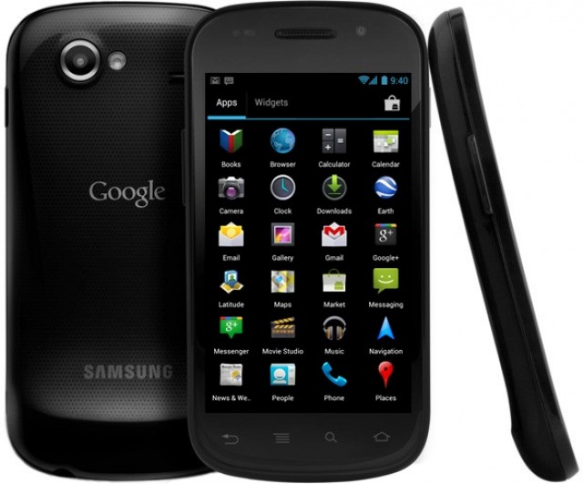
Experiment Methodology
- Android Nexus 1, S
- Up to 5 VPs per phone
Benchmarks:
CPU <Linpack>
Graphics<Neocore>
Storage<Quadrant>
Web Browsing<Sun Spider>
Networking< Custom Wifi Test>

Slide 17
http://sigops.org/sosp/sosp11/current/2011-Cascais/13-andrus-slides.pdf

Slide 18
Results

Slide 19
Conclusion
Cells is a lightweight virtualization architecture for smartphones.
Foreground-background model allows for low overhead virtualization for resource constrained phone platform.
Supports shared device functionality with minimal modification to user and kernel space

Slide 20
References
Jeremy Andrus, Christoffer Dall, Alexander Van't Hof, Oren Laadan, and Jason Nieh. 2011. Cells: a virtual mobile smartphone architecture. In Proceedings of the Twenty-Third ACM Symposium on Operating Systems Principles (SOSP '11). ACM, New York, NY, USA, 173-187. URL: http://doi.acm.org/10.1145/2043556.2043574
Jeremy Andrus, Alexander Van't Hof, Naser AlDuaij, Christoffer Dall, Nicolas Viennot, and Jason Nieh. 2014. Cider: native execution of iOS apps on android. In Proceedings of the 19th international conference on Architectural support for programming languages and operating systems (ASPLOS '14). ACM, New York, NY, USA, 367-382. DOI=http://dx.doi.org/10.1145/2541940.2541972
Asim Kadav and Michael M. Swift. 2012. Understanding modern device drivers. In Proceedings of the seventeenth international conference on Architectural Support for Programming Languages and Operating Systems (ASPLOS XVII). ACM, New York, NY, USA, 87-98. DOI=http://dx.doi.org/10.1145/2150976.2150987
Ken Barr, Prashanth Bungale, Stephen Deasy, Viktor Gyuris, Perry Hung, Craig Newell, Harvey Tuch, and Bruno Zoppis. 2010. The VMware mobile virtualization platform: is that a hypervisor in your pocket?. SIGOPS Oper. Syst. Rev. 44, 4 (December 2010), 124-135. DOI=http://dx.doi.org/10.1145/1899928.1899945
Charles P. Wright, Jay Dave, Puja Gupta, Harikesavan Krishnan, David P. Quigley, Erez Zadok, and Mohammad Nayyer Zubair. 2006. Versatility and Unix semantics in namespace unification. Trans. Storage 2, 1 (February 2006), 74-105. DOI=http://dx.doi.org/10.1145/1138041.1138045
Alexander Van't Hof, Hani Jamjoom, Jason Nieh, and Dan Williams. 2015. Flux: multi-surface computing in Android. In Proceedings of the Tenth European Conference on Computer Systems (EuroSys '15). ACM, New York, NY, USA, , Article 24 , 17 pages. DOI=http://dx.doi.org/10.1145/2741948.2741955
Nairan Zhang, Parameswaran Ramanathan, Kyu-Han Kim, and Sujata Banerjee. 2012. PowerVisor: a battery virtualization scheme for smartphones. In Proceedings of the third ACM workshop on Mobile cloud computing and services (MCS '12). ACM, New York, NY, USA, 37-44. DOI=http://dx.doi.org/10.1145/2307849.2307859
http://www.air-watch.com/

