Slide 1
Single-Chip Heterogeneous Computing:
Does the Future Include Custom Logic, FPGAs, and GPGPUs?
Wasim Shaikh
Date: 10/29/2015

Slide 2
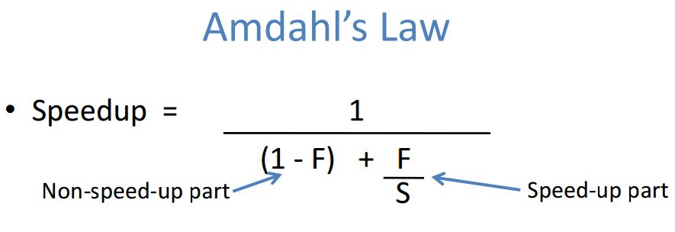
Multiprocessor Era
Why Multiprocessor?
  Performance gains while parallel processing
  Recall Moore`s law.
  Better technology to support more transistors per chip.
  Many cores but the performance of each core is still the same.
Notes:
As you all know if you have a parallelizable set of instructions in your program and if you run them on multiple processing units simultaneously then you can increase the throughput.

Slide 3
Why this study
Energy efficiency
Off chip bandwidths
Need a better design for managing multiple cores.
Solutions:
Same strength multiple cores
Custom logic design
GPGPU SIMD engine
Field programmable gate array
Notes:
Till now focus was on performance but power is a first order consideration now.

Slide 4
Chip Models
Notes:
a. consisting of identical high-performance microprocessors coupled with private and lower-level shared Caches
b. an asymmetric multicore consists of a single fast microprocessor for sequential execution, while nearby minimally sized baseline cores
c. illustrates a hypothetical heterogeneous multicore containing a conventional, sequential microprocessorcoupled with a sea of U-cores

Slide 5
Prior work
work done by Prof. Hill and Marty
  M. D. Hill et al., “Amdahl’s Law in the Multicore Era,” Computer, vol. 41, pp. 33–38, 2008.
Conventional Cores -> Serial section of code
Unconventional Cores -> Parallel section of code
Extension on modelling Unconventional cores (U-cores)
This work is targeting less obvious relationship between power and performance for U core multiprocessors

Slide 9
Focus of the study
Modelling unconventional U-cores.
Identify important trends in U-cores design
Initial observations:
  Custom logic -> very efficient but costly
  GPGPU -> promising due to SIMD vector operations
  FPGA -> great flexibility at the cost of area and power

Slide 10
What they used for modelling
Need a cost model that includes power budget.
  Power model for each BCE.
  Power model for sequential core.
Power-seq (perf ) = perf^α as per E. Grochowski et al., “Energy per Instruction Trends in Intel Microprocessors,”in Technology@Intel Magazine, 2006.
  where α was estimated to be 1.75.
  Pollack’s Law perf = sqrt(r)
Hence
  Power-seq (perf ) = sqrt(r)^α
Notes:
Assumption: Unused cores can be powered off entirely.

Slide 11
Assumption for the model
Clock frequency does not increase.
Parallel sections are perfectly parallelizable
Serial sections are perfectly serial
No overhead in synchronizing memories
Power hungry sequential processor could be turned off completely without any static power consumption

Slide 12
New Speedup

Slide 13
Cost function for Bandwidth
Defined in terms of BCE compulsory bandwidth
  Compulsory bandwidth: Working bandwidth of a BCE when entire kernel is in on-chip memory.
Scales linearly w.r.t performance.

Slide 14
Modelling U-cores for power and Bandwidth
Two new parameters: μ, φ
μ: relative performance relative to BCE core.
φ: relative bandwidth compared to BCE compulsory bandwidth
Can characterize any design space for U-cores.
a U-core with μ > 1 and f = φ : Accelerator
Similarly, μ = 1 but f < φ : Same performance with less power

Slide 16
Notes:
They modelled the circuit later to evaluate mu and phi

Slide 17
Calibration Methodology
To calibrate μ, φ
Devices used:
  Core i7-960 – 4 way multicore
  GTX285, GTX480 : Programmable Nvidia GPU
  R5870 : Similar capable GPU from Advanced Micro Devices
  Virtex-6 LX760 : FPGA from Xillinx
  65nm commercial synthesis for custom logic
Workloads:
  Matrix-Matrix multiplication (MMM): high arithmetic intensity and simple memory
  Fast Fourier Transform (FFT): possesses complex dataflow and memory requirements
  Black-Scholes (BS): rich mixture of arithmetic operators.
Notes:
They measure power as well but not mentioning here.
For the Core i7, we measured the EATX12V power rail,
which only supplies power to the cores and private L1/L2
caches [64].
a significant
amount of effort was placed into measuring GPU power
consumption, due to the numerous non-computing related
components (e.g., RAM).

Slide 18
Results:

Slide 19
Results:

Slide 21
On Equal Area basis,
3.4 performance Improvement at 0.7X power relative to BCE

Slide 22
Notes:
Actual die area is 576 mm2
100 W for core only not for computing parts
180 GB/s optimistic based on GTX480 177 GB/s

Slide 23
Reevaluate U-cores
ITRS roadmap poses major challenge.
Three questions need to be answered:
  Is it good to go with Heterogeneous U cores under these bandwidth and power limitation?
  Is the custom logic always the best?
  Can our conclusion change if first order motive is Energy efficiency and not performance?

Slide 32
Useful links
Prof. Hill and his team has developed a java based online tool to change parameters of cost function of these models and regenerate resulting speedup.
Lets take a look at this tool,
http://research.cs.wisc.edu/multifacet/amdahl/

Slide 33
Thank You

Slide 34
Recent Work in the domain
Paul, S.; Krishna, A.; Wenchao Qian; Karam, R.; Bhunia, S. "MAHA: An Energy-Efficient Malleable Hardware Accelerator for Data-Intensive Applications", Very Large Scale Integration (VLSI) Systems, IEEE Transactions on, On page(s): 1005 - 1016 Volume: 23, Issue: 6, June 2015Abstract | Full Text: PDF (5386KB)
Polig, R.; Atasu, K.; Chiticariu, L.; Hagleitner, C.; Hofstee, H.P.; Reiss, F.R.; Zhu, H.; Sitaridi, E. "Giving Text Analytics a Boost", Micro, IEEE, On page(s): 6 - 14 Volume: 34, Issue: 4, July-Aug. 2014
Nilakantan, S.; Battle, S.; Hempstead, M. "Metrics for Early-Stage Modeling of Many-Accelerator Architectures", Computer Architecture Letters, On page(s): 25 - 28 Volume: 12, Issue: 1, January-June 2013
Total citations till now: 45

Slide 35
Backup Slides – Varying f for FFT workload
Notes:
Bandwidth limitation 180 GB/s

Slide 36
Backup Slides – Varying f for FFT workload

Slide 37
Backup Slides – Varying f for FFT workload
Notes:
Bandwidth limitation relaxed

Slide 38
Backup Slides – Varying f for FFT workload

