Slide 1
Exploring the tradeoffs between programmability and efficiency in Data-parallel accelerators
Yunsup Lee, Rimas Avizienis, Alex Bishara, Richard Xia, Derek Lockhart,
Christopher Batten, and Krste Asanovic
ISCA ’11

Slide 2
Motivation
Need for data-parallelism in various applications
Trend of offloading DLP tasks to accelerators
Capability to handle wider variety of DLP
Need for programmability
Tradeoff with implementation efficiency

Slide 3
In This Paper…
Study of five Architectural patterns for DLP
Present a parametrized synthesizable RTL implementation
Evaluation for VLSI layouts of Micro-architectural patterns
Evaluation of area, energy & performance

Slide 4
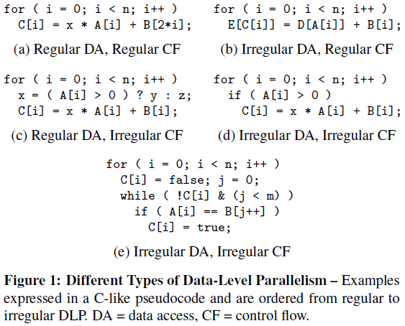
For regular & Irregular dlp…
MIMD
Vector-SIMD
Subword-SIMD
SIMT
VT

Slide 5
mimd
Multiple cores – scalar or multi-threaded
Single Host thread(HT) – interacts with OS, manages accelerator
Several Micro-threads(uT)
Easy Programmability
More area & lower efficiency

Slide 6
Vector-Simd
Multiple vector processing elements – Control Threads(CTs)
Each CT has several uTs in lock-step
Straightforward for regular DLP
CP executes redundant insts once, CP VIU amortize overhead, VMU efficient large blocks
Complex irregular DLP may need vectored flags and arithmetic

Slide 7
Subword-SIMD
Vector-like with scalar wide datapaths
Fixed-length unlike vector-SIMD, alignment constraints for memory
Limited support for irregular DLP

Slide 8
SIMT
No CTs, HT manages uTs
Executes multiple scalar ops
Execute redundant instructions, multiple scalar accesses, per uT stripmining calculations
Simple to map data-dependent control flow, generates masks to disable inactive uTs

Slide 9
VT
Executes efficient vector memory instructions
Issues vector-fetch instructions to indicate start of scalar stream for uT execution
uTs execute in a SIMD manner
Vector-fetched scalar branch can cause divergence

Slide 10
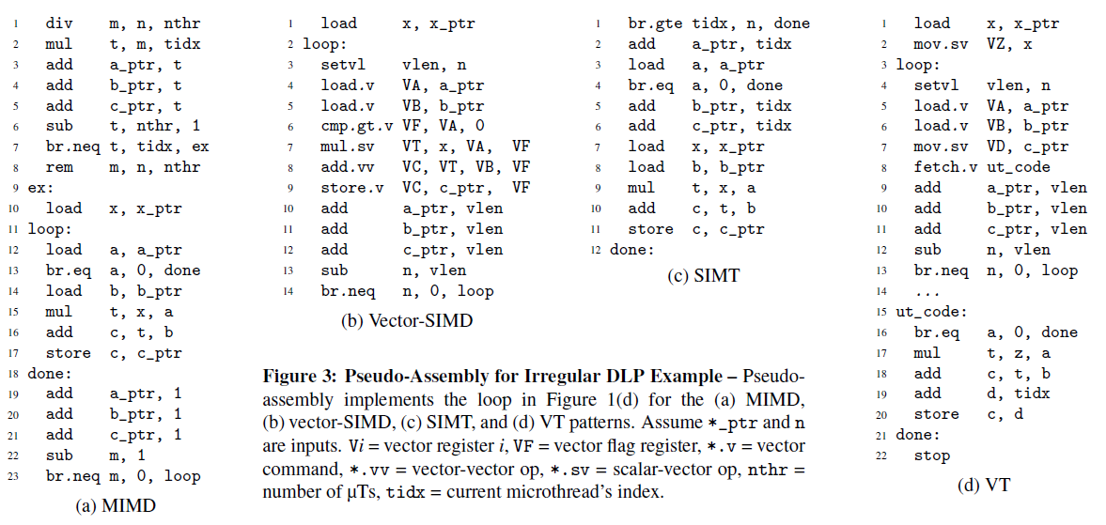

Slide 11
Micro-architectural Components
Library of parametrized synthesizable RTL components
Long latency functional units – int mul,div & single precision float add, mul, div and sqrt
Scalar integer core – RISC ISA, can be multi-threaded
Vector lane – unified 6r3w port regfile(dynamically reconfigurable), 2 VAUs(int ALU + long latency FU), VLU, VSU & VGU
Vector Memory unit – coordinates data movement between memory and vector regfile
Vector Issue unit – fetches instructions, handles control flow, differentiates vector-SIMD & VT
Blocking & non-blocking $

Slide 12
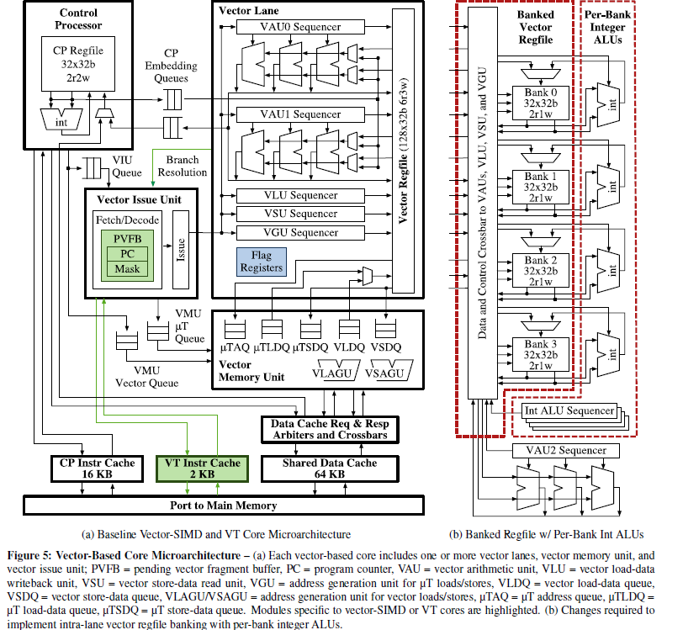

Slide 13
Tiles
MIMD – scalar int core with int & FP long-latency FUs, 1-8 uTs per core
Vector – single-threaded scalar int core, VIU, vector lanes, VMU, shared long-latency FUs
Multi-core tiles – 4 MIMD or 4 single-lane vector cores
Multi-lane tiles – single CP with 4 lane vector unit
Each tile – shared 64KB 4-bank D$, request & response arbiters & crossbars, CP-16KB I$ & VT VIU-2KB vector I$

Slide 14
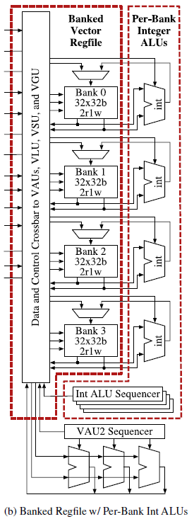
Optimizations
Banked vector regfile – 4 banks 2r1w-port regfile
Per bank int ALUs -
Density-time execution – compresses vector fragment, active uTs only
Dynamic fragment convergence – dynamically merge fragments in PVFB if PCs match [1-stack(single stack) & 2-stack(current & future)]
Dynamic memory coalescer – Multilane VTs, attempts at satisfying multiple uT accesses through the same wide memory access(128bit)

Slide 15
HARDware Toolflow
Use a Synopsys-based ASIC toolflow for simulation, synthesis & PAR
Power estimation using IC compiler & PrimeTime benchmarks
Only gate-level energy results used
DesignWare components with register retiming
Use CACTI to model SRAMs and cache

Slide 16
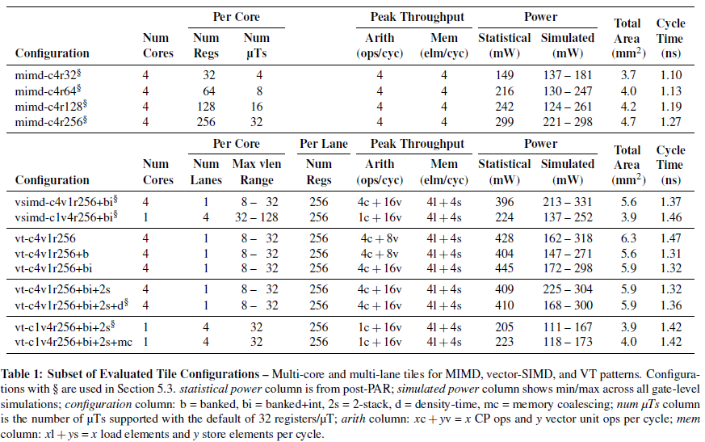
Tile configs
22 tile configs explored
Vector length capped at 32 – some structures scale quadratically in area

Slide 17
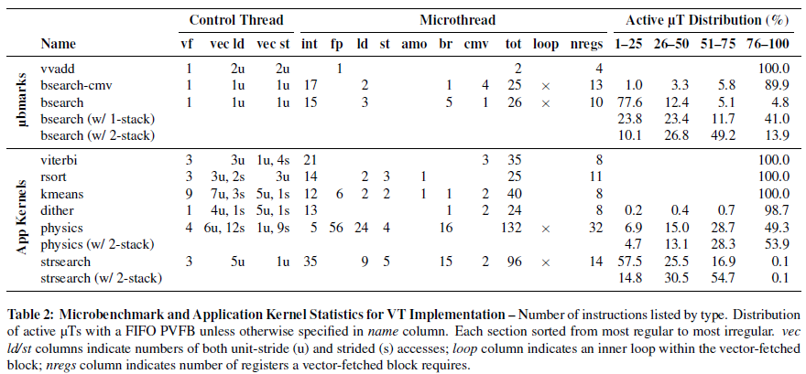
Microbenchmarks & APP Kernels
Microbenchmarks
vvad[1000 element FP add], bsearch[1000 array lookups]
Kernels
- Viterbi[regular DLP], rsort, kmeans, dither[irregular mem access], physics & strsearch[irregular DLP]

Slide 18
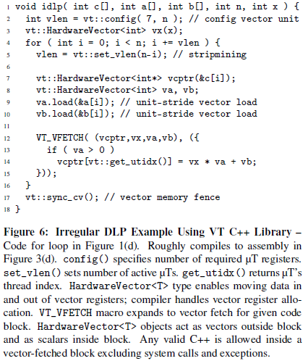
Programming Methodology
Code for HT, explicitly annotate data-parallel tasks for uTs
Develop an explicit-DLP programming environment
Modified GNU C++ library for unified ISA for CT and uTs
Develop VT library

Slide 19
Cycle time & Area comparison

Slide 20
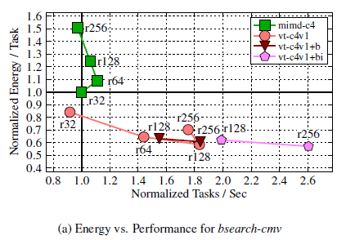
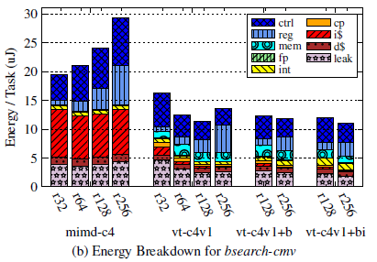
Micro-Architectural Tradeoffs
Impact of additional physical registers per core
Impact of regfile banking and per bank int ALUs

Slide 21
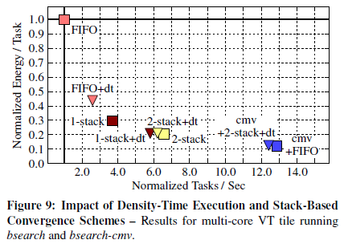
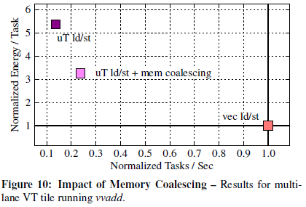
Impact of Density-time execution, Dynamic fragment convergence & memory coalescing

Slide 22
Application Kernel Results
Adding more uTs to MIMD ineffective
Vector-based machines faster and more efficient compared to MIMD, area reduces relative advantage
VT is more efficient than vector-SIMD for both multi-core and multi-lane
Multi-lane vector designs more efficient compared to multi-core designs
Single-core multi-lane VT with 2-stack PVFB, banked regfile and per bank int ALUs good starting point for Maven

Slide 23
Conclusions
Data-parallel accelerators must be capable of handling a broader range of DLP
Vector-based micro-architectures are more area and energy efficient compared to scalar micro-architectures
Maven, VT micro-architecture based on vector-SIMD, more efficient and easier to program

Slide 24
Looking Ahead
More detailed comparison of VT with SIMT
Improvements in programming vector-SIMD ?
Hybrid machines with pure MIMD & pure SIMD more efficient for irregular DLP ?

Slide 25
Couple of things missing…
Effect of inter-tile interconnect and memory system
Comparison with similar VT micro-architectures eg. Scale VT
ANYTHING ELSE ?

Slide 26
THANK YOU

