Slide 1
A Scalable Architecture For High-Throughput Regular-Expression Pattern Matching
Yao Song
11/05/2015

Slide 2
Motivations
The rate of data to be processed for pattern matching increases rapidly.
network intrusion detection systems
Email monitoring systems
The content of data stream to be matched becomes very complex.
Copyright enforcement programs
Architectural innovations are needed to satisfy the performance requirement.

Slide 3
Regular Expression (RE)
most widely used pattern-specification language
a sequence of characters defining a pattern
empty
single or concatenated characters
two or more REs separated by or (|)
one RE followed by closure operator (*)
Meta-characters (such as “$”) and escape sequences (\)

Slide 4
Regular Expression Example
begin with “$”
followed by one or more digits
optionally, followed by decimal point with exactly 2 digits

Slide 5
Automaton Categories
NFA: Non-deterministic Finite Automaton
each input symbol lead to multiple possible next states
has fewer states
space-efficient, time-inefficient
DFA: Deterministic Finite Automaton
each input symbol has one next state
more states
space-inefficient, time-efficient
This design using DFA

Slide 6
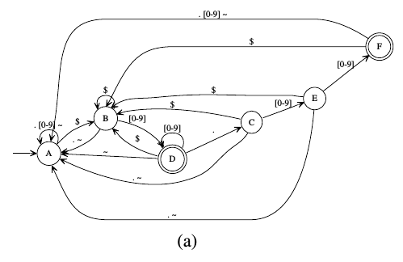
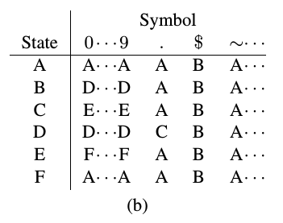
FSM Representation of REs and Transition Table
FSM described by 5-tuple (Q, Σ, q0, δ, A)

Slide 7
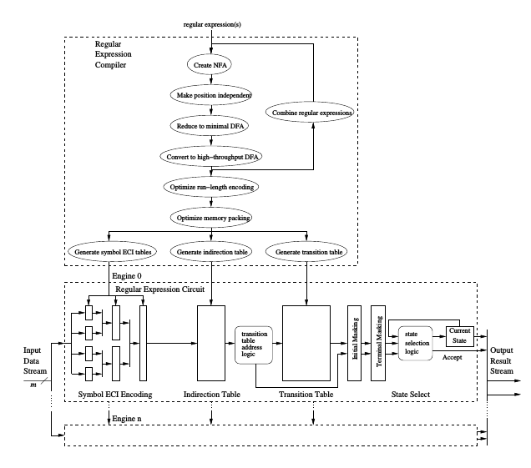
Overview Structure

Slide 8
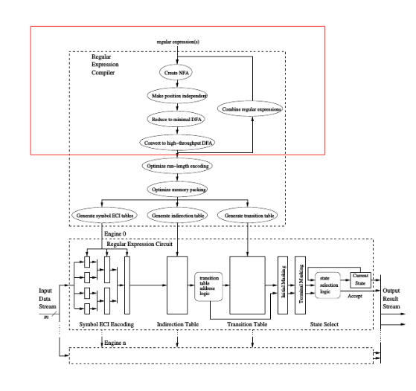
High-Throughput FSM with Encoding

Slide 9
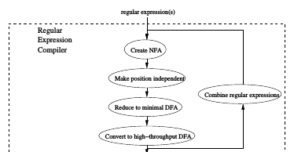
High-Throughput FSM with Encoding

Slide 10
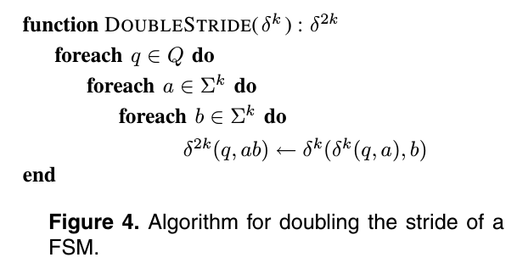
Constructing High-Throughput FSM
process multiple symbols for one transition
naive approach lead to large storage overhead because of the expansion of transition table

Slide 11
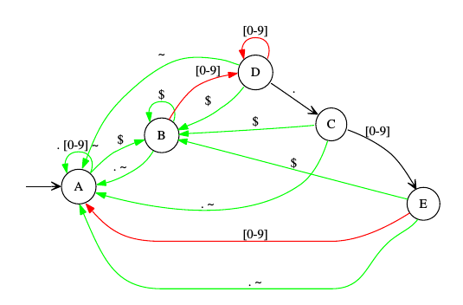
Adding Accepts and Restarts
The transition of high-throughput DFA might traverse an accepting state
Adding two flag bits in transition function
Different colors for in progress(black), accept(red) and restart
Reducing the number of state in the automaton

Slide 12
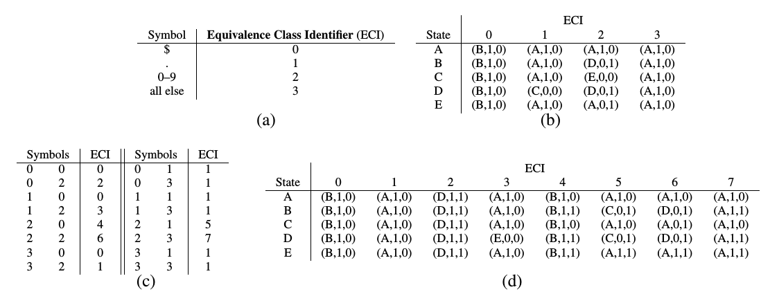
Alphabet Encoding
Reducing the size of transition table for high-throughput FSMs
Combining equivalent input symbol series.

Slide 13
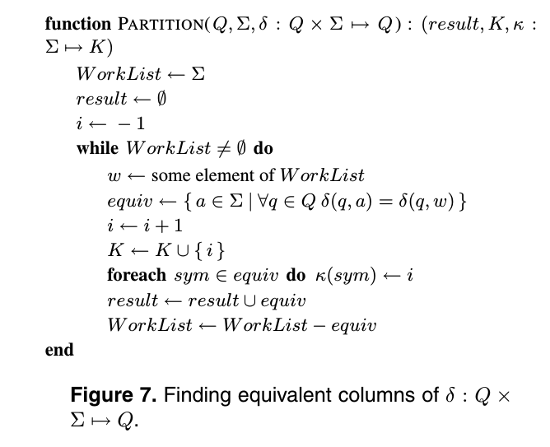
Alphabet Encoding
result: the set of m-symbol combinations
K: the set of ECI
κ: the transition relationship (δ) of encoded automaton

Slide 14
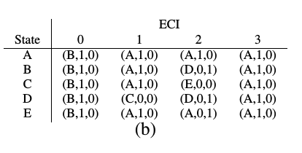
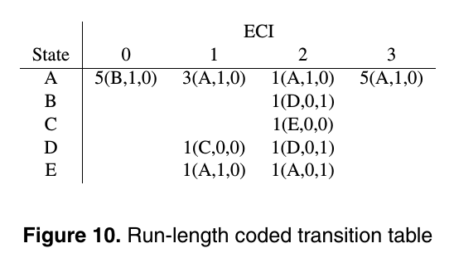
Run-Length Encoding
If a symbol s repeats n times, they can be encoded as n(s)
Disadvantage: increasing the cost of accessing the transition table to obtain a desired entry
Solved by special memory organization and an extra level of indirection

Slide 15
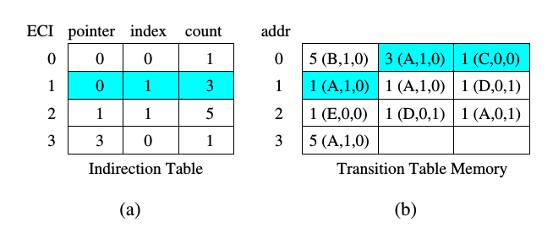
Transition Table Memory and Indirection Table
1st version, relatively naive implementation
Assuming 3 entries can be fetched per memory access
Compressed columns should be placed in physical memory compactly.
A level of indirection helps locate the desired entry, however the hardware logic for finding that entry is complex

Slide 16
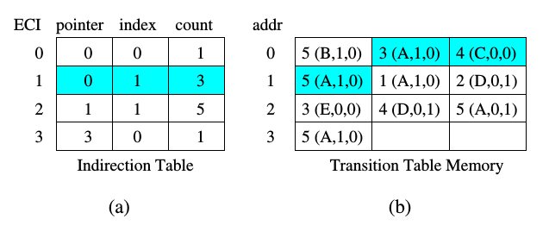
Transition Table Memory and Indirection Table
2st version, improved on 1st version
Storing pre-computed prefix sums instead of “coefficient” in each entry
Hardware needs to calculate terminal index and word count for each column

Slide 17
Transition Table Memory and Indirection Table
final version, improved on 2st version
Storing terminal index and word count in Indirection Table
No need for logic to calculate terminal index and word count

Slide 18
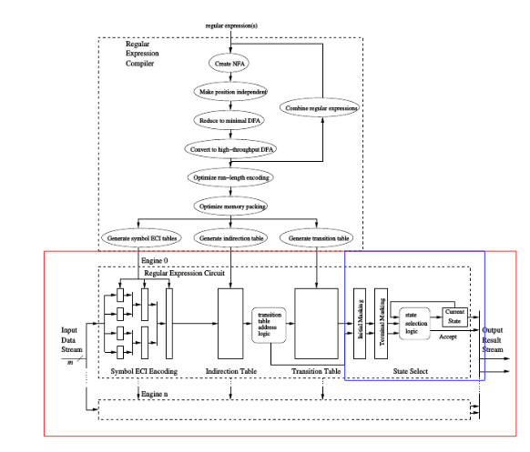
State Select Block (global scope)

Slide 19
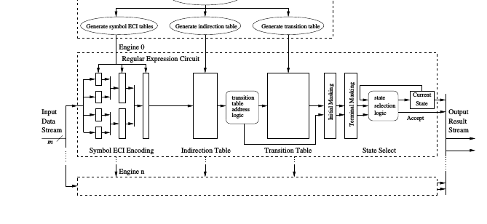
State Select Block (in the larger context)

Slide 20
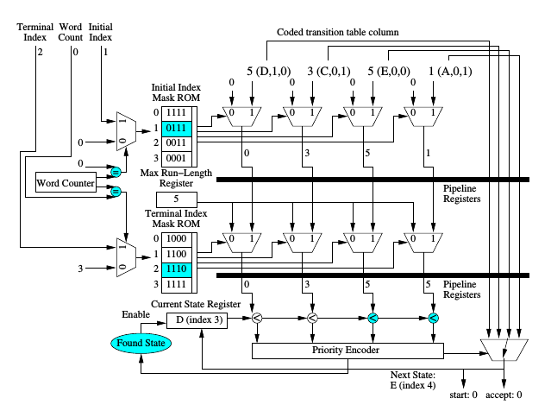
State Select Block

Slide 21
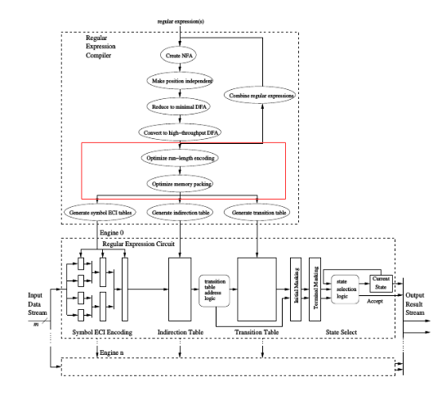
Optimizations (global scope)

Slide 22
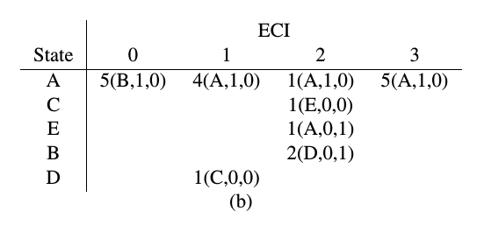
Optimize Run-Length Encoding
Optimizing run-length encoding via state reordering
Calculating difference matrix
State reordering based on difference matrix

Slide 23
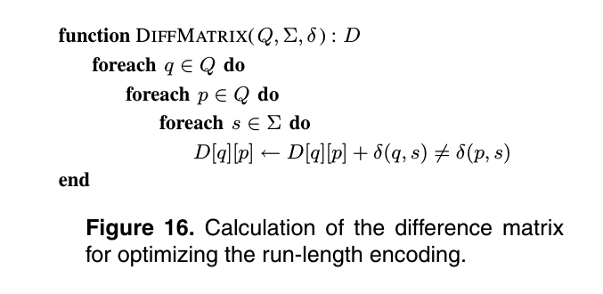
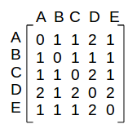
Calculating Difference Matrix

Slide 24
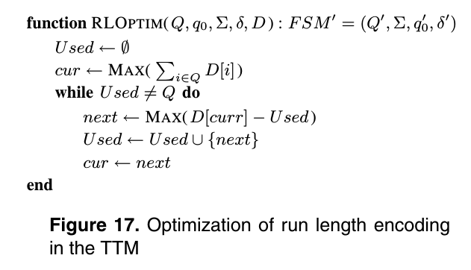
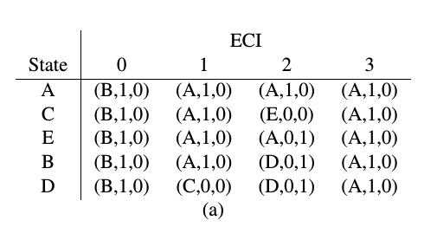
State Reordering
iteration# | cur | next | used
1 | D | B | B
2 | B | E | B, E
3 | E | C | B,E,C
4 | C | A | B,E,C,A

Slide 25
Memory Packing
Column 2 has 3 entries
But need 2 memory access to fetch
Better packing method can reduce the number of memory access per column

Slide 26
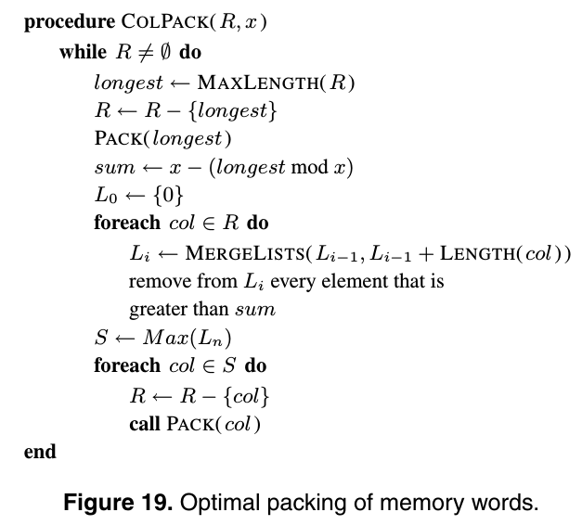
Memory Packing
First pack the longest column among the remaining columns and check how many entries left in the last memory address, result stored in “sum”
columns whose total sum is not greater than “sum” are packed in this iteration and removed from R

Slide 27
Evaluation - Metrics
Throughput (performance)
The number of bytes per second that can be processed by the engine
Density (efficiency)
capacity per unit area
based on the number of characters used to specify the instance of the search problem.

Slide 28
Evaluation - Results

Slide 29
Conclusion
As a general RE matching engine, this design achieves similar performance as the best known methods in string matching
Experiment show ASIC implementation can achieve throughput of 16 Gpbs at density of nearly 1000 engines on a die.

Slide 30
Critiques
Practical regular expressions can be complex
It might be impossible to construct DFA with reasonable number of states
wildcard closure, repeated symbols
This work is based on DFA might not be able to deal with very complex REs

Slide 31
Related Work
Hardware regular expression matching can be Ternary CAM (TCAM)-based
For each TCAM entry, TCAM part stores previous state and input symbol, companion SRAM stores destination state.
Parallelism lead to high speed
Ability to process wildcard.
Huang, Kun, et al. "Scalable TCAM-based regular expression matching with compressed finite automata." Proceedings of the ninth ACM/IEEE symposium on Architectures for networking and communications systems. IEEE Press, 2013.
Meiners, Chad R., et al. "Fast regular expression matching using small TCAM."IEEE/ACM
Transactions on Networking (TON) 22.1 (2014): 94-109.

Slide 32
Thank you!
Questions?

