Slide 1
SNNAP : Approximate Computing on Programmable SoCs via Neural Acceleration
Thierry Moreau Mark Wyse Jacob Nelson Adrian Sampson Hadi Esmaeilzadeh Luis Ceze Mark Oskin
University of Washington
Georgia Institute Of
Technology
University of Washington
Presented by :
Mojes Koli

Slide 2
New Avenues in Computer Architecture
As the clock frequency of silicon chips is leveling off, the computer architecture community is looking for different solutions to continue application performance scaling.
1.
Specialized logic in form of Accelerators
Designed to perform special tasks efficiently compared to GPPs.
Specialization leads to better efficiency by trading off flexibility for leaner
logic and hardware resources
2.
Exploiting Approximate Computing
Today's computers are designed to compute precise results even when it is not necessary.
Approximate computing trades off accuracy to enable novel optimizations
http://www.purdue.edu/newsroom/releases/2013/Q4/approximate-computing-improves-efficiency,-saves-energy.html
University of Wisconsin-Madison

Slide 3
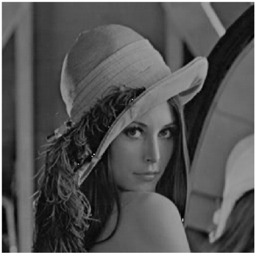
Approximate Computing ?
500 / 21 = ?
Is it greater than 1 ?
Is it greater than 30?
Is it greater than 23?
Filtering based on precise calculations
Filtering based on approx. calculations

Slide 4
Approximate Computing via Neural Acceleration
1.
Identify Approximate code regions from source code.
2.
Train neural networks to mimic regions of approximate code.
3.
During Runtime , when CPU comes across this annotated code , offload this tasks, and sleep.
4.
Such tasks now run on Neural Processing Unit (NPU) accelerators.
Key points :
-> NPU implemented in Programmable logic.
-> During training , neural network’s topology and weights are adjusted.
-> Can target different applications without costly FPGA configurations.
-> Low programmer effort.
-> SNNAP : Neural Network Accelerator in Programmable logic
University of Wisconsin-Madison

Slide 5
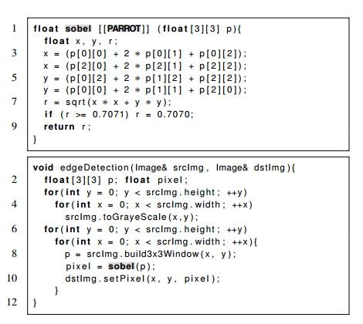
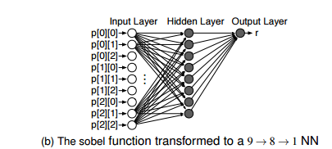
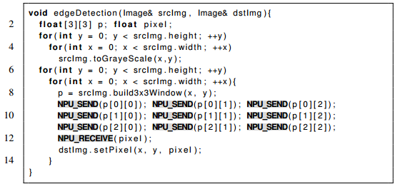
[22] Neural acceleration for general-purpose approximate programs

Slide 6
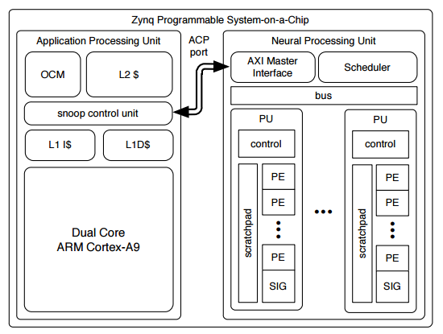
Architecture Design for SNNAP
-> NPU & Processor operate
independently
-> Each PU has a control unit to orchestrate comm.
between PEs and SIG.
-> Neural networks are based in Multi-layer Perceptron
SIG : Sigmoid Function unit
PU : Processing units
PE : Processing elements
-> 3 communication Interface on Zynq PSoC.
1. Medium-throughput General Purpose IOs (GPIOs) – During configuration.
- Latency as low as 114 CPU cycle roundtrip .
2.High-throughput ARM Accelerator Coherency Port (ACP) – During Execution.
- Latency as low as 93 CPU cycle roundtrip .
3. Two unidirectional event lines eventi and evento – During Synchronization.
- Latency of 5 CPU cycles.

Slide 7
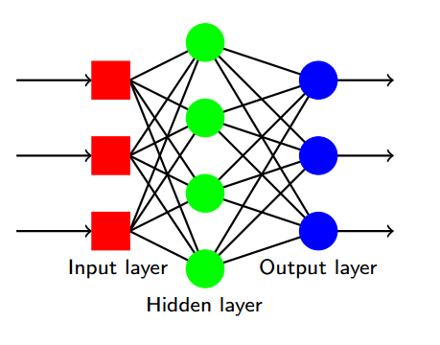
Multi-layer Perceptron (MLP)
- > Artificial Neural Network (ANN) model.
- > Maps sets of input data onto a set of appropriate outputs
- > MLP utilizes a supervised learning technique called backpropagation for training the network
- > The goal of any supervised learning algorithm is to find a function that best maps a set of inputs to its correct output.

Slide 8
Multi-layer Perceptron (MLP)
General idea of supervised learning
1. Send the MLP an input pattern, x, from the training set.
2. Get the output from the MLP, y.
3. Compare y with the “right answer”, or target t, to get the error quantity.
4. Use the error quantity to modify the weights, so next time y will be closer to t.
5. Repeat with another x from the training set.

Slide 9
Processing Unit Datapath
- > Hardware implementation of MLPs.
-> Weights are statistically partitioned on local block-RAM (BRAM)
-> Accumulator FIFO stores partial sums when number of inputs > number of PEs.
-> Sigmoid FIFO stores output until final evaluation is complete. Final result goes to CPU caches.
-> PU can support arbitrary number of PEs.
-> 16-bit signed fixed-point numeric representation with 7 fraction bits internally.
-> 48 bit fixed-point adder to overcome overflow in long chain of complex tasks.

Slide 10
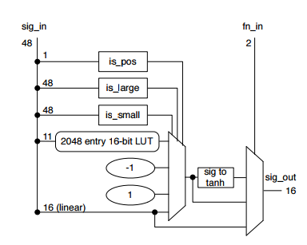
Sigmoid Unit Datapath
- > Applies Activation function to outputs from PE chain.
- > Applies linear approximation or +/- 1 approximation based on input size.
- > SNNAP uses 3 commonly used activation functions, namel sigmoid, hyperbolic and linear activation function.

Slide 11
Overview

Slide 12
Evaluation
Applications used in evaluation
Microarchitectural parameters for the Zynq platform, CPU, FPGA and NPU.

Slide 13
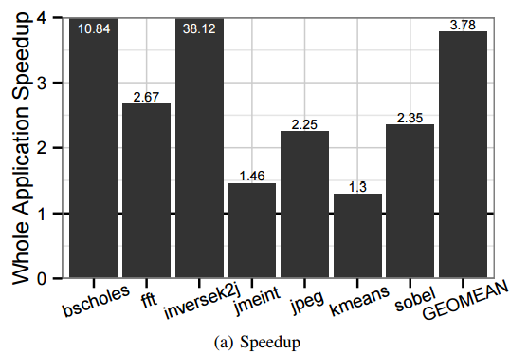
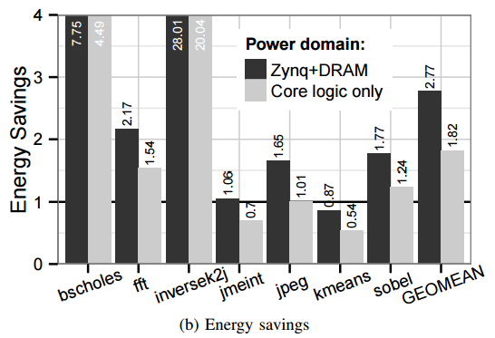
Performance and Energy benefits
-> Inversek2j has the highest speedup
- Trigonometric function calls , taking over 1000 cycles on CPU, but small NN runs faster.
-> kmeans has the lowest speedup
- Approximate code is small to run efficiently on CPU, but NN is deep.
-> Average speedup is 3.78x.
-> Zynq+DRAM
- Power supplies for the Zynq chip and its associated DRAM, peripherals and FPGA
-> Core logic only
- No DRAM or peripherals included.
-> Inversek2j shows highest gains
-> jmeint and kmeans shows worst energy performance.

Slide 14
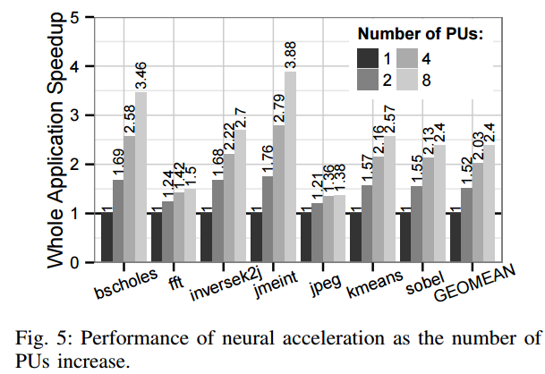
Impact of parallelism
-> Higher PU counts lead to higher power consumption
- However, the cost can be offset by the performance gain.
-> The best energy efficiency occurs at 8 PUs for most benchmarks
- exceptions are jpeg and fft.

Slide 15
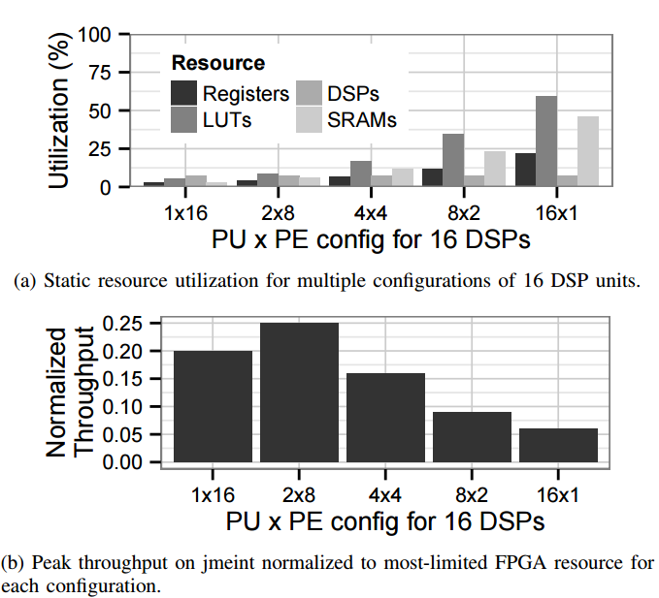
Optimal PE count

Slide 16
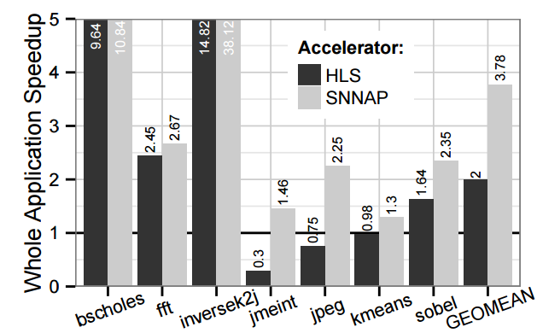
HLS Comparison Study
-> Used Vivado HLS to synthesize specialized hardware datapath for target regions which were tested in previous evaluations.
-> Integrated in CPU-FPGA interface and compared it with SNNAP for
speedup , resource-normalized throughput , FPGA unitization and programmer efforts.
Speedup

Slide 17
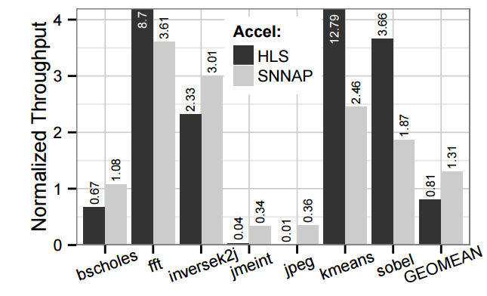
HLS Comparison Study
Resource-normalized throughput
-> Isolated FPGA execution from the rest of the application to carry out this calculations.

Slide 18
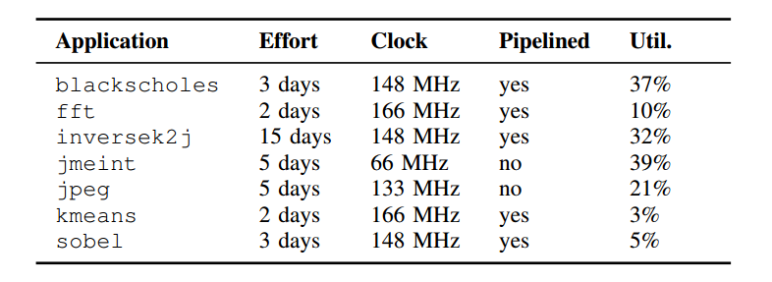
HLS Comparison Study
Programmer Efforts
-> SNNAP : No hardware knowledge.
-> HLS tools : significant programmer effort and hardware-design expertise is still often required

Slide 19
Shortcomings
-> Latency between CPU and NPU is still high.
-> Cannot scale to applications with high bandwidth requirements.
-> Can use support vector machine model.
Key Points.
-> Designed to work with a compiler workflow that automatically configures the neural network’s topology and weights instead of the programmable logic itself.
-> Enables effective use of neural acceleration in commercially available devices.
-> NPUs can accelerate a wide range of computations.
-> SNNAP can target many different applications without costly FPGA reconfigurations.
-> expertise required to use SNNAP can be substantially lower than designing custom FPGA configurations..

Slide 20
THANK YOU

Slide 21
BACKUP SLIDES

Slide 22
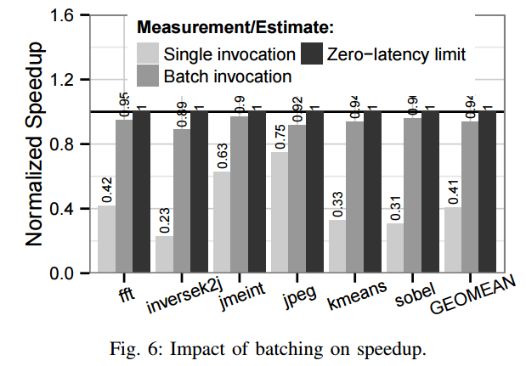
Impact of batching
-> Non-batched communication leads to slowdown
- Since affect of communication latency can be seen here.
-> Batch invocations hide such latencies by amortizing them.

Slide 23
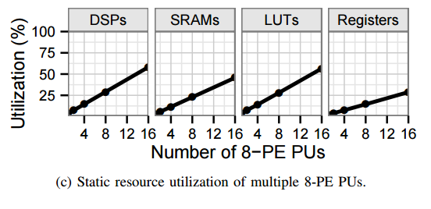
FPGA Utilization

Slide 24
Approximate Computing : Applications
-> One example is video rendering, where the eye and brain fill in any missing pixels.
-> Other applications where a certain percentage of error can be tolerated without affecting the quality of the result as far as the enduser is concerned include:
-> wearable electronics
-> voice recognition
-> scene reconstruction
-> Web search
-> Fraud detection
-> financial and data analysis
-> process monitoring
-> robotics
-> tracking tags and GPS
-> audio, image, and video processing and compression (as in Xbox and PS3 videogaming).

