Slide 1
ShiDianNao: Shifting Vision Processing Closer to the Sensor
Authors – Zidong Du et al.
Presented by – Gokul Subramanian Ravi
November 12, 2015

Slide 2
Summary
Fact: Neural network accelerators achieve high energy efficiency/performance for recognition and mining applications.
Problem: Further improvements limited by memory bandwidth constraints.
Proposal:
Mapping entire CNN into SRAM: Memory accesses for weights.
Moving closer to sensors: Memory access for I/O.
Result:
CNN accelerator placed next to a CMOS or CCD sensor.
Absence of DRAM accesses + exploitation of access patterns: 60x energy efficiency.
Synthesis at 65 nm: Large speedup over CPUs/GPUs/DianNao.

Slide 3
Outline
Overview of Neural Networks
Memory Constrained Acceleration
Primer on CNNs
Mapping Principles
Accelerator Architecture
Computation
Storage
Control
CNN Mapping
Results
Conclusion

Slide 4
Overview of Neural Networks
Feed forward networks trained by trial/error or back-propagation.
Machine learning implemented in FPGAs/accelerators provide high performance/efficiency in multiple applications.
Convergence of trends towards recognition and mining applications, neural network based algorithms can tackle a significant share of these applications.
Best of both worlds: accelerators with high performance/efficiency and yet broad application scope.
Two types of NN – C(Convolutional)NN and D(Deep)NN.

Slide 5
CNN vs. DNN
Deep Neural Networks:
Used in object detection, parsing, language modeling.
Each neuron has unique weight
Sizes ranging up to 10 billion neurons
Convolutional Neural Networks:
Used in computer vision, recognition etc.
Each neuron shares its weight with other neurons.
Sizes are smaller (eg. 60 million weights).
Due to its small weights memory footprint, it is possible to store a whole CNN within a small SRAM next to computational operators
No longer a need for DRAM memory accesses to fetch the (weights) in order to process each input.

Slide 6
Memory Constrained Acceleration
Highest energy expense is related to data movement, in particular DRAM accesses rather than computation.
DRAM accesses – fetch weights and inputs.
The image is acquired by the CMOS/CCD sensor, sent to DRAM, and later fetched by the CPU/GPU for recognition processing.
The small size of the CNN accelerator makes it possible to hoist it next to the sensor, and only send the few output bytes of the recognition process to DRAM or the host processor.

Slide 7
Shi + DianNao = ShiDianNao
A synthesized (place & route) accelerator design for large-scale CNNs and DNNs.
Achieves high throughput in a small area, power and energy footprint.
Exploits the locality properties of processing layers introduces custom designed storage structures reducing memory overhead.
ShiDianNao builds atop this to almost completely eliminate DRAM accesses.
* DianNao: A Small-Footprint High-Throughput Accelerator for Ubiquitous Machine-Learning

Slide 8
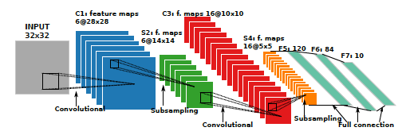
Convolutional Neural Networks
Input: 2D arrays of input pixels/neurons
Convolution Layer:
Set of local filters designed for identifying characteristics of input feature maps.
Processes a convolutional window capturing Kx Ky input neurons in one input feature map.
A 2D array of local filters produces an output feature map, where each local filter corresponds to an output neuron.

Slide 9
Convolutional Neural Networks
Pooling Layer:
Down-samples an input feature map by performing maximum or average operations to non-overlapping windows of input neurons.
Normalization Layer:
2 Types: LRN and LCN.
Improves the recognition accuracy of CNN.
Classifier Layer: integrates one or more classifier layers to compute the final result.

Slide 10
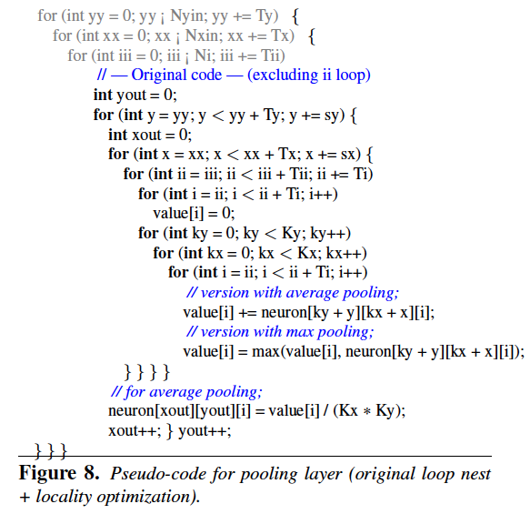
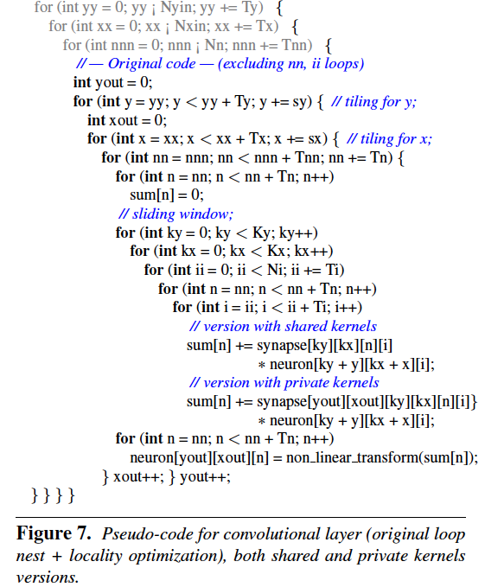
Code Snippets
* DianNao: A Small-Footprint High-Throughput Accelerator for Ubiquitous Machine-Learning

Slide 11
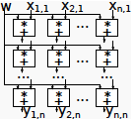
Mapping Principles
Processing elements –
represent neurons,
are organized in a 2D mesh,
receive broadcasted kernel elements,
receive through right-left and up-down shifts the input feature map
accumulate locally the resulting output feature map.
Temporal sharing / Sequential mapping.

Slide 12
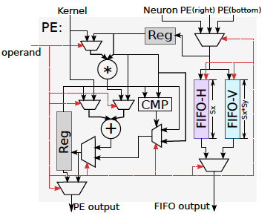
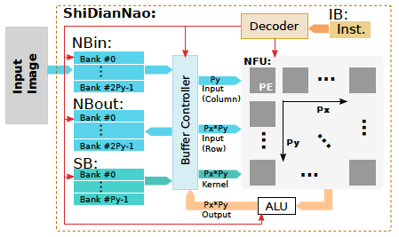
Architecture: Computation
Two buffers for input and output neurons (NBin and NBout), buffer for synapses (SB)
A neural functional unit (NFU) plus an arithmetic unit (ALU) for computing output neurons
16-bit operations.

Slide 13
Architecture: Computation
NFU optimized into 2D to handle 2D data as used in convolution.
Intuitive way of mapping is to map K_{x}*K_{y} kernel to same number of PEs to output one neuron – disadvantageous.
Single PE/output neuron, time shared across input neurons (increased latency?).
PE can perform addition, multiplication or comparison.
Lightweight ALU to implement non-linear activation function (in the form of piecewise linear interpolation).

Slide 14
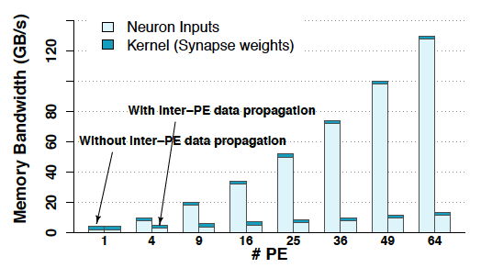
Inter-PE data propagation
Required data available in NBin/NBout but repeatedly reading them requires high b/w.
Inter-PE data propagation allows efficient data reuse.
Temporarily store outputs and transfer to left and lower neighbors.

Slide 15
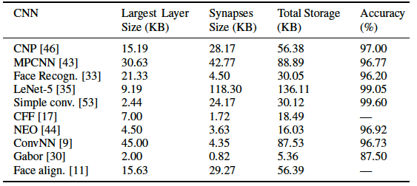
Architecture: Storage
On-chip SRAM to store data/instructions.
~136 KB storage sufficient for total data of practical CNNs.
Implements 288KB SRAM.

Slide 16
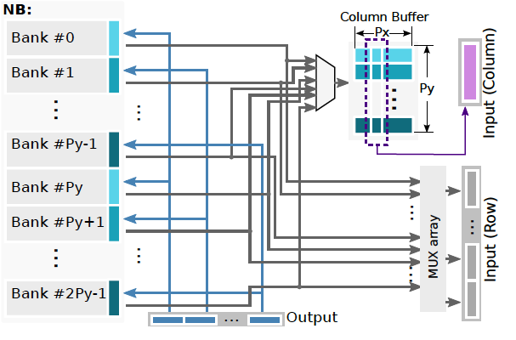
Architecture: Control
Support efficient computation and data reuse.
NB – 2*P_{y} banks, each with width P_{x}*2 bytes.

Slide 17
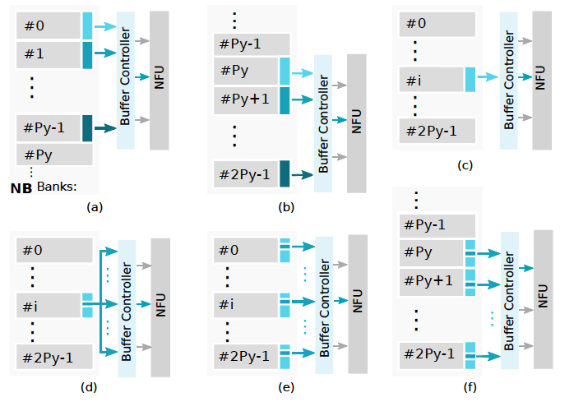
Read modes

Slide 18
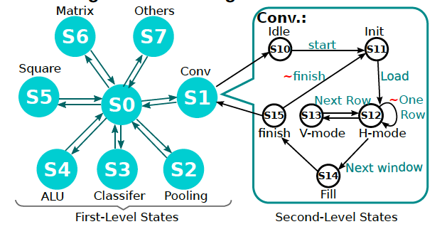
Hierarchical control FSM
2 level hierarchical FSM to describe execution flow.
Level 1: ALU task / layer type etc.
Level 2: Within-layer execution steps.

Slide 19
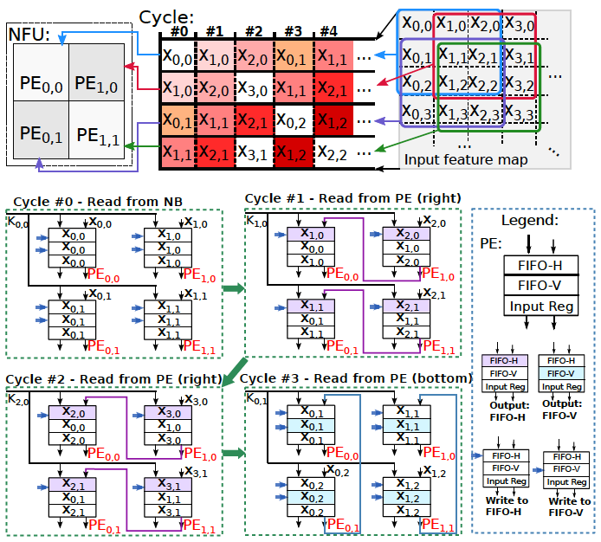
Mapping Conv. Layer to design

Slide 20
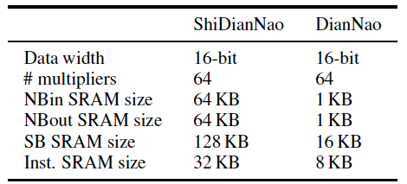
Results: Parameters/overheads

Slide 21
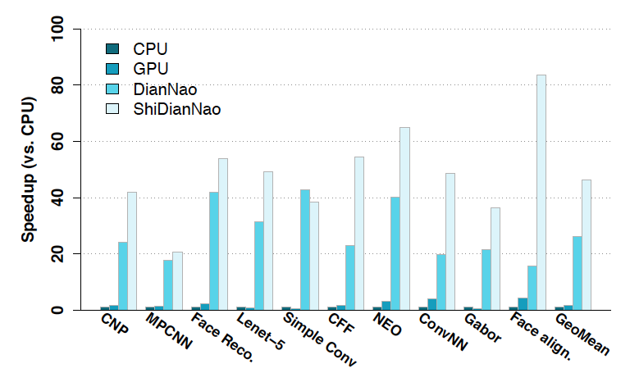
Results: Performance

Slide 22
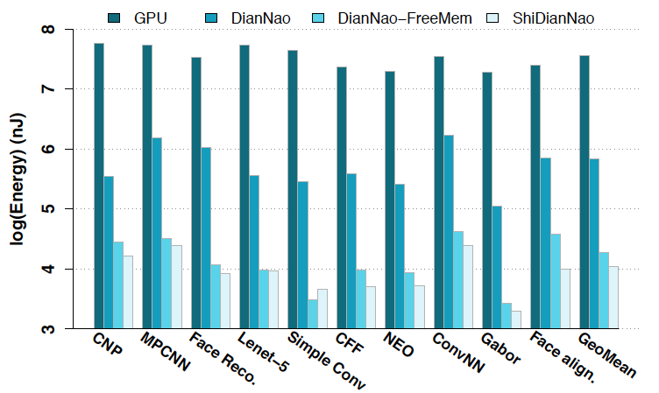
Results: Energy

Slide 23
Conclusions
Versatile accelerator for visual recognition algorithms.
50x, 30x, 1.8x faster than CPU, GPU and DianNao.
4700x and 60x less energy than GPU and DianNao.
“Only” 3x the area of DianNao.
320 mW at 1GHz.

Slide 24
Questions

