Slide 1
Heterogeneous System coherence for Integrated CPU-GPU Systems
Original work by Jason et. Al
Presented By,
Anilkumar Ranganagoudra
For ECE751 Coursework

Slide 2
Summary
Physical and logical CPU-GPU integration
Two key bottlenecks in heterogeneous cache coherence
  Directory bandwidth: must support more than 1 request per cycle
  Directory MSHRs: need tens of thousands
Heterogeneous System Coherence
  Leverages coarse-grained coherence
  Moves coherence traffic onto incoherent direct-access bus
  Directory bandwidth ↓ by 94% and resources ↓ by 95%
Notes:
Define MSHRs
3:30

Slide 3
Executive summary
Hardware coherence can increase the utility of heterogeneous systems
Major bottlenecks in current coherence implementations
  High bandwidth difficult to support at directory
  Extreme resource requirements
We propose Heterogeneous System Coherence
  Leverages spatial locality and region coherence
  Reduces bandwidth by 94%
  Reduces resource requirements by 95%
Notes:
Uses 1 KB regions to only send one request to dir per 16 64 B blocks

Slide 4
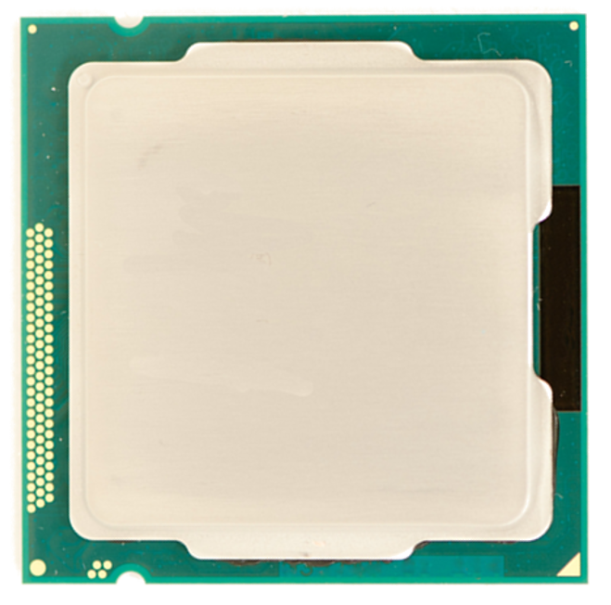
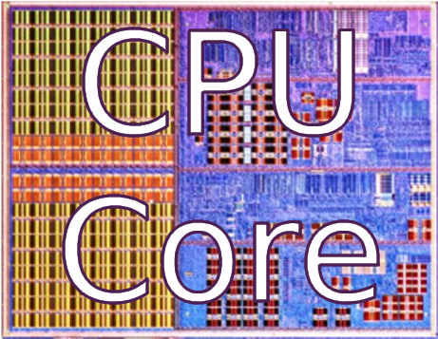
Physical Integration
Notes:
As we all know, Moore’s law has allowed the continued reduction of transistor size for decades.
Recently, as transistors have shrunk, more cores have been added to the chip

Slide 5
Physical Integration

Slide 6
Physical Integration

Slide 7
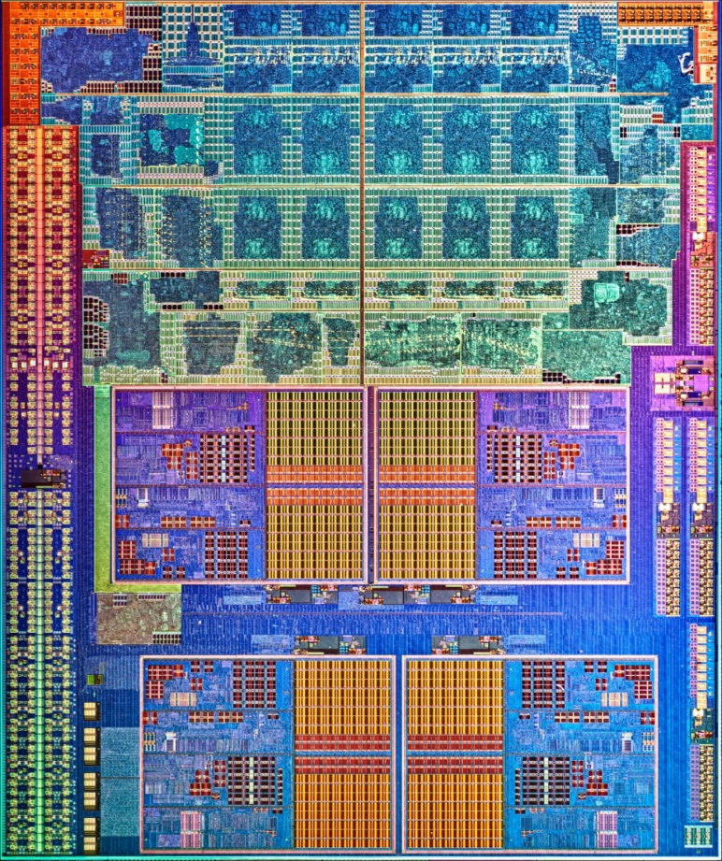
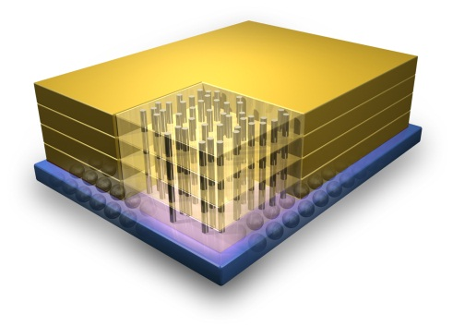
Physical Integration
Stacked High-bandwidth DRAM
GPU
CPU
Cores
Credit: IBM
Notes:
REMEMBER THE STACKED DRAM!!!!!

Slide 8
Logical Integration
General-purpose GPU computing
  OpenCL
  CUDA
Heterogeneous Uniform Memory Access (hUMA)
  Shared virtual address space
  Cache coherence
Allows new heterogeneous apps

Slide 9
Outline
Motivation
Background
  System overview
  Cache architecture reminder
Heterogeneous System Bottlenecks
Heterogeneous System Coherence Details
Results
Conclusions

Slide 10
System overview
System level
High-bandwidth interconnect
Notes:
Bring HB Interconnect
We assume something like die-stacking and a very high bandwidth in this presentation

Slide 11
System overview
APU
Arrow thickness
→bandwidth
GPU compute accesses must stay coherent
Invalidation traffic
Direct-access bus
(used for graphics)
Notes:
In order to stay coherent need to put all GPU coherent requests through directory
Very high bandwidth
Arrow thickness

Slide 12
System overview
GPU
Very high bandwidth:
L2 has high miss rate
Notes:
CU = streaming multiprocessor
Talk more about i-fetch/register file/scratch pad

Slide 13
System overview
Low bandwidth: Low L2 miss rate

Slide 14
Cache Architecture Reminder
CPU/GPU L2 cache
Demand requests from L1 cache
Searches cache tags for a tag match
Allocates an MSHR entry
Tag hit on probe: send data to other core
On a directory probe, check MSHRs and tags
On a miss, send request to directory
On a hit, return data to the L1
Notes:
For the baseline system
Bring on animations when explaining mechansims

Slide 15
Directory Architecture Reminder
Directory
Demand requests from L2 cache
Searches cache tags for a tag match
Allocates an MSHR entry
On a miss, the data comes from DRAM
Allocate and send probes to L2 caches
Notes:
“Mostly inclusive” directory. Send probes only to sharers on hits, send probes to everyone on misses.
Define probe: for instance, an invalidation

Slide 16
Background Summary
System under investigation
  Heterogeneous CPU-GPU on chip
  High-bandwidth DRAM
Directory pipeline complex
  MSHR array is associative
  Difficult to pipeline with more than 1 request per cycle
  Important resources: MSHR entries

Slide 17
Outline
Motivation
Background
Heterogeneous System Bottlenecks
  Simulation overview
  Directory bandwidth
  MSHRs
  Performance is significantly affected
Heterogeneous System Coherence Details
Results
Conclusions

Slide 18
Simulation details
gem5 simulator
  Simple CPU
  GPU simulator based on AMD GCN
  All memory requests through gem5
Workloads
  Modified to use hUMA
  Rodinia & AMD APP SDK
CPU Clock | 2 GHz
CPU Cores | 2
CPU Shared L2 | 2 MB (16-way banked)
GPU Clock | 1 GHz
Compute Units | 32
GPU Shared L2 | 4 MB (64-way banked)
L3 (Memory-side) | 16 MB (16-way banked)
DRAM | DDR3, 16 channels
Peak Bandwidth | 700 GB/s
Baseline Directory | 256k entries (8-way banked)
Notes:
Define GCN
Make sure to point out the assumption of stacked high-bandwidth DRAM
Point out 1 GHz
Workloads coming next!!

Slide 19
GPGPU Benchmarks
Rodinia benchmarks
  bp trains the connection weights on a neural network
  bfs breadth-first search
  hs performs a transient 2D thermal simulation (5-point stencil)
  lud matrix decomposition
  nw performs a global optimization for DNA sequence alignment
  km does k-means clustering
  sd speckle-reducing anisotropic diffusion
AMD SDK
  bn bitonic sort
  dct discrete cosine transform
  hg histogram
  mm matrix multiplication
Notes:
Here’s a list, see the paper for more details

Slide 20
System Bottlenecks
Difficult to scale directory bandwidth
  Difficult to multi-port
  Complicated pipeline
High resource usage
  Must allocate MSHR for entire duration of request
  MSHR array difficult to scale
Designed to support CPU bandwidth
High bandwidth
Notes:
In order to stay coherent need to put all GPU coherent requests through directory
Very high bandwidth
“Often” highly associative: MSHRs

Slide 21
Directory Traffic
Difficult to support >1 request per cycle
Notes:
Define axes.

Slide 22
Resource usage
Very difficult to scale MSHR array
Causes significant back-pressure on L2s
Notes:
Little's law calculated line: 700GB/s / 64 bytes per request = 11 requests/ns * 22 ns latency = 242 outstanding requests.

Slide 23
Performance of baseline
Compared to unconstrained resources
Back-pressure from limited MSHRs and bandwidth
Notes:
4 workloads experince HUGE slowdown
Using 32 mshrs
Explain back pressure signals

Slide 24
Bottlenecks Summary
Directory bandwidth
  Must support up to 4 requests per cycle
  Difficult to construct pipeline
Resource usage
  MSHRs are a constraining resource
  Need more than 10,000
  Without resource constraints, up to 4x better performance

Slide 25
Outline
Motivation
Background
Heterogeneous System Bottlenecks
Heterogeneous System Coherence Details
  Overall system design
  Region buffer design
  Region directory design
  Example
  Hardware complexity
Results
Conclusions
Notes:
6:00 Feel pretty OK about this section.

Slide 26
Baseline Directory Coherence
Initialization
Kernel Launch
Read result

Slide 27
Heterogeneous System Coherence (HSC)
Initialization
Kernel Launch
Notes:
2,3,7 5,6

Slide 28
Region coherence
Applied to snooping systems
  [Cantin, ISCA 2005] [Moshovos, ISCA 2005] [Zebchuk, MICRO 2007]
Extended to directories
  [Fang, PACT 2013] [Zebchuk, MICRO 2013]
Notes:
2,3,7 5,6

Slide 29
Heterogeneous system coherence (HSC)
Region buffers coordinate with region directory
Direct-access bus
Direct-access bus
Notes:
Bring up region dir
Bring up regin buf
Coord with region dir
Direct access bus
Region of 16 64 B blocks or 1KB

Slide 30
Heterogeneous system coherence (HSC)

Slide 31
Heterogeneous system coherence (HSC)

Slide 32
HSC: L2 cache & region buffer
Region tags and permissions
Only region-level permission traffic
Interface for direct-access bus
Notes:
Overhead of 2% of a 4MB cach

Slide 33
HSC: Region directory
Region tags, sharers, and permissions

Slide 34
HSC: Example memory request
GPU L2 Cache
Region
GPU Region Buffer
RBE
Region Directory
DBE
Notes:
Not to scale

Slide 35
HSC: Example memory request
GPU L2 Cache
GPU Region Buffer
RBE
Region Directory
RDE
Notes:
Not to scale

Slide 36
HSC: Hardware Complexity
Region protocols reduce directory size
  Region directory: 8x fewer entries
Region buffers
  At each L2 cache
  1-KB region (16 64-B blocks)
  16-K region entries
  Overprovisioned for low-locality workloads
Notes:
Less than 1% of the overall area

Slide 37
HSC Keypoints
Key insight
  GPU-CPU applications exhibit high spatial locality
  Use direct-access bus present in systems
  Offload bandwidth onto direct-access bus
Use coherence network only for permission
Add region buffer to track region information
  At each L2 cache
  Bypass coherence network and directory
Replace directory with region directory
  Significantly reduces total size needed

Slide 38
Outline
Motivation
Background
Heterogeneous System Bottlenecks
Heterogeneous System Coherence Details
Results
  Speed-up
  Latency of loads
  Bandwidth
  MSHR usage
Conclusions
Notes:
5:30

Slide 39
Three cache-coherence protocols
Broadcast: Null-directory that broadcasts on all requests
Baseline: Block-based, mostly inclusive, directory
HSC: Region-based directory with 1-KB region size

Slide 40
HSC Performance
Largest slowdowns from constrained resources
Largest slowdowns from constrained resources
Largest slowdowns from constrained resources
Largest slow-downs from constrained resources
Notes:
Spend a lot more time here explaining
Higher is better

Slide 41
Directory Traffic reduction
Average bandwidth significantly reduced
Theoretical reduction from 16 block regions
Notes:
Theoretical reduction
Then overall average bandwidth greatly reduced (94%)

Slide 42
HSC Resource Usage
Maximum MSHRs significantly reduced

Slide 43
Results Summary
HSC significantly improves performance
  Reduces the average load latency
  Decreases bandwidth requirement of directory
HSC reduces the required MSHRs at the directory
Notes:
Load latency decreased by prefetching permissions and by reducing queuing delays

Slide 44
Related Work
Coarse-grained coherence
  Region coherence
    Applied to snooping systems [Cantin, ISCA 2005] [Moshovos, ISCA 2005] [Zebchuk, MICRO 2007]
    Extended to directories [Fang, PACT 2013] [Zebchuk, MICRO 2013]
  Spatiotemporal coherence [Alisafaee, MICRO 2012]
  Dual-grain directory coherence [Basu, UW-TR 2013]
    Primarily focused on directory size
GPU coherence [Singh et al. HPCA 2013]
  Intra-GPU coherence

Slide 45
Conclusions
Hardware coherence can increase the utility of heterogeneous systems
Major bottlenecks in current coherence implementations
  High bandwidth difficult to support at directory
  Extreme resource requirements
We propose Heterogeneous System Coherence
  Leverages spatial locality and region coherence
  Reduces bandwidth by 94%
  Reduces resource requirements by 95%

Slide 46
comments
Design Space Exploration on the parameters chosen
Work on non-streaming memory access benchmarks
Energy Efficiency could be made on the benchmarks

Slide 47
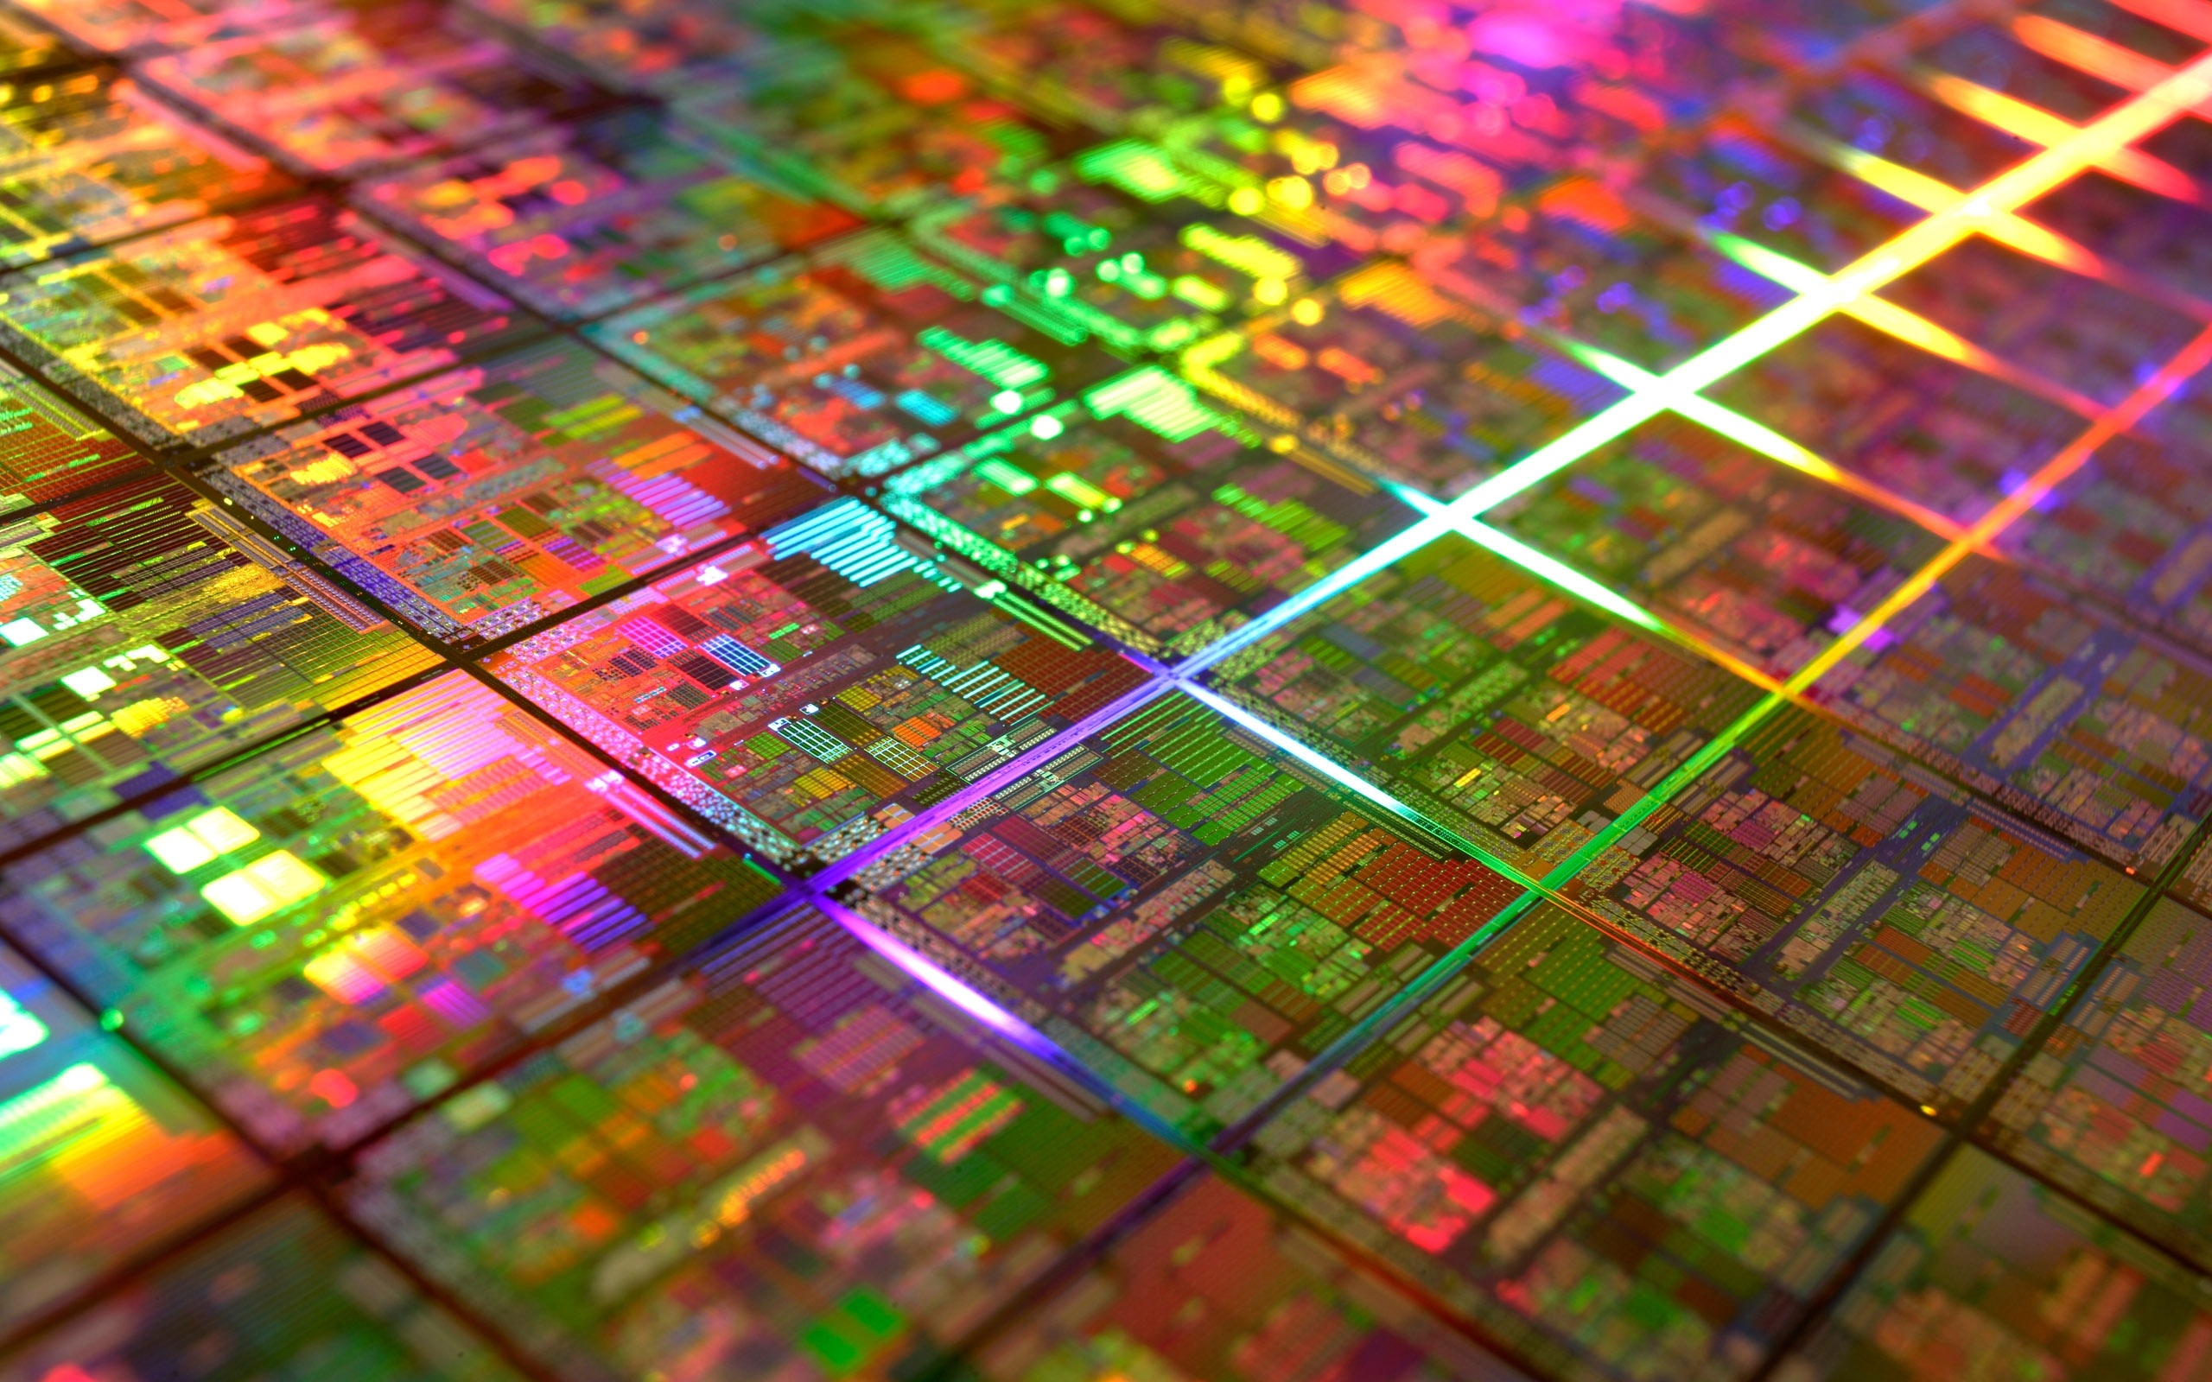

Questions?

Slide 48
Disclaimer & Attribution
The information presented in this document is for informational purposes only and may contain technical inaccuracies, omissions and typographical errors.
The information contained herein is subject to change and may be rendered inaccurate for many reasons, including but not limited to product and roadmap changes, component and motherboard version changes, new model and/or product releases, product differences between differing manufacturers, software changes, BIOS flashes, firmware upgrades, or the like. AMD assumes no obligation to update or otherwise correct or revise this information. However, AMD reserves the right to revise this information and to make changes from time to time to the content hereof without obligation of AMD to notify any person of such revisions or changes.
AMD MAKES NO REPRESENTATIONS OR WARRANTIES WITH RESPECT TO THE CONTENTS HEREOF AND ASSUMES NO RESPONSIBILITY FOR ANY INACCURACIES, ERRORS OR OMISSIONS THAT MAY APPEAR IN THIS INFORMATION.
AMD SPECIFICALLY DISCLAIMS ANY IMPLIED WARRANTIES OF MERCHANTABILITY OR FITNESS FOR ANY PARTICULAR PURPOSE. IN NO EVENT WILL AMD BE LIABLE TO ANY PERSON FOR ANY DIRECT, INDIRECT, SPECIAL OR OTHER CONSEQUENTIAL DAMAGES ARISING FROM THE USE OF ANY INFORMATION CONTAINED HEREIN, EVEN IF AMD IS EXPRESSLY ADVISED OF THE POSSIBILITY OF SUCH DAMAGES.
ATTRIBUTION
© 2013 Advanced Micro Devices, Inc. All rights reserved. AMD, the AMD Arrow logo and combinations thereof are trademarks of Advanced Micro Devices, Inc. in the United States and/or other jurisdictions. SPEC is a registered trademark of the Standard Performance Evaluation Corporation (SPEC). Other names are for informational purposes only and may be trademarks of their respective owners.

Slide 49
Backup Slides

Slide 50
Load Latency
Average load time significantly reduced

Slide 51
Execution time breakdown

