Slide 1
Short Circuiting Memory Traffic in Handheld Platforms
Paper presented in MICRO 2014
Review by Ajay Sekar
*Graphs and figures used from paper “Short Circuiting memory traffic in Handheld platforms”

Slide 2
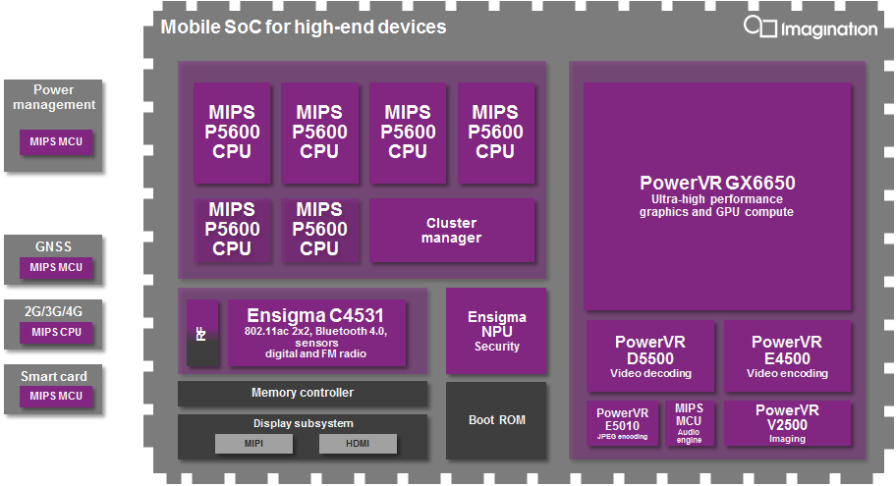
Problem Statement
Many media IP’s being integrated in the SoC.
Applications related to media and graphics generate a lot of memory traffic
LPDDR3 Memory throughput - 5.3 GB/s 1 CH , 1333 MHz.
Memory Controller turns out to be the bottleneck …
http://blog.imgtec.com/multimedia/the-day-i-designed-my-own-mobile-soc

Slide 3
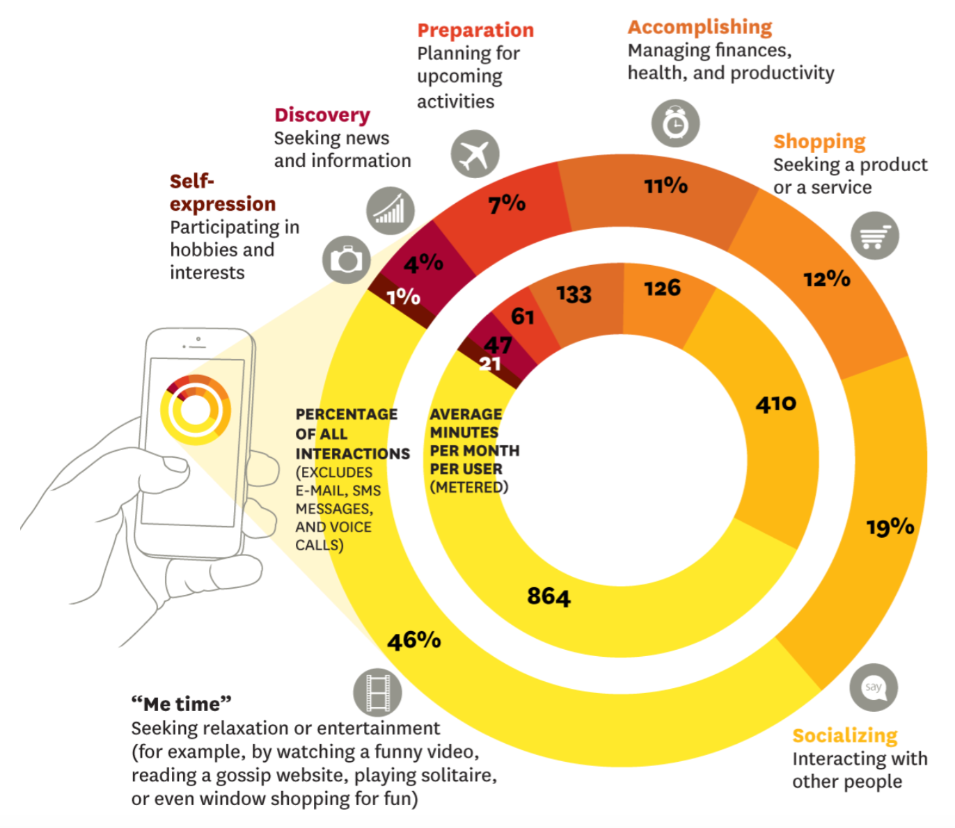
Usage
Application Characteristics
1.Real time responsiveness - to maintain quality.
2. Frame transactions contain MB’s of data transfer.
3. Data has to be transferred with multiple IP’s
This could overwhelm the memory system

Slide 4
Frames from multiple IP’s can stress the memory .
Consequences
IP’s stall for the memory requests
Energy Wastage… IP’s powered on for a longer time
Core requests have to contend with high IP memory traffic.

Slide 5
High Level Solutions
Optimize memory transactions between IP’s in a flow
Decongest System Agent.
Improve memory latency

Slide 6
Defining a Flow …
(1) Device driver issues a request to the IP with physical address location
(2) IP sends data read requests … gets queued up and prioritized… response received
(3) Complete frame is written back to the memory
(4) Core invokes IP2
(5) IP2 reads data written by IP1

Slide 7
Memory stalls - Analysis
IP that spend more time on compute = Less stalls
Camera and Graphics App send huge frames of data … leading to stalls
Stalls leads to frame drops
Demand way higher than supply

Slide 8
4x IP’s have more stalls
Improving Mem Freq does not help
Problem : Queuing latency in the Mem Controller

Slide 9
Performance Optimization
Is there reuse of data between IP’s ?
Yes !!
Reuse distances vary with respect to the application.
Large frames - 10 ms reuse distance
Small frames - <1 ms reuse distance
Can locality be used to exploit the distance … coming up next

Slide 10
SOL 1 : Can caches help in data reuse between IP’s ?
Idea - Have a shared cache between the memory and the IP which can be used by all IP’s
Observation - Avg Hit Rates Vs the Cache sizes
A2, A3 - Have small frames - fit inside 4 MB cache
A1,A4,A5 benefit from increasing the cache size , better hit rates
A8 doesn't show any improvement -
- Frame size too large to fit into a 32 MB cache
- Reuse distance is large - data would get evicted by frames in the flow or by other flows in the system

Slide 11
Observation - Average cycles consumes by the IP’s
SND - small frames , larger caches would mean longer lookups
DC - frames fit into larger caches(32 MB), better performance
AE is latency tolerant - more computation - thus cache size does not affect performance
Conclusions
Bigger caches affect area and power budgets.
Large IP-IP reuse distance - main cause of the memory stalls.

Slide 12
SOL 2 : Sub-Framing
Goal - To reduce IP-IP reuse distance
Similar to “tiling” concept used in matrix multiplication.
Blocked Matrix Multiply
http://www.eecs.harvard.edu/~mdw/course/cs61/mediawiki/images/b/bb/Lectures-cacheperf.pdf

Slide 13
Sub-Framing (contd)
Frames are divided into sub-frames
IP’s process data in sub-frame granularity - IP2 would be be invoked if IP1 had completed a sub-frame
Observation : Sub frame Size Vs reuse distance
re-use distance exponentially decreases with decrease in sub-frame size.
Flow buffers and IP-IP short circuiting utilize the sub-framing concept.

Slide 14
Flow Buffers
Private buffers which are place between IP’s
Buffers reuse the data and prevent consume IP from accessing the memory.
- Flow buffers require extra hardware
read subframe from memory
write subframe to memory
IP A
IP B
IP C
Reduces intermediate memory accesses

Slide 15
IP-IP Short-circuiting
Similar to “store-load forwarding”
Forward the the stores of IP1 in memory queues to loads of IP2
Works only if the sub-frame reuse distance is small.

Slide 16
Implementation
OS and HW Support
SA-HAL layer is added - maintains the flow information
SA holds matrix of consumer and producer IP’s in a flow.
SA-HAL logs the producer and consumer of a flow in the flow.
Consumer is informed when the sub-frame is completed.

Slide 17
Effect of sub framing with Flow buffering and Short circuiting
Youtube has better hit rates with Flow buffer and IP-IP short circuiting.
Hit rates increase with increase in buffer sizes
Memory bottleneck is reduced …

Slide 18
Performance Gains
% of frames completed with baseline, subframe-cache and subframe-fwd
Application that benefit SB-C and SB-F see 45 % reduction in cycles per frame
VD-DC , loss of 17 % - parallel working IP’s stress the memory

Slide 19
Energy Gains
Avg 40% reduction in active cycles
Memory energy consumption is reduced by 33%
Reduced DRAM accesses

Slide 20
Conclusion
Optimized System Agent to reduce memory traffic
Exploring locality to reuse the data. - reducing memory accesses.
Avg 45 % performance gains for media/graphics application (exceptions)
Energy consumption of IP’s and memory reduced.

Slide 21
Backup Slides

Slide 22
Flows

Slide 23
Platform Configuration

Slide 24
System Agent
Application makes API calls to invoke the HW
Device Drivers transforms API calls in IP invocations
Control signal given to the IP - registers and memory pointers
IP’s reads and write values into the Memory using DMA

