Slide 1
Stash: Have Your Scratchpad and Cache it Too
Matthew D. Sinclair et. al
UIUC
Presenting by
Sharmila Shridhar

Slide 2
SoCs Need an Efficient Memory Hierarchy
Energy-efficient memory hierarchy is essential
Heterogeneous SoCs use specialized memories
E.g., scratchpads, FIFOs, stream buffers, …
Scratchpad
Cache
Directly addressed: no tags/TLB/conflicts | ✓ | X
Compact storage: no holes in cache lines | ✓ | X

Slide 3
SoCs Need an Efficient Memory Hierarchy
Energy-efficient memory hierarchy is essential
Heterogeneous SoCs use specialized memories
E.g., scratchpads, FIFOs, stream buffers, …
Can specialized memories be globally addressable, coherent?
Can we have our scratchpad and cache it too?
Scratchpad
Cache
Directly addressed: no tags/TLB/conflicts | ✓ | X
Compact storage: no holes in cache lines | ✓ | X
Global address space: implicit data movement | X | ✓
Coherent: reuse, lazy writebacks | X | ✓

Slide 4
Can We Have Our Scratchpad and Cache it Too?
Scratchpad
Cache
Stash
Directly addressable
Compact storage
Global address space
Coherent
Make specialized memories globally addressable, coherent
Efficient address mapping
Efficient coherence protocol
Focus: CPU-GPU systems with scratchpads and caches
Up to 31% less execution time, 51% less energy

Slide 5
Outline
Motivation
Background: Scratchpads & Caches
Stash Overview
Implementation
Results
Conclusion

Slide 6
Global Addressability
Scratchpads
Part of private address space: not globally addressable
Explicit movement
Cache
Globally addressable: part of global address space
Implicit copies, no pollution, support for conditional accesses
, pollution, poor conditional accs support
GPU
CPU
Registers
Scratchpad
Cache
Cache
L2 $ Bank
L2 $ Bank
Interconnection n/w

Slide 7
Coherence: Globally Visible Data
Scratchpads
Part of private address space: not globally visible
Eager writebacks and invalidations on synchronization
Cache
Globally visible: data kept coherent
Lazy writebacks as space is needed, reuse data across synch

Slide 8
Stash – A Scratchpad, Cache Hybrid
Scratchpad
Cache
Stash
Directly addressed: no tags/TLB/conflicts | ✓ | X | ✓
Compact storage: no holes in cache lines | ✓ | X | ✓
Global address space: implicit data move. | X | ✓ | ✓
Coherent: reuse, lazy writebacks | X | ✓ | ✓

Slide 9
Outline
Motivation
Background: Scratchpads & Caches
Stash Overview
Implementation
Results
Conclusion

Slide 10
Stash: Directly & Globally Addressable
// A is global mem addr
// scratch_base == 500
for (i = 500; i < 600; i++) {
reg r_{i} = load[A+i-500];
scratch[i] = r_{i} ;
}
reg r = scratch_load[505];
// A is global mem addr // Compiler info: stash_base[500] -> A (M₀)
// R_{k} = M₀ (index in map)
reg r = stash_load[505, R_{k} ];
Accelerator
Accelerator
500
505
500
505
Map
…
…
…
…
500→A
M₀
Scratchpad
Stash
Generate load[A+5]
Like scratchpad: directly addressable (for hits)
Like cache: globally addressable (for misses)
Implicit loads, no cache pollution

Slide 11
Stash: Globally Visible
Stash data can be accessed by other units
Needs coherence support
Like cache
Keep data around – lazy writebacks
Intra- or inter-kernel data reuse on the same core
GPU
CPU
Registers
Stash
Map
$
Cache
L2 $ Bank
L2 $ Bank
Interconnection n/w

Slide 12
Stash: Compact Storage
Global
…
.
.
.
Stash
…
…
Caches: cache line granularity storage (“holes” ⇒ waste)
Do not compact data
Like scratchpad, stash compacts data

Slide 13
Outline
Motivation
Background: Scratchpads & Caches
Stash Overview
Implementation
Results
Conclusion

Slide 14
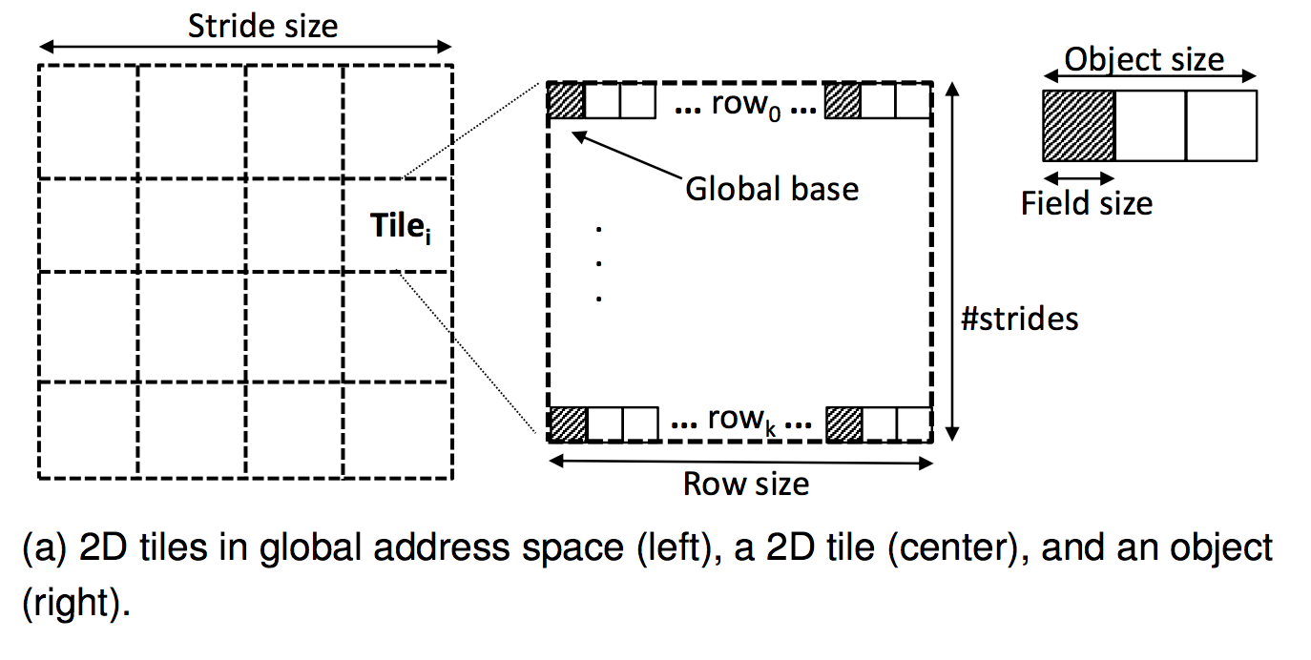
Stash Software Interface
Software gives a mapping for each stash allocation
AddMap(stashBase, globalBase, fieldSize, objectSize,
rowSize, strideSize, numStrides, isCoherent)

Slide 15
Stash Hardware
Stash-Map
Stash instruction
…
VP-map
VA
TLB
…
RTLB
Data Array
S
t
a
t
e
Map index
table
PA/VA
V | Stash base | VA base | Field size, Object size | Row size, Stride size, #strides | isCoh | #Dirty Data
Notes:
Map Index per thread block. Shared Stash Map.
Six arithmetic operations to get VA.

Slide 16
Stash Instruction Example
MISS
Stash-Map
stash_load[505, R_{k}];
…
VP-map
VA
TLB
HIT
…
RTLB
Data Array
S
t
a
t
e
Map index
table
PA
V | Stash base | VA base | Field size, Object size | Row size, Stride size, #strides | isCoh | #Dirty Data
Notes:
Map Index per thread block. Shared Stash Map.
Six arithmetic operations to get VA.

Slide 17
Lazy writebacks
Stash writebacks happen lazily
Chunks of 64B with per chunk dirty bit
On store miss, for the chunk
set dirty bit
update stash map index
Increment #DirtyData counter
On eviction,
Get PA using stash map index and writeback
Decrement #DirtyData counter

Slide 18
Coherence Support for Stash
Stash data needs to be kept coherent
Extend a coherence protocol for three features
Track stash data at word granularity
Capability to merge partial lines when stash sends data
Modify directory to record the modifier and stash-map ID
Extension to DeNovo protocol
Simple, low overhead, hybrid of CPU and GPU protocols

Slide 19
DeNovo Coherence (1/3)
[DeNoVo: Rethinking the Memory Hierarchy for Disciplined Parallelism]
Designed for Deterministic code w/o conflicting access
Line granularity tags, word granularity coherence
Only three coherence states
Valid, Invalid, Registered
Explicit self invalidation at the end of each phase
Lines written in previous phase-> Registered state
Keep valid data or registered core ID in Shared LLC

Slide 20
DeNovo Coherence (2/3)
Private L1, shared L2; single word line
Data-race freedom at word granularity
Read
No transient states
No invalidation traffic
No directory storage overhead
No false sharing (word coherence)
Invalid
Read
Valid
Write
Write
Registered
Read, Write

Slide 21
DeNovo Coherence (3/3)
Extenstions for Stash
Store Stash Map ID along with registered core ID
Newly written data in Registered state
At the end of the kernel, self-invalidate entries that are not registered
In contrast, scratchpad invalidates all the entries
Only three states, 4th state used for Writeback

Slide 22
Outline
Motivation
Background: Scratchpads & Caches
Stash Overview
Implementation
Results
Conclusion

Slide 23
Evaluation
Simulation Environment
GEMS + Simics + Princeton Garnet N/W + GPGPU-Sim
Extend McPAT and GPUWattch for energy evaluations
Workloads:
4 microbenchmarks: implicit, reuse, pollution, on-demand
Heterogeneous workloads: Rodinia, Parboil, SURF
1 CPU Core (15 for microbenchmarks)
15 GPU Compute Units (1 for microbenchmarks)
32 KB L1 Caches, 16 KB Stash/Scratchpad
Notes:
Implicit- implicit loads and lazy writebacks
Pollution- two AoS arrays. B can fit inside cache only without pollution from A.
On demand- Reads n writes only 1 element out of 32
Reuse- Subsequent kernels reuse the data

Slide 24
Evaluation (Microbenchmarks) – Execution Time
Implicit
Implicit
Scr = Baseline configuration
C = All requests use cache
Scr+D = All requests use scratchpad w/ DMA
St = Converts scratchpad requests to stash

Slide 25
Evaluation (Microbenchmarks) – Execution Time
Implicit
No explicit loads/stores

Slide 26
Evaluation (Microbenchmarks) – Execution Time
Implicit
Pollution
No cache pollution

Slide 27
Evaluation (Microbenchmarks) – Execution Time
Implicit
Implicit
Pollution
On-Demand
Reuse
Only bring needed data

Slide 28
Evaluation (Microbenchmarks) – Execution Time
Implicit
Implicit
Pollution
On-Demand
Reuse
Data compaction, reuse

Slide 29
Evaluation (Microbenchmarks) – Execution Time
Implicit
Implicit
Pollution
On-Demand
Reuse
Average
Avg: 27% vs. Scratch, 13% vs. Cache, 14% vs. DMA

Slide 30
Evaluation (Microbenchmarks) – Energy
Implicit
Pollution
On-Demand
Reuse
Average
Avg: 53% vs. Scratch, 36% vs. Cache, 32% vs. DMA

Slide 31
Evaluation (Apps) – Execution Time
SURF
BP
NW
PF
SGEMM
ST
AVERAGE
106
102
103
103
Scr = Reqs use type specified by original app
C = All reqs use cache
St = Converts scratchpad reqs to stash

Slide 32
Evaluation (Apps) – Execution Time
LUD
SURF
BP
NW
PF
SGEMM
ST
AVERAGE
121
106
102
103
103
Avg: 10% vs. Scratch, 12% vs. Cache (max: 22%, 31%)
Source: implicit data movement
Comparable to Scratchpad+DMA

Slide 33
Evaluation (Apps) – Energy
LUD
SURF
BP
NW
PF
SGEMM
ST
AVERAGE
168
120
180
126
108
128
Avg: 16% vs. Scratch, 32% vs. Cache (max: 30%, 51%)

Slide 34
Conclusion
Make specialized memories globally addressable, coherent
Efficient address mapping (only for misses)
Efficient software-driven hardware coherence protocol
Stash = scratchpad + cache
Like scratchpads: Directly addressable and compact storage
Like caches: Globally addressable and globally visible
Reduced execution time and energy
Future Work:
More accelerators & specialized memories; consistency models

Slide 35
Critique
In GPUs, data in shared memory has the visibilty per thread block. Use syncthreads to ensure data is available. How is that behavior implemented?
Else multiple threads can encounter miss on same data. How is it handled?
Why don’t they compare Scratchpad+DMA for GPU applications results?

