Slide 1
Fusion : Design Tradeoffs in Coherent Cache Hierarchies for Accelerators
Snehasish Kumar, Arrvindh Shriraman, and Naveen Vedula
School of Computing Sciences, Simon Fraser University
ISCA-’15
Presented by :
Keshav Mathur

Slide 2
Outline
Motivation
Proposed Design
Implementation details
Evaluation Methods
Results
Conclusion and Comments
References

Slide 3
Accelerators : We need them, but ..
Specialised Hardware to reduce power and gain performance
Power and Clock Gating easier
Specialization Spectrum
Dynamically Specialized Datapaths for Energy Efficient Computing, Venkatraman Govindaraju Chen-Han Ho Karthikeyan Sankaralingam Vertical Research Group University of Wisconsin-Madison
Granularity of Accelerators : Fine Grained fix function vs coarse domain specific
Programmability Concerns : How easy is the discovery and how frequent is the invocation

Slide 4
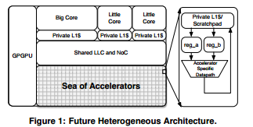
Fixed Function Accelerators
Fine grain off-loading of functions to multiple accelerators
Enables data path reuse + Saves control path power
DMA
LLC
func1();
func2();
func3();
func4();
Y. S. S. B. R. Gu and Y. W. D. Brooks. Aladdin: A pre-rtl, powerperformance
accelerator simulator enabling large design space exploration
of customized architectures
Creates producer - consumer scenario - Incurs frequent data movement ( DMA Calls )
Forwarding Buffers ? Co-located, shared memory? - Scratchpad ? Cache ? Stash ? Both ? Always ? ??

Slide 5
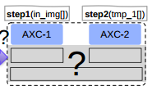
Architecture : Tile + ?
- Tiled architecture : Multiple fixed function accelerators on a single tile
- Independent memory hierarchy
- Independent coherence protocol
- Multiple Tiles per core
Indeterministic behaviour (Hit/Miss)
Coherent , Non polluting memory
Capture locality, enable reuse
H/w address translation energy and latency
Implicit data movement, lazy writebacks
Deterministic Access
Low Load Use Latency
Efficient Memory Utilization
Incoherent ,Private Address Space
Software Managed
Scratchpad Caches

Slide 6
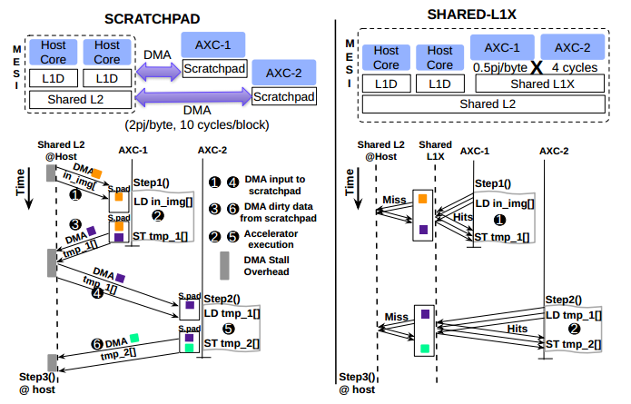
Baseline Systems: SCRATCH and SHARED
Shared L1 per tile
L1X takes part in MESI based coherence
L2 at host maintains inclusion with L1X
Capture spatial and temporal locality
Provide coherent view of memory
Customized hierarchy needed for efficiency
Size vs Latency tradeoffs as needs to be sized for multiple s/w threads
Private Scratchpad
1 per Accelerator
DMA controller
Good for Compute Intensive workloads
Large Size of Scratch.
amortizes DMA overhead
Large Size increases access latency, energy
High overhead for kernels of seq. programs with
high locality
eg: SoC systems :AXI - ARM [1], CAPI -IBM [2]

Slide 7
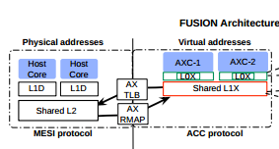
Fusion Architecture
Private L0X per accelerator, independently sized
Banked L1x : shared
ACC Coherence between L0 and L1
L1x Coherent with core via MESI protocol implementation
Virtual address (no TLB) space for accelerators
Timestamp based coherence between accelerators L0x and L1x
PID Tags in caches
PID1
PID2

Slide 8
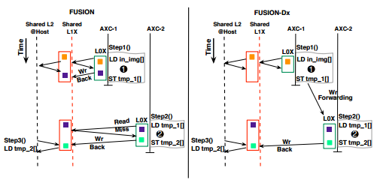
Fusion : Data flow
Reduced data migration by avoiding DMAs
Frequent Write Backs between L0 and L1 cause energy overhead
Write forwarding avoids write back to cache
Exploits producer consumer scenario

Slide 9
Virtual Memory
ACX -0
ACX -0
AX- TLB
V. Addr
L0x
L1x
L1D
L1D
Shared L2
L1x
MESI
ACC
TLB provides virtual to physical address translations on a L1x Miss
This is used to index to shared L2 and participate in MESI actions

Slide 10
Virtual Memory
Phy. Block Addr.
Virtual Cache line ptr
ACX -0
ACX -0
AX- RMAP
L0x
L1x
L1D
L1D
Shared L2
L1x
MESI
ACC
Requests filtered at L2 Directory based on sharer list

Slide 11
Accelerator Coherence Protocol
Timestamp based , Self - Invalidation protocol
2 Hop Protocol , saves energy
Motivation to enable data mitigation b/w Acc rather than concurrent sharing
Supports Sequential Consistency for accelerators
Host Side : 3 Hop Directory based MESI
Lease time based on operation and known compute latency of accel.
L0x Cache Line LTime
Local Time , Valid = Time < LTime ;
L1x Cache Line GTime
Global Time , Valid = max( LTime ) for all L0x LTimes

Slide 12
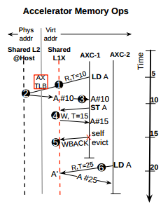
Accelerator Memory Operations
Request : Load A, #10
Misses in L0x -> Misses in L1x
Virtual -> Physical Addr. in Ax TLB
MESI read request at L2
Response: Data + Phys. Block addr , Add to sharer list
Physical -> Line Pointer map
Data + Line Pointer @L1
Consumed by Acc

Slide 13
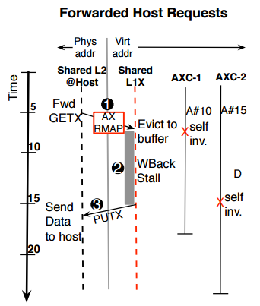
Host Requests

Slide 14
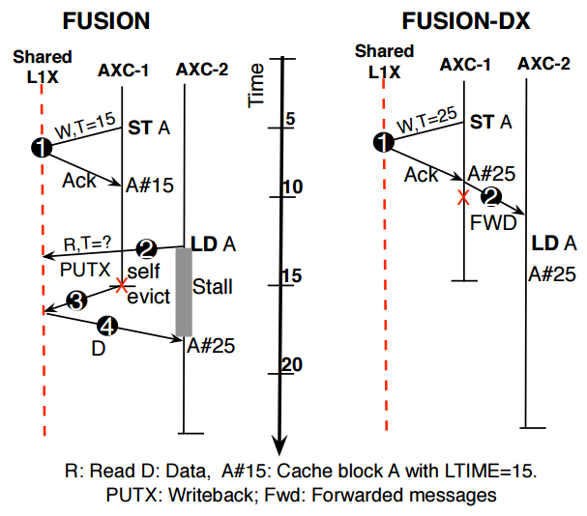
Fusion vs Fusion -Dx

Slide 15
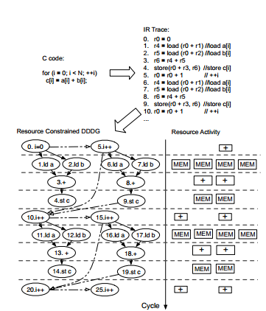
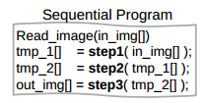
Evaluation Methods
MACSIM : Simulator for Heterogenous Computing Systems
C
A
GEMS: Simulator for Memory Hierarchy
Aladdin Like Flow
L1D
L1D
Shared L2
GPROF

Slide 16
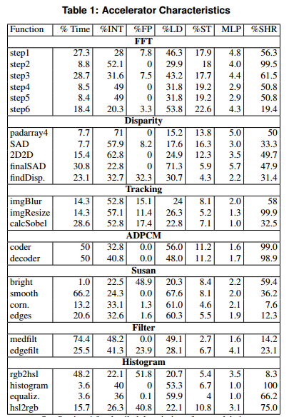
Benchmarks Characterisation
Most memory Intensive : FFT, DISP, TRACK, HIST
Compute Intensive : ADPCM, SUSAN, FILTER
Max. Data Re-use : FFT , Tracking , ADPCM, HIST
Max. Per tile accelerators : 6 ( FFT )

Slide 17
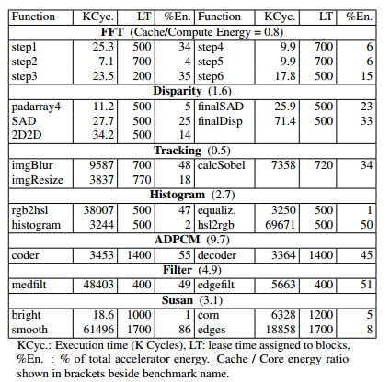
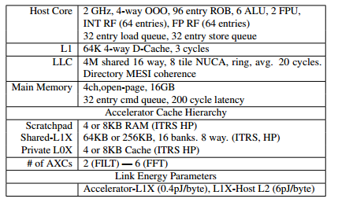
Evaluation Specs

Slide 18
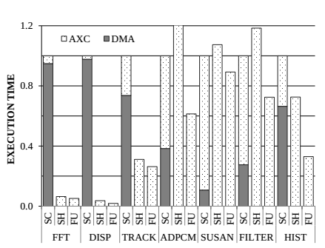
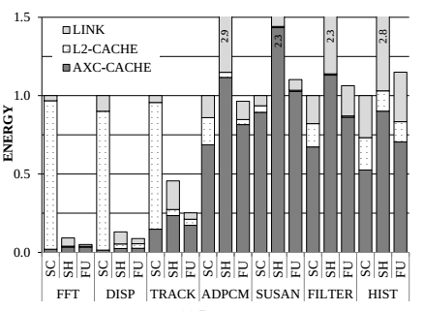
Results
Baseline: Scratchpad
Observation: Shared L1x helps memory intensive kernels but hurts compute dominated kernels
Observation: Private L0x captures spatial locality in SUSAN and ADPCM , better than SHARED
Observation :L0x Caches reduce L2 access energy by filtering DMA calls for memory intensive prog.
Observation : Fusion’s L1x further filters L2 accesses, but increased coherence message result in no significant energy improvement

Slide 19
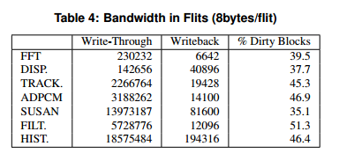
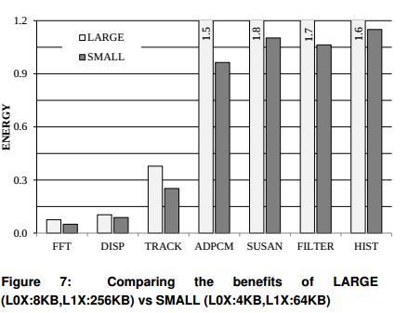
Results
Large Caches at L1x and L0x still may not capture all the working sets and hence fail to give any energy benefits
Write Through caches are energy expensive
Protocol Extensions like write forwarding can reduce energy consumption in Fusion model.
Address Translation overheads need to be mitigated -> reduced in Fusion by removing TLB from critical path.

Slide 20
Comments
Not all benchmarks with high share percentage are evaluated on write-forwarding.
Should kernels that are candidates for write forwarding be designed as single accelerators ?
How does providing private L0 ( 4-8KB) per ACx scale for more than 6 ( max here ) ACx per tile ?
Adding timestamp comparison logic / update logic in the cache is a major change in cache design. Do these affect access latency ?

Slide 21
References
Goodridge. The effect and technique of system coherence in arm multicore technology
POWER8 Coherent Accelerator Processor Interface http://www-304.ibm.com/webapp/set2/sas/f/capi/home.html
Towards Cache Friendly Hardware Accelerators , Yakun Sophia Shao, Sam Xi, Viji Srinivasan† , Gu-Yeon Wei, David Brooks
Rakesh Komuravelli, Matthew D. Sinclair, Johnathan Alsop, Muhammad Huzaifa, Maria Kotsifakou, Prakalp Srivastava, Sarita V. Adve, and Vikram S. Adve. 2015. Stash: have your scratchpad and cache it too. In Proceedings of the 42nd Annual International Symposium on Computer Architecture (ISCA '15). ACM, New York, NY, USA, 707-719. DOI=http://dx.doi.org/10.1145/2749469.2750374
Y. S. S. B. R. Gu and Y. W. D. Brooks. Aladdin: A pre-rtl, powerperformance accelerator simulator enabling large design space exploration of customized architectures
B. Reagen, R. Adolf, S. Y. Shao, G.-Y. Wei, and D. Brooks. Machsuite: Benchmarks for accelerator design and customized architectures. In IEEE International Symposium on Workload Characterization (IISWC), 2014

Slide 22
Thank you
Questions ??

