Slide 1
PENN: Programmable Engine for Neural Networks
Vinay Gangadhar, Sharmila Shridhar,
Anilkumar Ranganagoudra, Chandana Hosamane
ECE 751 Project Presentation
Fall 2015
University of Wisconsin - Madison

Slide 2
Executive Summary
Design of a Programmable Accelerator/Engine for Neural Networks (NNs)
A flexible programming software interface to map NNs like DNN, CNN or any ML network
A 2 level configurability:
Synthesis
Runtime
End-to-End implementation with RISCV Toolchain (Ongoing)
Comparison with a Domain Specific Accelerator (DSA) -- DianNao with preliminary performance, area and power results

Slide 3
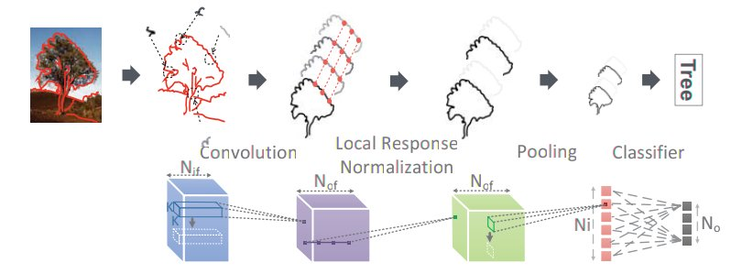
Introduction
Neural networks – A new computing paradigm
Deep neural, Convolutional, Recurring and other Neural networks
High computational throughput and energy efficiency requirements
Domain/Application Specific Accelerators and ASIC for the help
Ex: DianNao Bros., NPU, Custom ASICs, Microsoft Catapult for CNN etc.
DNN → Focus of the project
Source: DaDianNao
Notes:
Neural networks is an emerging computing paradigm in last decade with resurgence of back-propogation and efficient perceptron based designs.
It is no longer the case the desktop and servers or even GPUs drive the computing needs of future NN based applications

Slide 4
Outline
Introduction
Motivation/Problem
Insights – Principles of Specialization
PENN Overview
Programmable Software Interface
PENN Architecture
Implementation & Preliminary Modeling Results
Conclusion
Notes:
Now with that introduction, we will now see what is the problem with DNN DSAs and why there is a need for programmability

Slide 5
Traditional
Accelerator
(DSA)
Programs
Domain-Specific
Programs
General Language
Compiler
(tiny HW/SW
Interface)
General ISA
General Hardware
Specialized
Hardware
10-1000X Performance/Power or Performance/Area
(completely lose generality/programmability)

Slide 6
Traditional
Specialization
Programs
Goal: To achieve efficiency of DSA with Programmability
DNN
Programs
General Language
(“specialized”)
Compiler
Synthesis Interface
(customizable + flexible
HW/SW Interface)
General ISA
General Hardware
Configurable
Hardware
Can we get 10-1000x?
Is it still general purpose enough?
Notes:
What you need is some sort of specialized program with a customizable and flexible interface exposed to programmers
We also add an extra level of interface called synthesis interface here for more reconfigurability

Slide 7
Outline
Introduction
Motivation/Problem
Insights – Principles of Specialization
PENN Overview
Programmable Software Interface
PENN Architecture
Implementation & Preliminary Modeling Results
Conclusion
Notes:
Now with that introduction, we will now see what is the problem with DNN DSAs and why there is a need for programmability

Slide 8
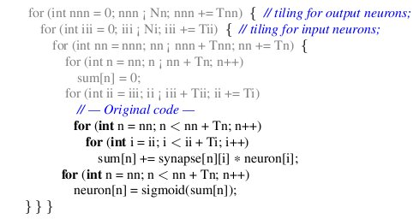
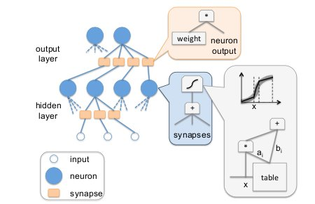
How to design a Specialized Architecture for DNNs?
DNN Programs
Regular Memory
Large Datapath
Ample Parallelism
Specialization Principles:
Concurrency
Compute
Communication
Data Reuse
Coordination

Slide 9
PENN Overview
Tiny Core
(RISC V SODOR)
Scratchpad
D$
DMA
Input Controller
Cycle 7
Cycle 7
CGRA
× N Tiles
CGRA
(Timing based)
FU
FU
CGRA
FU
FU
…
Output Controller
Concurrency
Compute
Communication
Data Reuse
Coordination

Slide 10
Configuring PENN
[fu-model]
FU_TYPE FU_ADD: Add16:0
FU_TYPE FU_MUL: Mul16:0
FU_TYPE FU_SPC: Sig16:0, Div16:1
OUT_DIRECTIONS: SE:0
[switch-model]
OUT_DIRECTIONS: N:0 NE:1 E:2 SE:3
S:4 SW:5 W:6 NW:7
[sub-model]
outs_per_switch: 3
ins_per_switch: 6
[dpath-model]
FU_MUL FU_ADD FU_MUL FU_ADD
FU_ADD FU_MUL FU_ADD FU_MUL
FU_MUL FU_ADD FU_MUL FU_ADD
FU_ADD FU_MUL FU_ADD FU_MUL
FU_MUL FU_ADD FU_MUL FU_SPC
[io-model]
VPORT_IN 0: 1:<3 5> 3:<5 7 9 11>
VPORT_IN 2: 4:<17 18>
SPORT_IN 0: 6:<19>
…
Synthesis Time
Functional Unit Mix
Datapath Width
Scratchpad Line Size
Number of PENN units
Run-Time
Datapath Configuration
Memory Access Pattern
Scratchpad Storage

Slide 11
Using PENN Infrastructure
DNN 1
DNN 2
DNN 3
1. Design Synthesis
Analyze DNN workloads
Define HW/SW interface and Synthesis Config.
Arch. Constraints
PENN
Config.
2. Programming
Fit applications into HW/SW interface
Get the scheduler program for DFG
Scheduler program
Programming Interface
DNN Kernels (modified)
3. Runtime
Runtime configuration
Switch dynamically per DNN kernel
Configure for DNN Kernel 1
Configure for DNN Kernel 2
Run
Kernel 1
Run
Kernel 2
Notes:
FU Type, Spatial Array size, datapath width

Slide 12
Outline
Introduction
Motivation/Problem
Insights – Principles of Specialization
PENN Overview
Programmable Software Interface
PENN Architecture
Implementation & Preliminary Modeling Results
Conclusion
Notes:
Now with that introduction, we will now see what is the problem with DNN DSAs and why there is a need for programmability

Slide 13
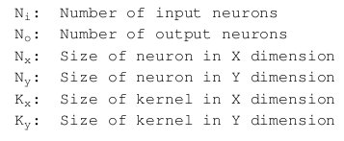
Programming Interface Definitions
mem_addr: starting address to access (can be GPP register that
holds address)
stride: memory stride [N_{i} x N_{x}]
access_size: length of stride access [N_{i} x K_{x}]
num_strides: Number of strides [K_{y}]
scratch_offset: offset value of scratchpad to load to/from
access_size
mem_addr
num_strides
memory stride

Slide 14
PENN Program Macros
Main Memory
DMA
Scratchpad
Input Controller
IC_DMA_SCRATCH_LOAD
IC_SCRATCH_READ
IC_DMA_READ
OC_PENN_WRITE
OC_PENN_SCRATCH_WRITE
OC_BUF_DMA_WRITE
Other Misc. Macros for synchronization and Constant buffering not shown here
CGRA
CGRA
(Timing based)
CGRA
Output Controller
Notes:
IC_DMA_SCRATCH_LOAD [access_size] [num_strides] [scratch_addr][word_offset]
IC_SCRATCH_READ [scratch_addr] [word_offset][port_type] [port_num]
IC_DMA_READ [mem_addr] [access_size] [num_strides] [port_type] [port_num]
OC_SB_WRITE [port_type] [port_num] [port_type] [port_num][num_strides]
OC_SB_SCRATCH_WRITE [port_type] [port_num][scratch_addr] [word_offset] [num_strides]
OC_BUF_DMA_WRITE [mem_addr] [access_size] [num-strides]

Slide 15
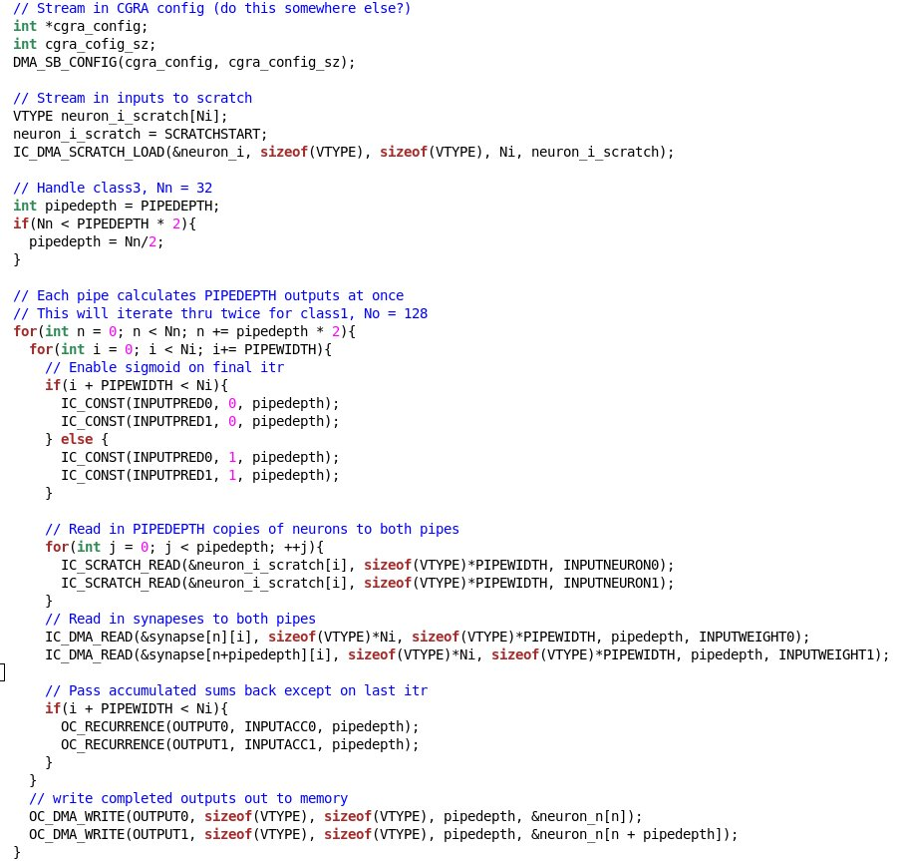
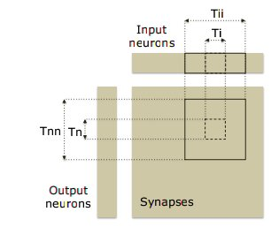
PENN Example Workload
Source: DianNao
Example Classifier Program

Slide 16
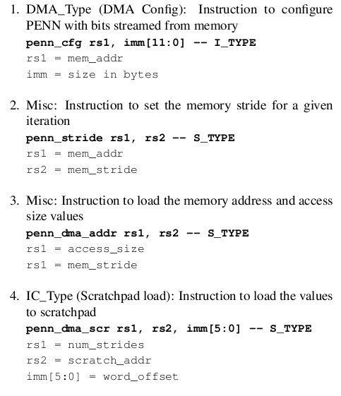
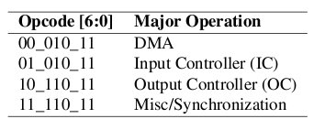
PENN Instructions
Extended RISCV Base 32bit ISA to encode PENN instructions
Example Instructions
Major Operations Encoding

Slide 17
Outline
Introduction
Motivation/Problem
Insights – Principles of Specialization
PENN Overview
Programmable Software Interface
PENN Architecture Details
Implementation & Preliminary Modeling Results
Conclusion
Notes:
Now with that introduction, we will now see what is the problem with DNN DSAs and why there is a need for programmability

Slide 18
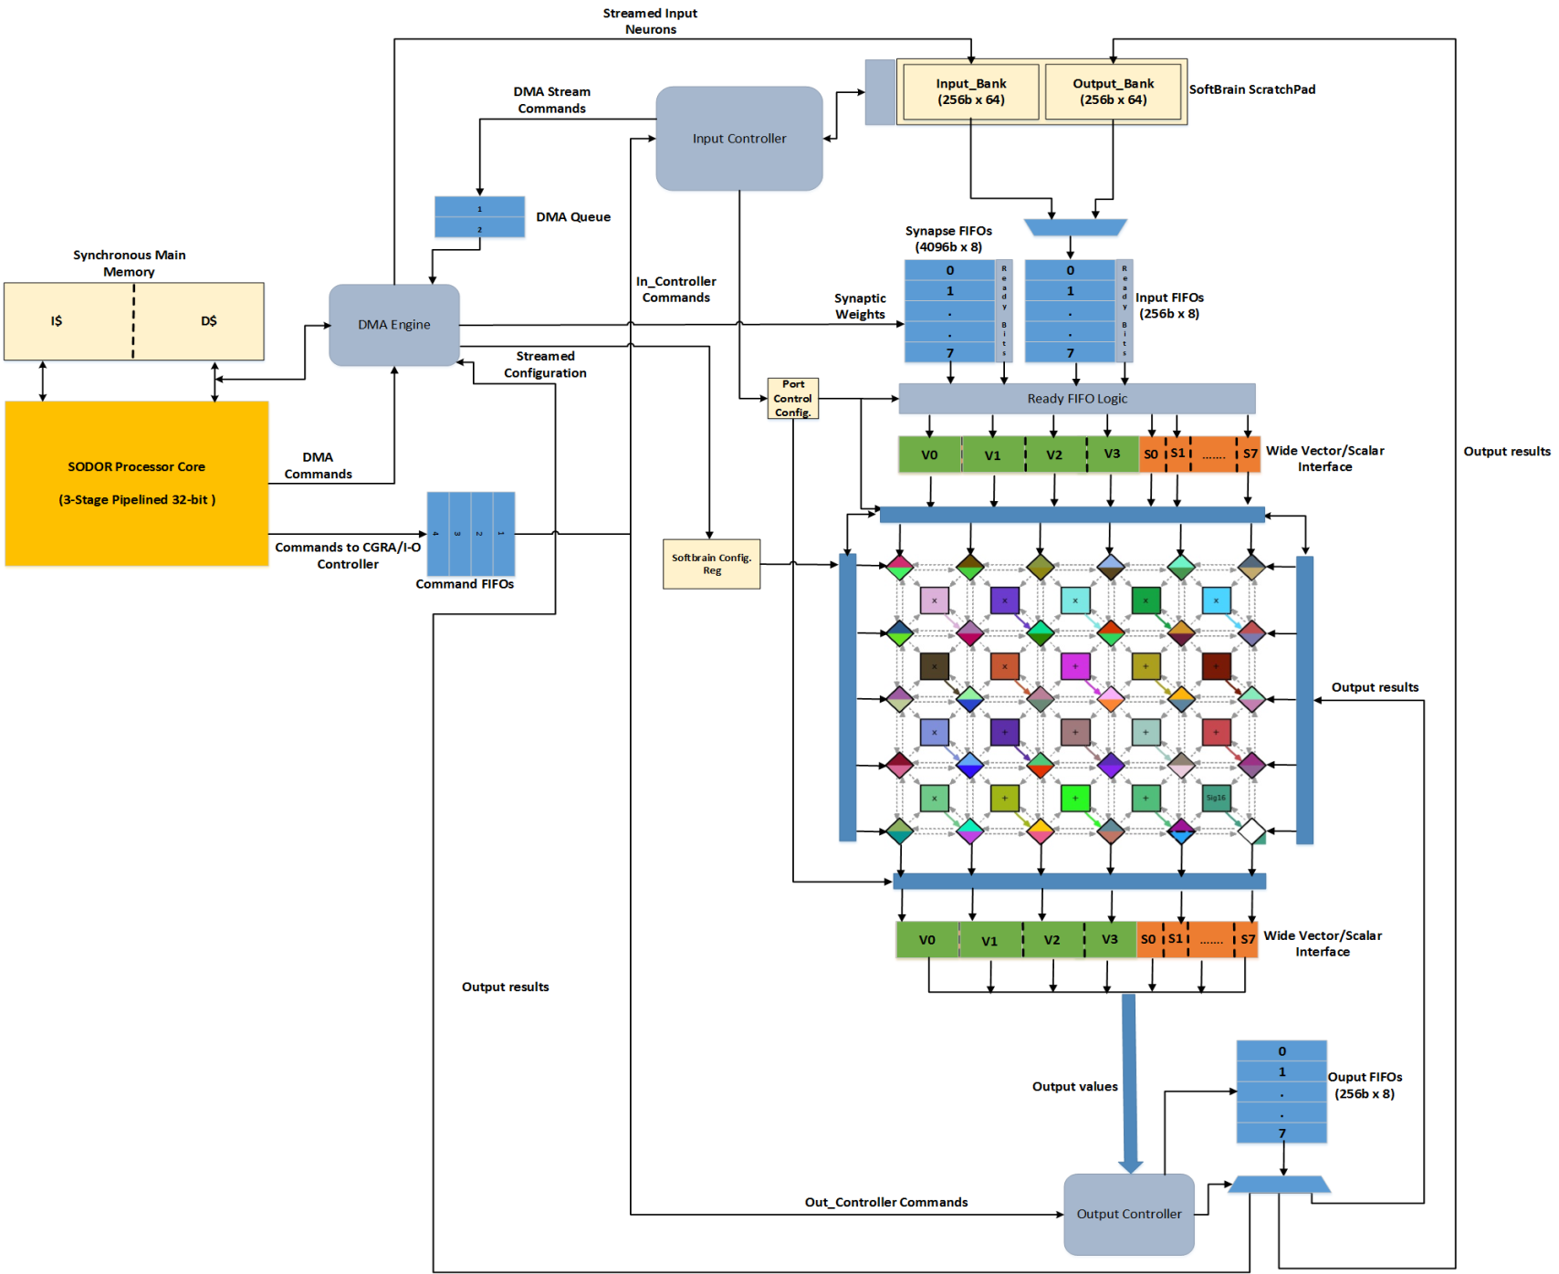
PENN Detailed Architecture

Slide 19
PENN Architecture
SODOR
Core
Scratchpad (4KB)
D$
DMA
Input Controller
Input
FIFO
Wide Port
Interface
Ready
Logic
Full
CGRA
Input Elements Vector
CQ
1 2 3 4 5 6 7 8
(Timing based)
5
1
62
73
84
Ready
Fifo
Output
FIFO
To Data Fifos
Output Controller
Ready
Consume

Slide 20
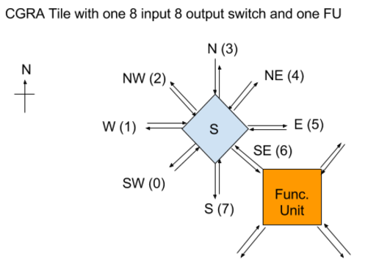
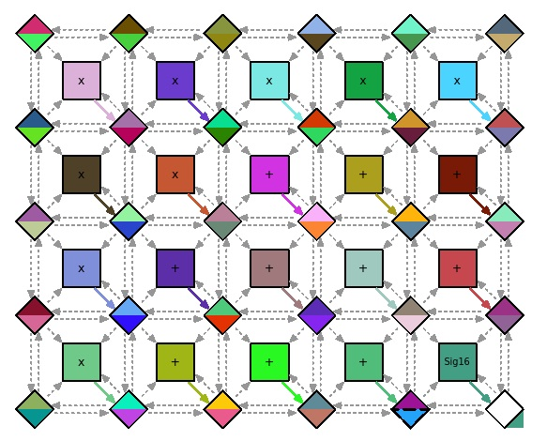
CGRA Fabric
6x5 CGRA Fabric
CGRA Tile
Functional Unit can be: ALU, Multiplier, Sigmoid
FU mix can be configured at Synthesis time
Datapath schedule is configured at run-time

Slide 21
CGRA Run-time Configuration
Configuration streamed down from top rows of switches – 40bits for each CGRA tile
Command to DMA to stream the configuration (40b x 6 switches each cycle):
IC_DMA_CFG_READ [mem_addr] [access_size] [num_strides] [port_type] [port_num]
IC_DMA_CFG_READ
cfg_mode=1
5 cycle config.
(30B/cycle)

Slide 22
Outline
Introduction
Motivation/Problem
Insights – Principles of Specialization
PENN Overview
Programmable Software Interface
PENN Architecture Details
Implementation & Preliminary Modeling Results
Conclusion
Notes:
Now with that introduction, we will now see what is the problem with DNN DSAs and why there is a need for programmability

Slide 23
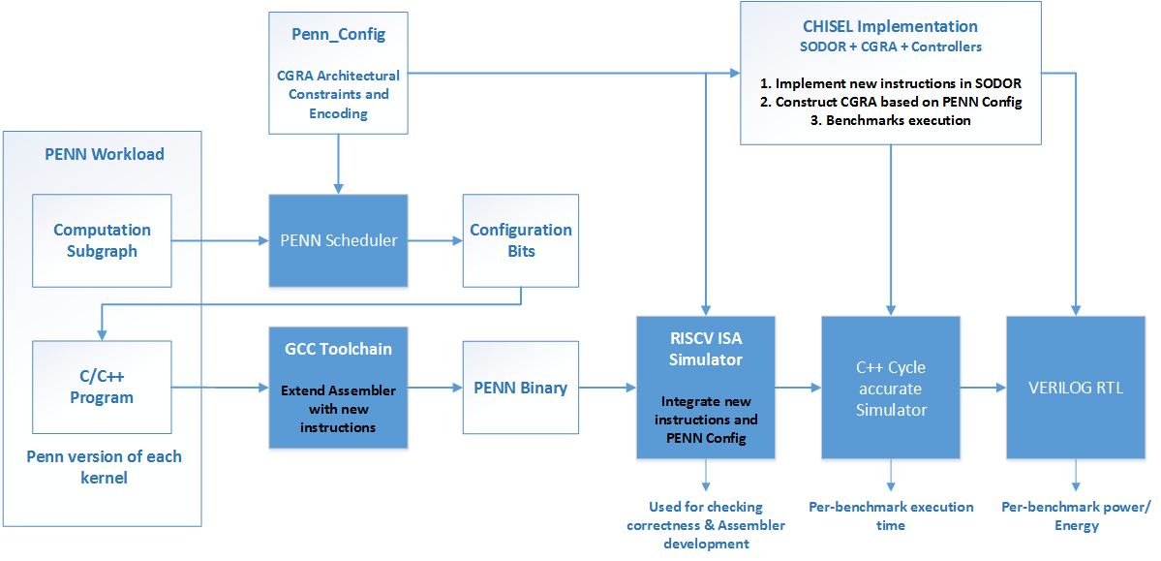
PENN Implementation
Hardware in Chisel (Scala based)
Interface/Parameters exposed for Synthesis level configuration
Generates Verilog and C++ cycle acurate Simulator
Extended the scheduler framework of Nowatzki. et.al [*]
Timing based scheduling for CGRA
RISCV ISA Simulator (Spike) was extended to include new PENN instructions
Functionality of scheduled dataflow graph is checked here
Modified the RISCV GNU Assembler to handle the intrinsic functions
Macros are pre-processed as inline assembly
*Nowatzki et. Al, “A general constraint-centric scheduling framework for spatial architectures,” in PLDI 2013

Slide 24
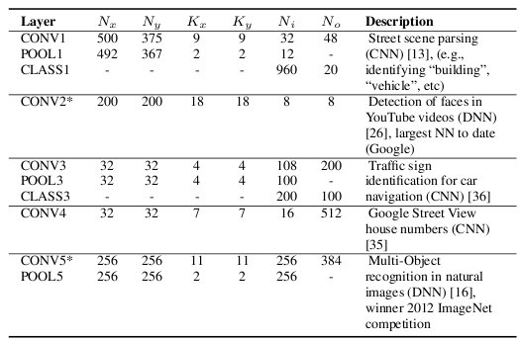
Evaluation & DNN Workloads
Same kernels as
in DianNao* paper
Performance results based on an Analytical Model (PENN Infrastructure still ongoing work)
Area and Power from Chisel generated Synthesized Verilog @32nm node
Compared with the DNN accelerator → DianNao
DianNao Perf. , area and power estimates from the paper [*] normalized to 32nm, 1GHz Freq.
*Chen et. al, DianNao: A SmallFootprint High-Throughput Accelerator for Ubiquitous Machine-Learning. In International Conference on
Architectural Support for Programming Languages and Operating Systems. ASPLOS’14.
Notes:
In remaining classifier and convolutional workloads, PENN has slight overhead on managing DMA (instructions overhead)
8x from multi-tile, 32x SIMD
CGRA provides some additional benefit by reducing instruction management and a reuse buffer reduces cache contention

Slide 25
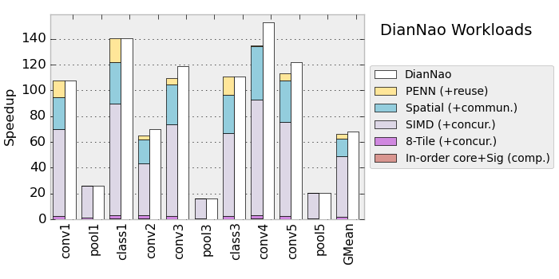
Performance Results
Baseline → 4-Wide OOO processor
Pooling Kernels max out on memory bandwidth
Maximum benefit from the Concurrency (SIMD + Multi-tile → ~49x)
Notes:
In remaining classifier and convolutional workloads, PENN has slight overhead on managing DMA (instructions overhead)
8x from multi-tile, 32x SIMD
CGRA provides some additional benefit by reducing instruction management and a reuse buffer reduces cache contention

Slide 26
Area Results
CGRA Fabric Breakdown (mm²)
36 Switches and 25 FUs
Switches | FUs
0.109 | 0.0048
Overall Area Comparison (mm²)
8 Tile –PENN | DianNao
1.95 | 0.56
1 Tile Area → 0.24 mm²
@32nm & 1GHz Freq.
~3.5x Area Overhead
DianNao area normalized to 32nm @ 1GHz Frequency

Slide 27
Power Results
CGRA Fabric Breakdown (mW)
36 Switches and 25 FUs
Switches | FUs
10.2 | 7.6
Overall Power Comparison (mW)
8 Tile –PENN | DianNao
526.64 | 213
1 Tile Power → 65.03mW
@32nm & 1GHz Freq.
~2.5x Area Overhead
DianNao power normalized to 32nm @ 1GHz Frequency

Slide 28
Challenges & Lessons Learned
H/W-S/W Co-design is challenging but Fun !!
Future specialization engines will follow this technique
Experience gained with assembler, static scheduler and simulator
CHISEL enables a nice parameterizable interface for exploring different design points
Scope for different acceleratable domains using PENN like H/W-S/W interface
File compression, Regex matching, Database processing etc.
Combined Area and Power overhead is amortized when multiple domains are mapped to PENN
A good study to push the limits of efficiency and still have programmability

Slide 29
Conclusion
A flexible programmable engine for Neural Networks
Configurable at 2 levels → Enabling wider design space exploration
Different types of NNs can be mapped with same H/W-S/W interface
DSA like performance with 2.5x Power and 3.5x Area overhead
Overhead becomes smaller when multiple domains are mapped to this engine
Scope for other domains → Database processing, File compression, Regex all can have similar programming interface

Slide 30
Back Up Slides

Slide 31
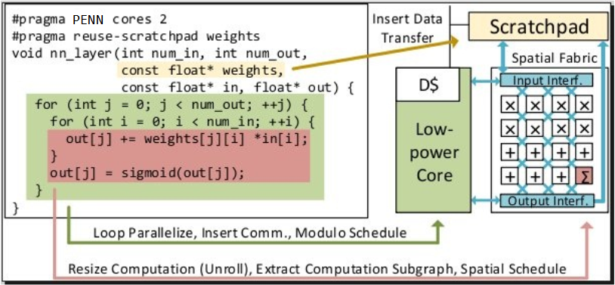
Example Program

Slide 32
Diannao – Machine Learning Accelerator
Diannao: accelerator for deep/convolutional neural networks.
Mapping of DNN/CNN to PENN:
Two or four 16 16-bit elements reduction tree fed into CGRA.
Scratchpad with input neurons can be re-used across multiple output neurons.
Partial output sums buffered into scratchpad or output buffers
CGRA is pipelined to compute 2 or 4 neuron-weight reduction tree per cycle.
Presumed Results: The design can match the performance of Diannao, though at somewhat larger area and power.
Diannao

Slide 33
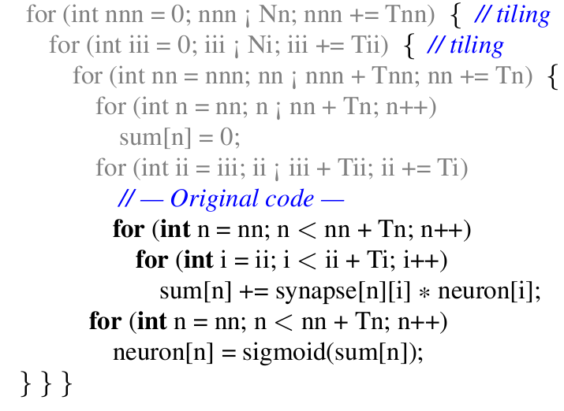
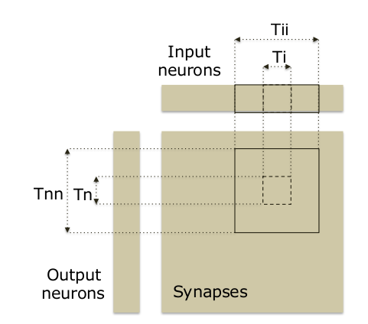
DianNao Example
Scratchpad load: All neurons
DMA stream: All synapses
Partial Sums stored in Output buffers before being fed to sigmoid units
Tn = 16, Ti = 16
Synapse stride_size: 16 x 16 x 2B
Neuron size: 16 X 2B

Slide 34
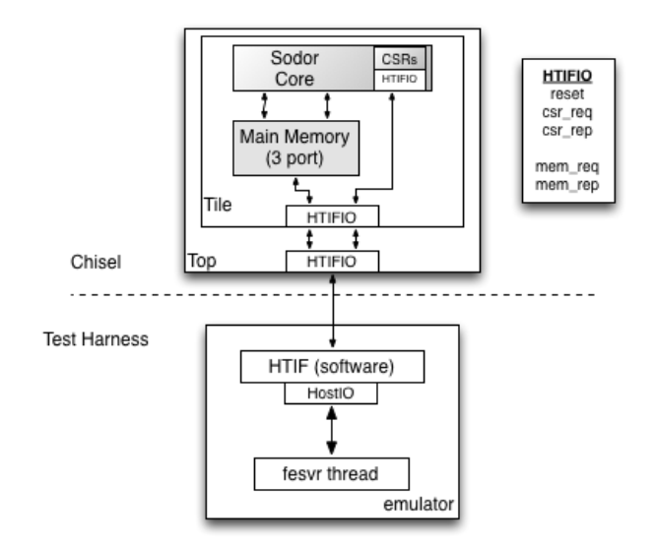
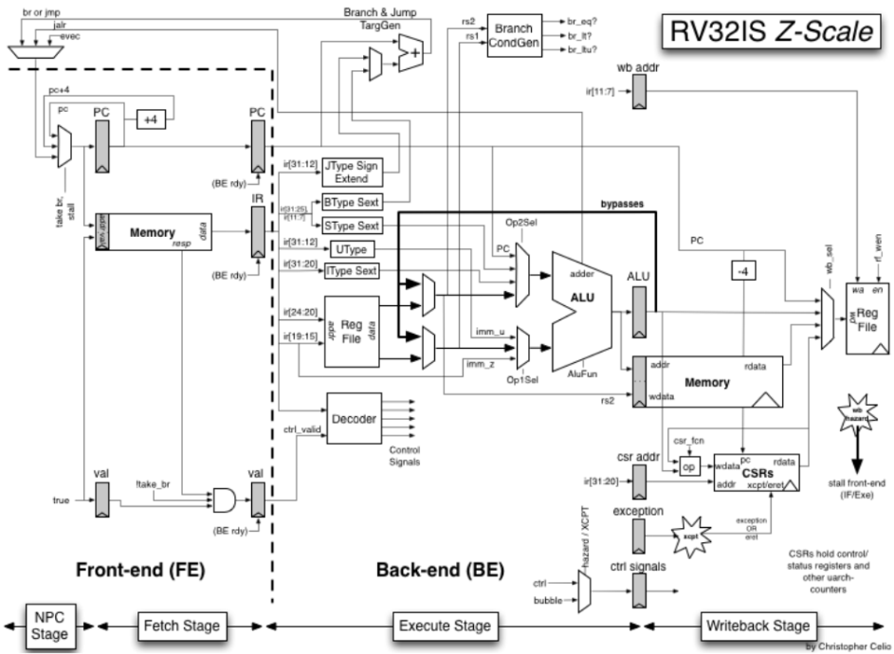
RISCV Core (3 Stage SODOR)
SODOR Core commands:
To DMA (Stream Configuration bits directly)
To Input Controller (For loading Scratchpad and Input FIFOs)
TO Output Controller (For handling Output values)

Slide 35
Workload Sizes
Benchmark | Accel. Blocks (in K Neurons) | Synapse Size (KB) | In Neuron Size (KB) | Out Neuron Size (KB)
conv1 | 30380 | 40 | 1491.25 | 2861.25
pool1 | 45.26 | 0 | 697.5 | 691.25
class1 | 0.12 | 7.5 | 1.88 | 64
conv2 | 3240 | 192500 | 181.25 | 152.5
conv3 | 460 | 110 | 40 | 55
pool3 | 8.19 | 0 | 40 | 31.25
class3 | 0.11 | 56 | 0.44 | 0.25
conv4 | 400 | 96.25 | 47.53 | 125
conv5 | 761270 | 2836 | 4351.25 | 6000
pool5 | 260 | 0 | 4062.5 | 4000

