Slide 1
Highly Efficient and Flexible Video Encoder
on CPU+FPGA Platform
Di Wu, Liang Zhang, Peng Liu, Yao Song

Slide 2
Motivation
For Video Encoding
Is it possible to combine the advantages of both ASIC and Software solution?
ASIC | high throughput low power consumption | difficult to upgrade Some tasks not suitable for hardware
Pure software | easy upgrade to new algorithm and standard highest quality | poor encoding performance

Slide 3
CPU+FPGA
Industry has provided CPU+FPGA SoCs, and it is a trend to integrate FPGA for GPUs in datacenter!
Xilinx Zynq - Dual-core ARM Cortex A9 + FPGA
For video encoding
Video Frame Encoding (FPGA)
Video Packet Wrapping (CPU)
Video Packet Transmission (CPU)
High performance!
Easy upgrading!
Easy programming!

Slide 4
Discussions in x264 Community
[x264-devel] FPGAs and x264
https://mailman.videolan.org/pipermail/x264-devel/2009-July/006009.html
“Just offloading simple DSP functions to an fpga is a bad idea when the host is a modern cpu.”

Slide 5
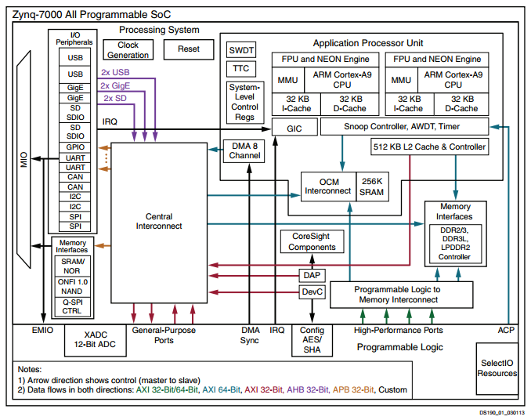
Xilinx Zynq Architecture
programming system (PS) and programmable logic (PL)
AXI interface connecting PS and PL
http://www.xilinx.com/support/documentation/data_sheets/ds190-Zynq-7000-Overview.pdf
Notes:
The programming system contains a dual-core ARM processor, users can develop their own logics such as hardware accelerator in PL.
AXI interface can be used to transfer data between PS and PL. AXI ports in PS include GP0/GP1 (master), HP0/HP1(slave) and ACP port.

Slide 6
Design Process
Most efforts of our project
Hardware
Developing custom IPs
Instantiating user defined IPs in Vivado
Instantiating programming system (PS) and predefined IP as well as user IP in Vivado
Synthesizing the system and implementing on Zynq
Software
Export hardware to SDK
Create BSP
Application development and debugging

Slide 7
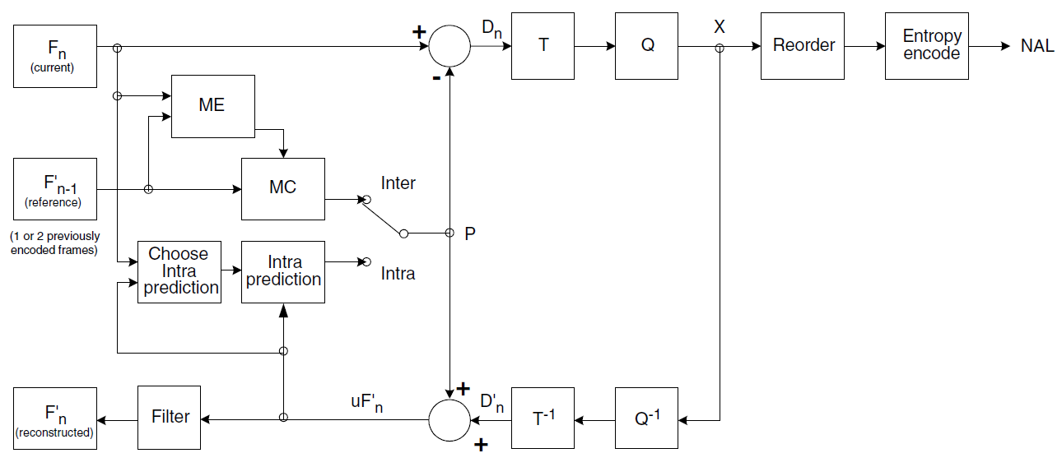
H.264 Baseline Profile
one of the three profiles defined in H.264 standard
widely used in mobile devices
supports predictive encoding, discrete cosine transform and quantisation, entropy encoding
Notes:
According to the H.264 standard[1], the baseline profile encoder supports intra and inter-predictive coding (temporal and spatial compression) , core transform, Hadamard transform, quantisation. These steps not only perform compression , but also make it easier for entropy encoder to compress the data. The entropy encoder used in H.264 baseline profile is context-based adaptive variable length coding (CAVLC). The diagram of the baseline encoder is shown in figure 1[2].

Slide 8
Video Encoder’s Tasks
Data Access
Input video frames
Reference frames
Intermediate data
Encoded video packets
Encoding
Motion Estimation
Prediction (Intra + Inter)
Filtering
Entropy coding

Slide 9
Data Access Challenges
We want
Low latency
Low cost
Zynq provides
AXI-based interconnection -> high throughput, but high latency
Only PS has memory controller
Solution
Minimum data exchange between PS and PL

Slide 10
AXI Interfaces
Three kinds of interfaces
AXI-Lite (Memory Map)
AXI-Full (Memory Map)
AXI-Stream
We use AXI-Lite interface for control signals, AXI-Full for YUV frames and encoded packets

Slide 11
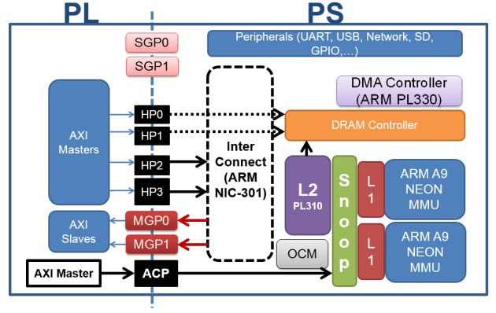
PS-PL Interconnection In Zynq
http://www.googoolia.com/wp/2014/06/20/lesson-8-an-overview-on-zynq-architecture/

Slide 12
Interfaces of Our H264 Encoder
Interrupt port
AXI-Lite slave interface for configuration
AXI-Full master interface for YUV frames reading and encoded packets writing
Encoder IP
Interrupt
AXI-Lite
Slave
configuration
YUV frames
AXI-Full
Master
Encoded packets

Slide 13
The Encoder Engine
Encoder Engine
CLK
CLK2
NEWSLICE
control signals
NEWLINE
QP
xbuffer_DONE
intra4x4_READYI
Y values of pixels
intra4x4_STROBEI
intra4x4_DATAI
intra8x8cc_readyi
U,V values of pixels
intra4x4_READYI
intra4x4_STROBEI
tobytes_BYTE
Encoded packets
tobytes_STROBE
tobytes_DONE
We use the open source implementation from
http://hardh264.sourceforge.net/

Slide 14
Internal of Our H264 Encoder
Encoder Controller
AXI Lite
Interrupt
Configuration
Encoder Engine
Y buffer(4-way)
AXI Master Burst
YUV frames
U buffer(4-way)
V buffer(4-way)
Encoded packets
Data Path
Open Source
Our Verilog code
Control Path
Xilinx IP

Slide 15
AXI Interfaces Implementation
Implement from scratch
RTL implementation based on templates generated by Vivado
Design with HLS
Use Xilinx’s IP
AXI Lite Slave interface
AXI Master Interface

Slide 16
Block Design
Let’s integrate our IP to Zynq SoC
Encoder IP
Interrupt
Controller
Interrupt
ARM Processor
configuration
GP0
YUV frames
AXI4 Interconnect
HP0
Encoded packets
DDR Memory Controller
PL
PS

Slide 17
Software Implementation
How to control the video encoder IP?
The AXI-Lite interface (memory map) can access registers
Control informations need to transfer to video encoder
Start address of a YUV frame
YUV format
Video resolution
QP value of the encoder
frame number
output address of h264 stream
Information provided by video encoder
video packet size

Slide 18
Encoding Process in PS
Put a video frame (YUV) in DRAM (from camera, decoder’s output, etc.)
Config the parameters
Start encoding
On interrupt, save encoded result

Slide 19
Encoding Process in PL
Move a YUV frame data from DDR RAM to Y, U, V buffers
Feed the pixels to encoder engine
Wait for the encoder to generate video packets and move the packets to DDR RAM
After finish the encoding of one frame, generate an interrupt

Slide 20
Implementation
Our implementation is still ongoing
Hopefully finish the design and evaluation before report deadline
Development Environment
Vivado 2015.3
Zedboard

Slide 21
Workload Characteristics
Data intensive
Frame by frame, not stream
Computation intensive
Real-time requirement for some applications

Slide 22
The Encoder Engine Verification
We simulated the encoder engine with test bench, it can generate the correct NAL unit stream.
Source YUV: coastguard(30 frames), 352x288, YUV420
QP: 28
PSNR: 36.3 dB
Compression ratio: 10.6:1
Reference: x264’s PSNR with same QP, medium preset
Only I frame. PSNR 40.31 dB, compression ratio 8.3:1
With P, B frame. PSNR 37.0 dB, compression ratio 42.6:1

Slide 23
Design Review
A H.264 video encoder IP for Zynq SoC
Our design needs to follow the design paradigm of AXI4 based IP
Minimum communication is the key to power/performance gain
Use high throughput mode (burst), or other optimization (future work: pipelining) to optimize the communication between CPU and FPGA logic
Vivado is a powerful tool, but the learning curve is very high (especially for software guys)

Slide 24
Discussion
Can we use some general framework to simplify our work?
No
Example: RSoC framework:http://rsoc-framework.com/
Suitable for “stream” applications

Slide 25
Conclusion
Task offloading is not always helpful, communication latency matters
Video encoding on CPU+FPGA SoC can be both efficient and flexible
Our system can be used to integrate other encoder engines
CPU+FPGA SoCs are powerful tools for designers, “do simple thing fast on HW, intelligence on SW”.

Slide 26
Future Works
Hardware
Optimization, e.g. pipelining
Video encoder engine improvement, e.g. support P frame and B frame
Software
Bitrate control logic
OS support
Integration with multimedia software framework (ffmpeg, gstreamer, etc.)

Slide 27
Thanks!
Q&A

