Slide 1
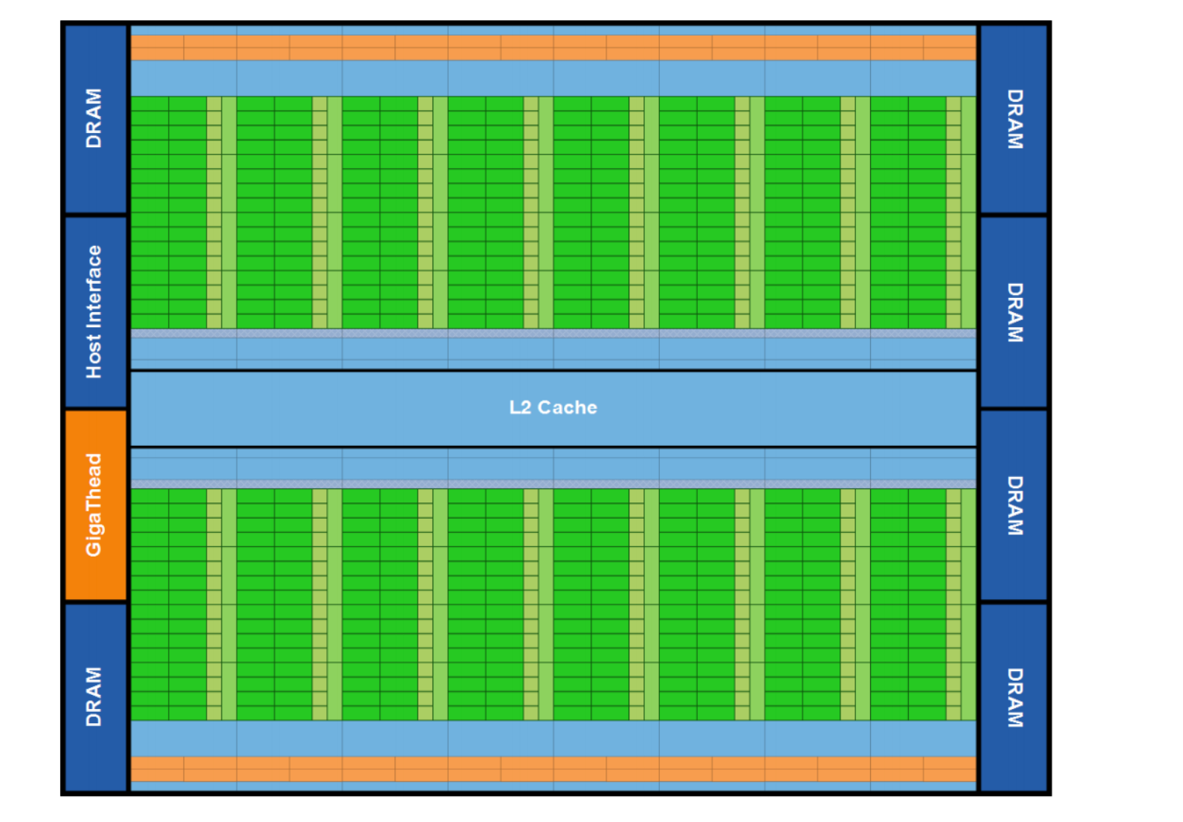
Complexity effective memory access scheduling for many-core accelerator architectures
Zhang Liang

Slide 2
Introduction: GPGPU
Multiply Shader Core (Nvidia’s Kepler already has more than 2000 shader cores)
Massive threads run parallel
Arithmetic intensity (very good at float point calculation, high GFLOPS)
API supports: OpenCL, Nvidia CUDA, graphic shading language
CUDA example: https://www.youtube.com/watch?v=K1I4kts5mqc

Slide 3
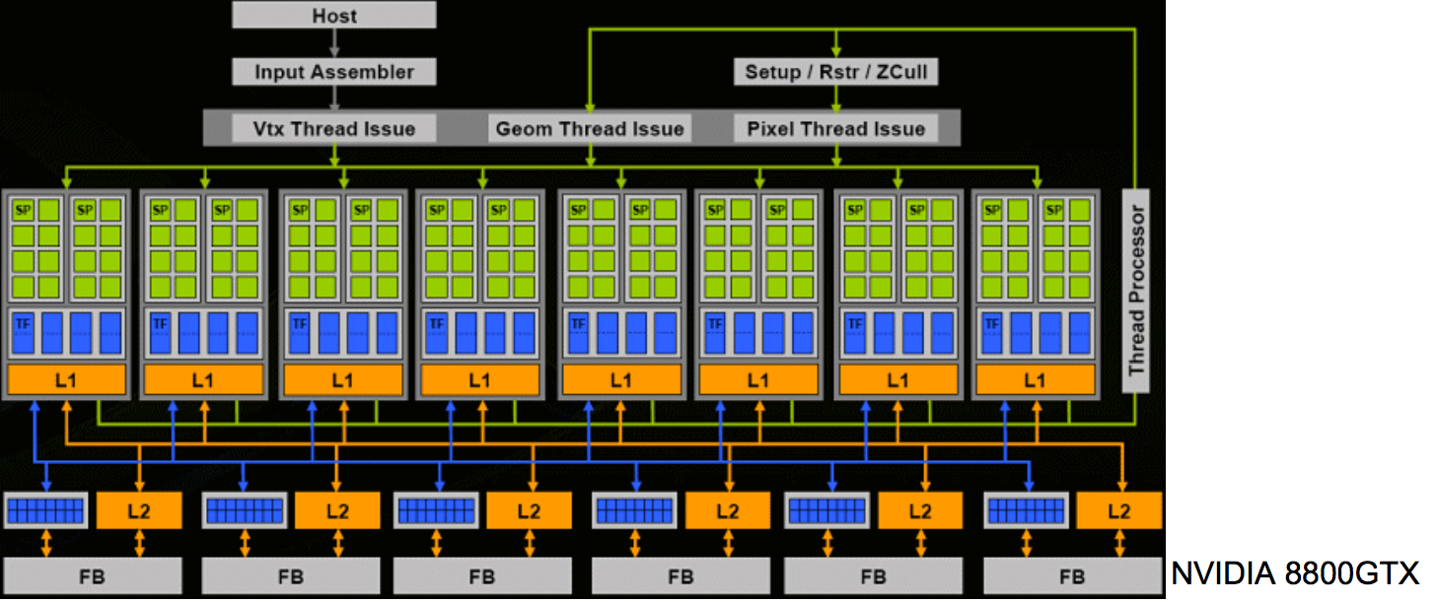
Graphic Pipeline: Vertex Processing (shader core) -> Rasteration (Fix Function Unit)->Pixel Processing (share core)
GPGPU takes advantage of powerful of shader core

Slide 4
Problem of GPGPU
Require very high bandwidth
Multiple Shader cores destroy “row access locality”
That’s why bandwidth is always the topic for new gpu architecture

Slide 5
Introduction: DDR
Each DDR has 4 banks
Each bank has multiply rows and multiply columns
Accessing row must be in row buffers

Slide 6
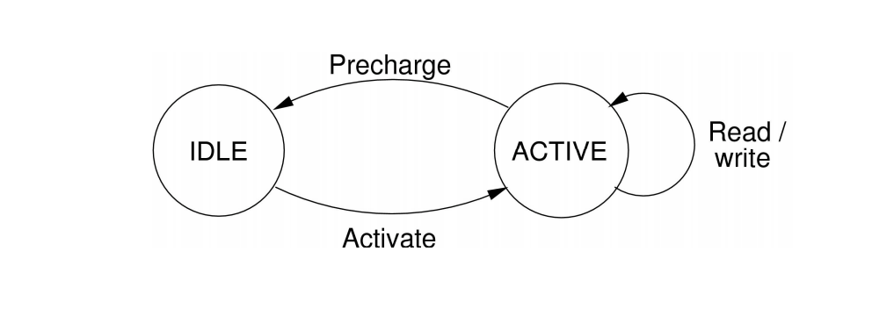
DDR cannot always response immediately

Slide 7
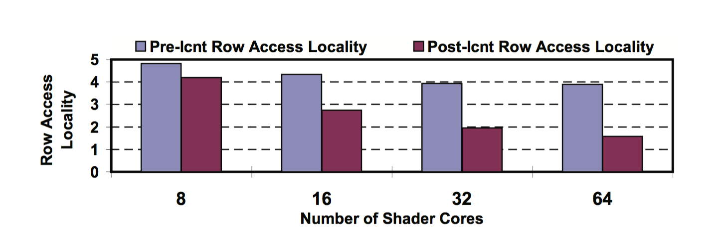
reasons for research
The gap between the pre-interconnect and post-interconnect of Row Access Locality, especially when the number of shader cores becomes larger

Slide 8
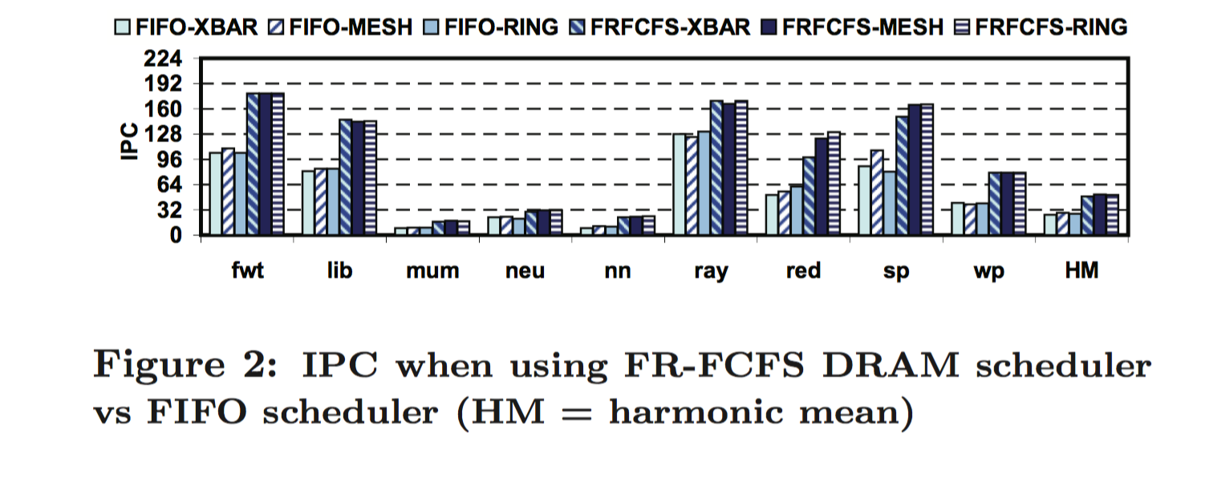
Reasons for research
FR-FCFS has high performance but area-intensive and may need to compare all requests in the DRAM controller queue every cycle

Slide 9
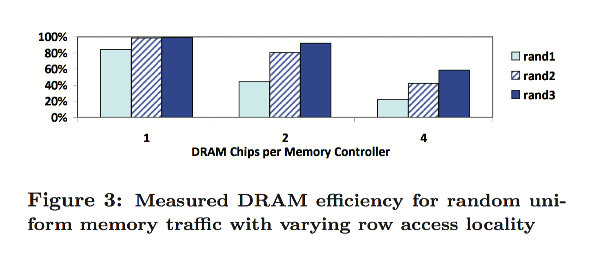
reasons for research
fewer DDR per controller is more effective
as number of controller increases, reduce the number of read/write commands per activated row for each chip
with low row access locality, the DRAM efficiency can reduce greatly

Slide 10
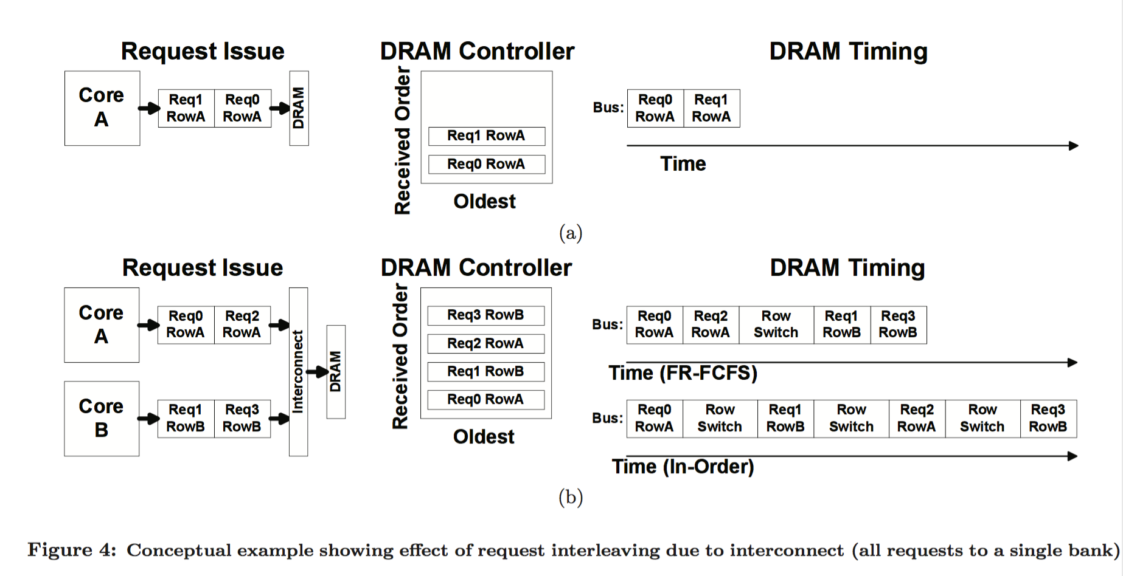
why need out of order scheduling

Slide 11
Proposed design
Using Simple in-order memory controllers
Using “smart” NoC
To achieve the same high performance as FR-FCFS

Slide 12
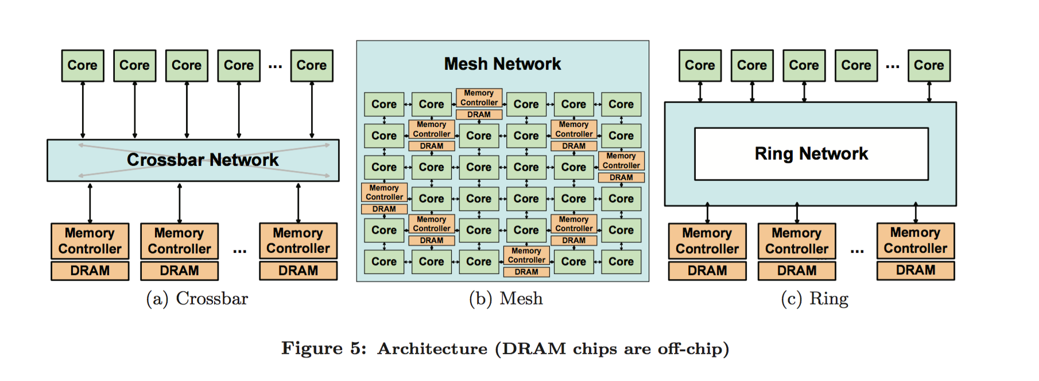
Interconnect architecture
Crossbar Network
Mesh
Ring Network

Slide 13
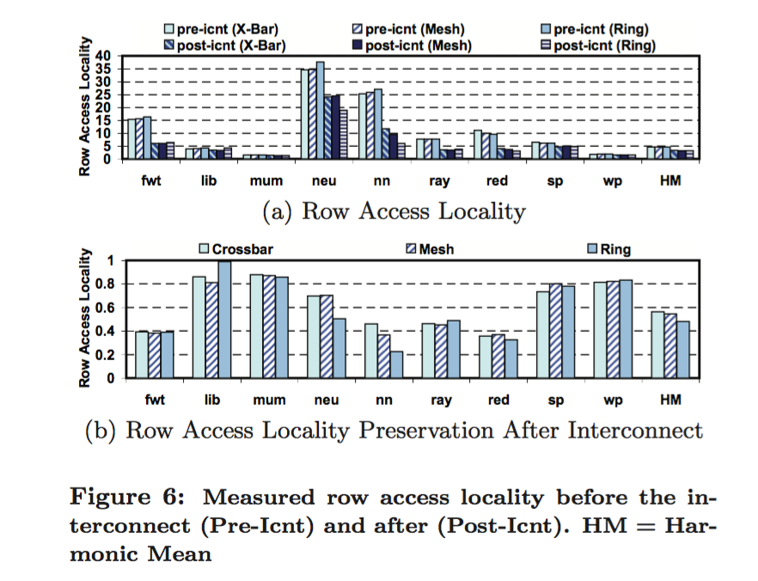
Row Access Locality decrease by almost 47% on average (between pre-interconnect and post-interconnect)

Slide 14
Two Arbitrations to keep row access locality
Hold Grant (HG): if a pair of I and O win in the last cycle, they win again in current cycle again
Row-Marching Hold Grant (RMHG): if a pair of I and O win in the last cycle, they only win again if the row matches the again (lost inherent in bank-level parallelism)

Slide 15
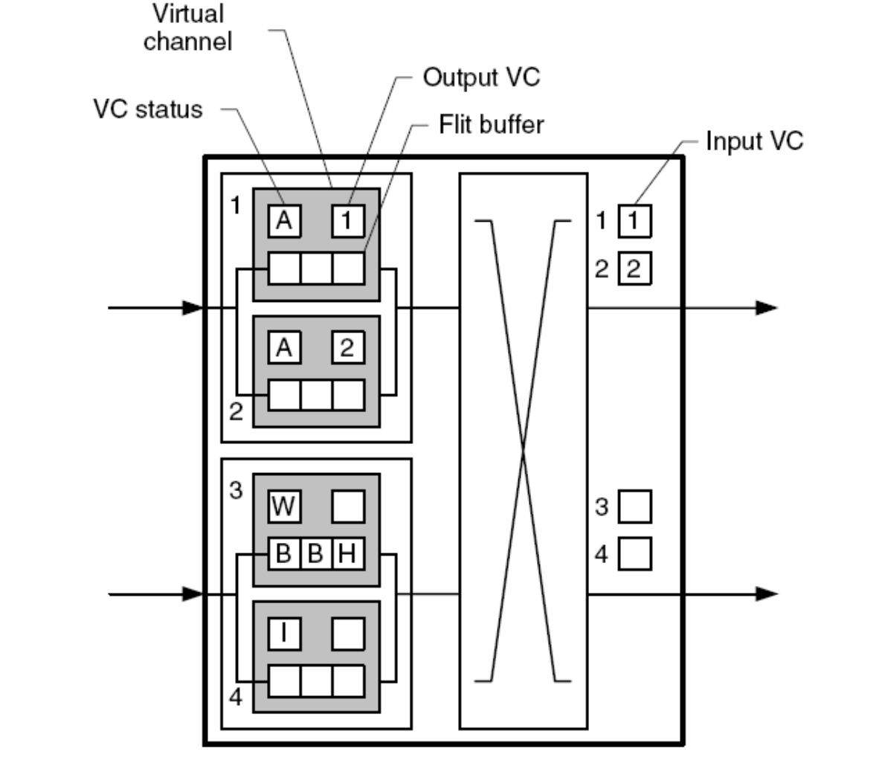
Two stages to apply HG
virtual channel allocation (request from the same shader core and to same DRAM must assign the same virtual channel in each router, performance increase 17.7%)
switch allocation (prevent from undoing the effect of virtual channel allocation)

Slide 16
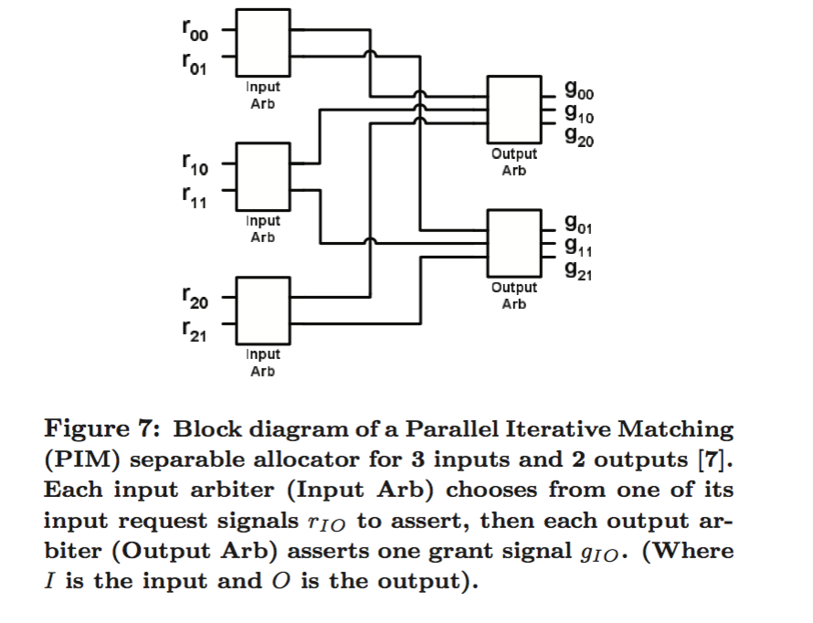
parallel iterative matching (PIM) allocation
1 input arbiter select from a single request per input port
2 output of the first stage of input arbiters is then fed to the output arbiters (choose output request)

Slide 17
Compare comparison RULE
the amount of storage
the amount of bit-comparison

Slide 18
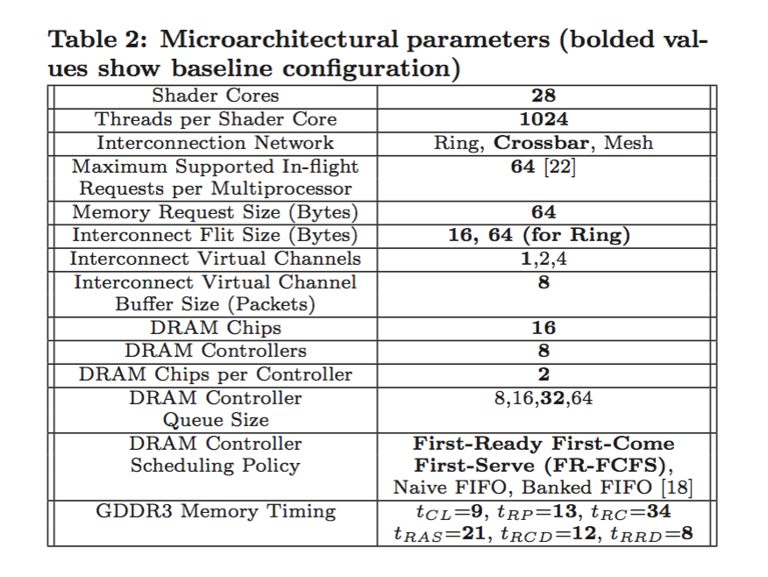
microarchitecture parameters to evaluate the design

Slide 19
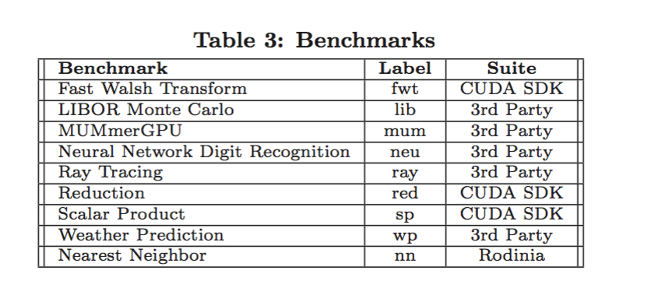
benchmark to evaluate

Slide 20
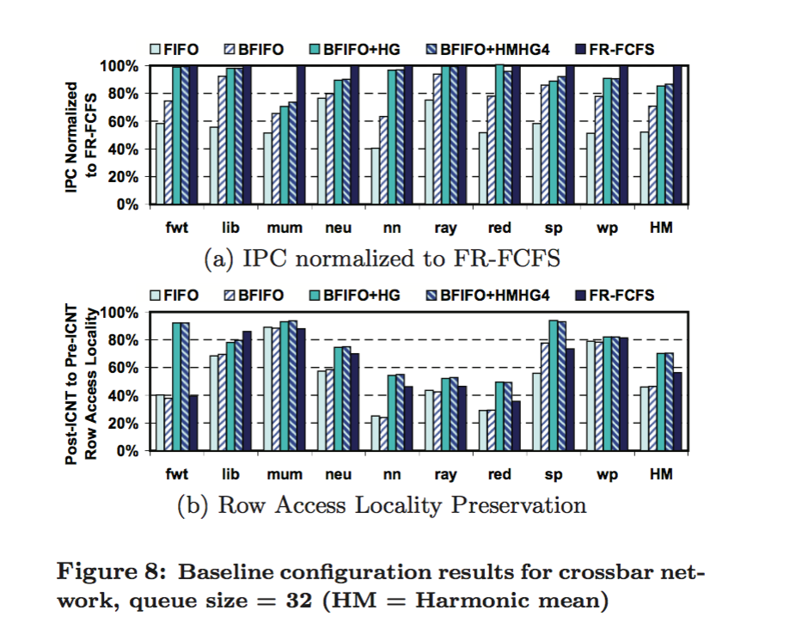
row access locality preservation with different topologies
HG and HMHG preserve 70% of row access locality
FR-FCFS only keep 56.2%

Slide 21
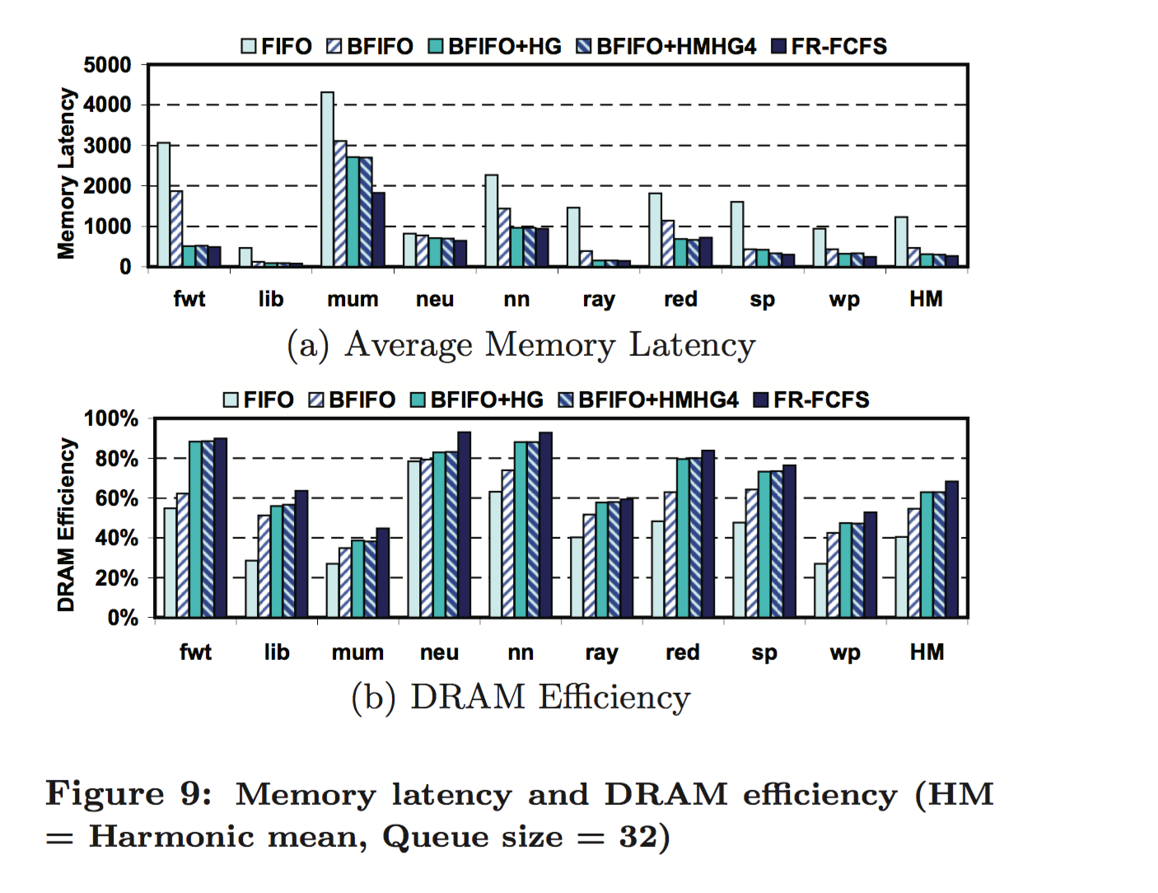
Average latency and DRAM efficiency
Reduce latency of in-order DRAM controller by more than 30% with HM and HMHG
improve efficiency by 15%

Slide 22
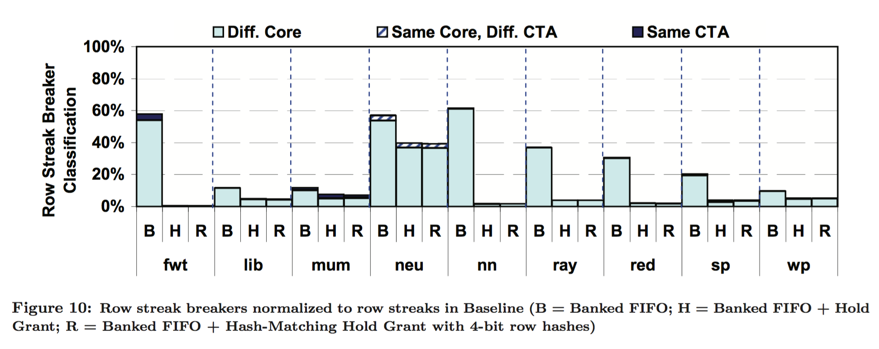
GAP between HM/HMHG and FR-FCFS
row streak breakers dominated from different shader core

Slide 23
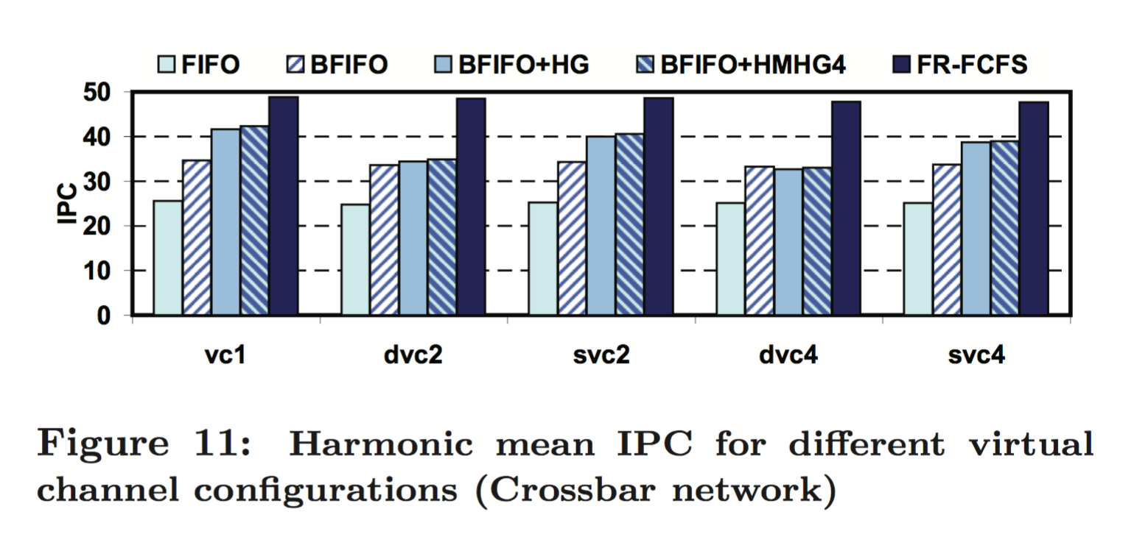
virtual channel configurations
static virtual channel has better performance, improve by about 18%
more virtual channel does not improve IPC

Slide 24
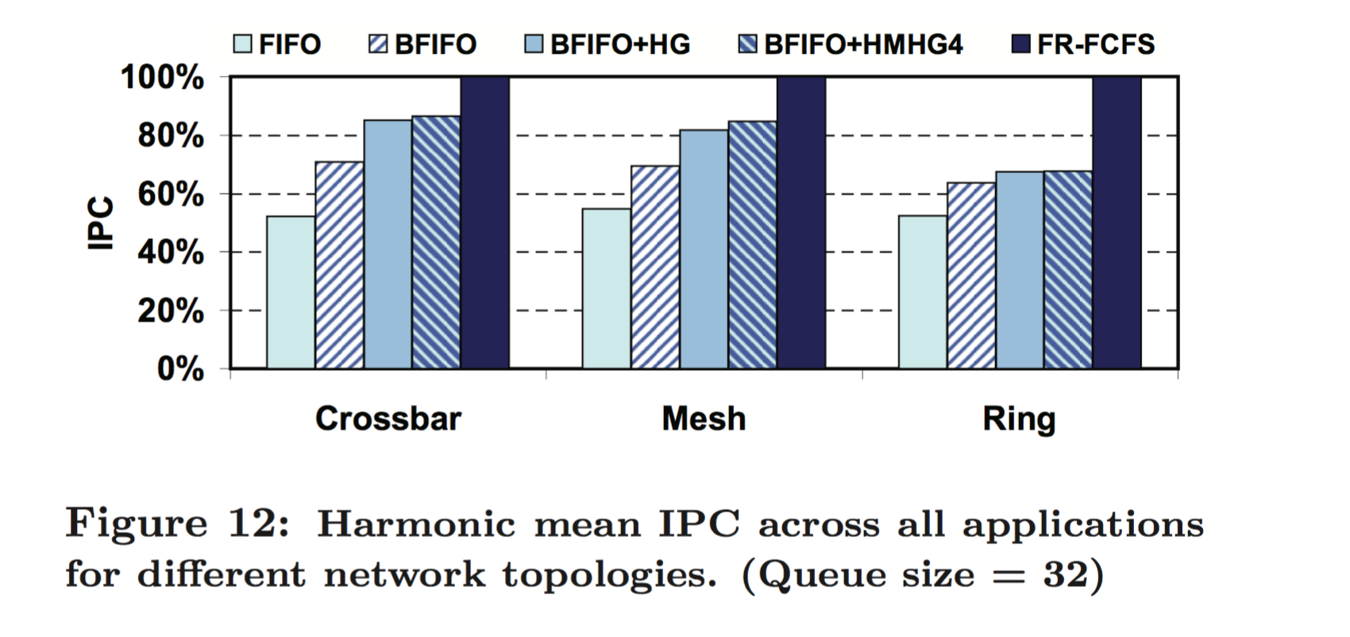
sensitivity analysis
Ring has poor performance
HG and HMHG has relative good performance with simple DRAM scheduling

Slide 25
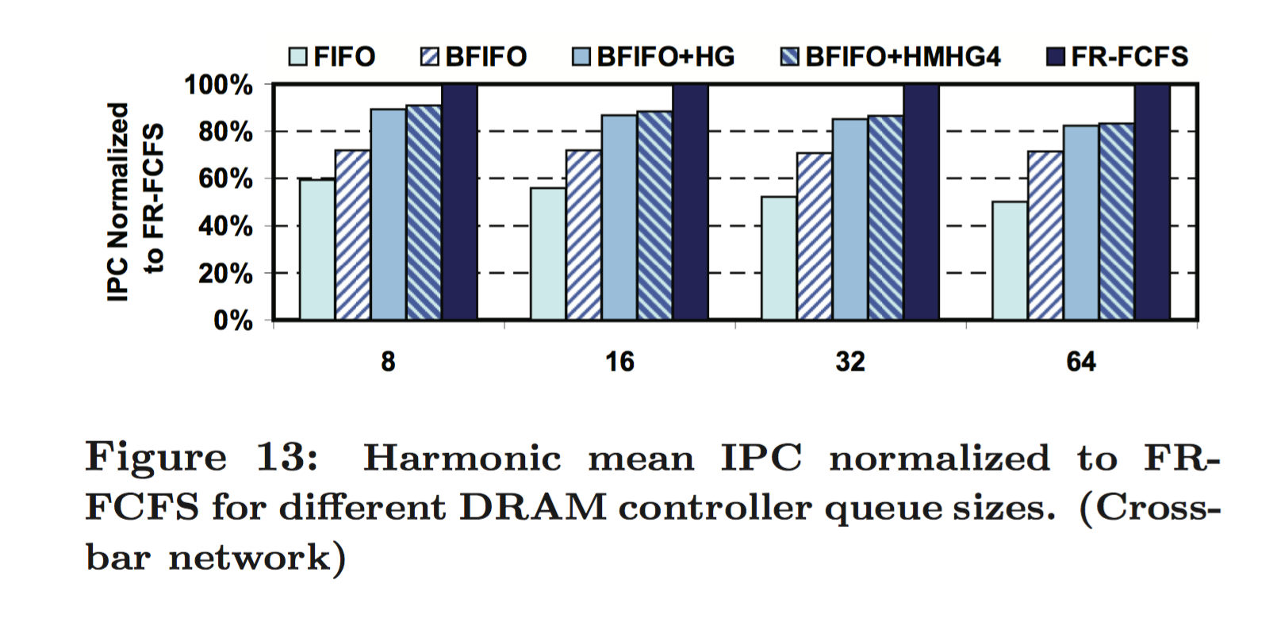
sensitive analysis
increase number of DRAM controller, the HG/HMHG performance is steadily compared to FR-FCFS, but complexity is not change

Slide 26
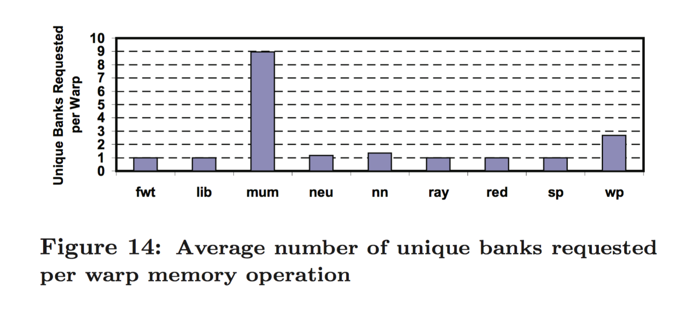
related work
PAR-BS: highly complex and area intensive for tens of thousands of threads
Most of the application always send requests to only a single bank per warp — our design can also do this
Only one application always to at least 3 different DRAM controller, the PAR-BS expected to have poor performance

Slide 27
Conclusion
Achieve 90% of performance compared to aggressive out-of-order scheduling
Three modification on NoC : HG, RMHG, HMHG
allow simple DRAM controller to achieve high performance

Slide 28
Thank You!

